Slide 1


Television Violence: How it Affects Children
Television Violence: How it Affects Children
© 2015 albert-learning.com

Slide 2
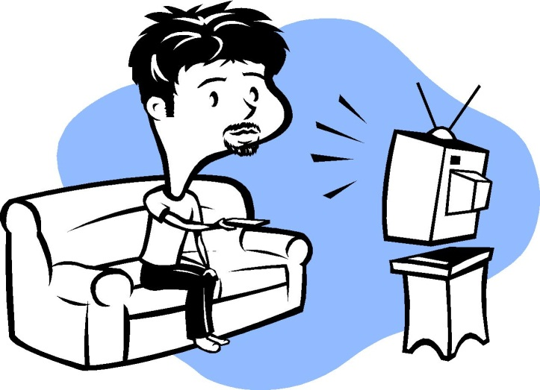
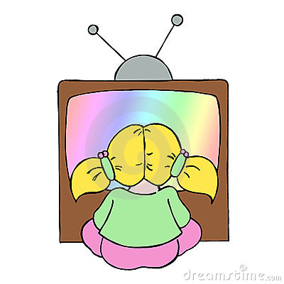
Some Facts:
Television Violence: How it Affects Children
TV Viewing by Adults per Week:
United kingdom |  | 28hrs
United States |  | 28hrs
France |  | 23hrs
Germany |  | 23hrs
Australia |  | 22hrs
TV Viewing by Adults per Week:
TV Viewing by Children per Week:
Children aged 2 to 5 watch TV for more than 32 hours per week
Children aged 6 to 8 watch TV for 28 hours per week
© 2015 albert-learning.com

Slide 3


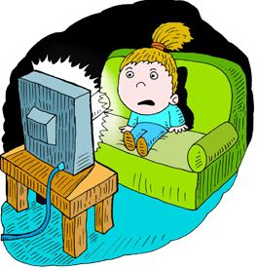
Is TV really so bad for children?
Television Violence: How it Affects Children
A Surgeon General's report last year concluded that 61% of all TV programming contains violence.
While experts agree that TV can entertain and inform, many programs may have a definite negative influence on childhood behavior and values.
A worldwide survey conducted found that more than four out of five parents are concerned that their children are exposed to too much violence.
© 2015 albert-learning.com

Slide 4
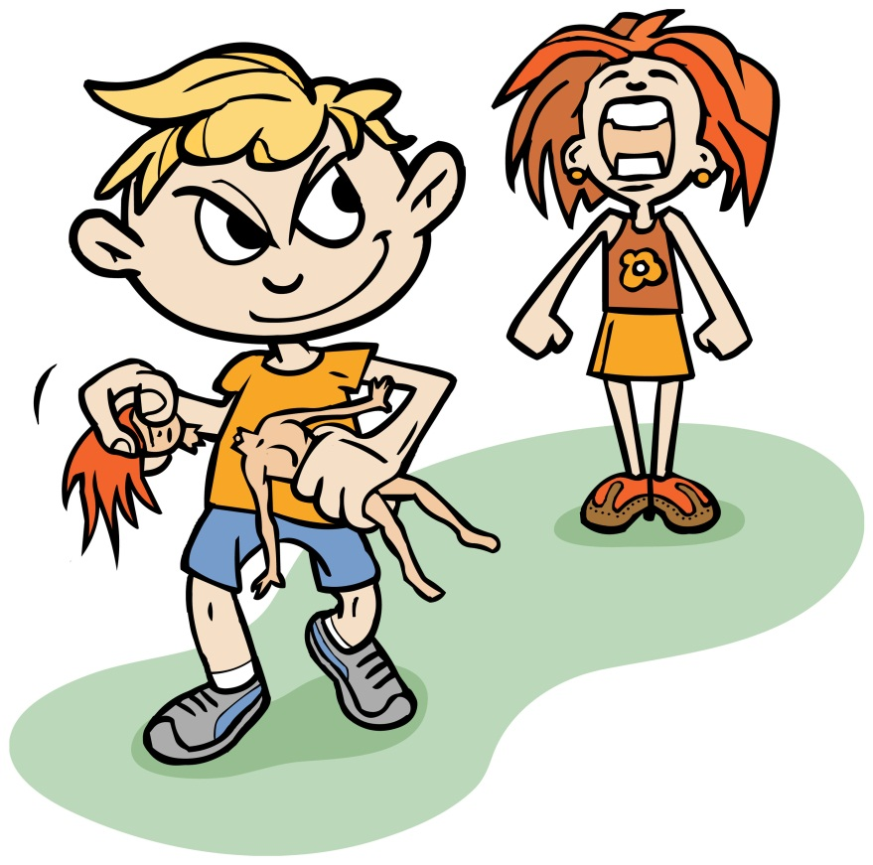
How does TV violence affect children?
Television Violence: How it Affects Children
Children who view violent acts on TV are more likely to show aggressive behavior.
Children may become less sensitive to the pain and suffering of others.
TV Violence can make a child fear that the world is dangerous and that something bad will happen to them.
TV characters often show risky behaviors, such as smoking and drinking and taking drugs.
Children have a difficult time understanding the difference between what is real or what is fiction, and tend to copy what they see.
© 2015 albert-learning.com

Slide 5

A Continuing Debate
Television Violence: How it Affects Children
Though there is evidence that TV violence affects children, TV Broadcasters and Scientists continue to debate the link between watching TV violence and aggressive behavior.
Some TV Broadcasters believe that there is not enough evidence to prove that TV violence is harmful.
However, Scientists who have studied
the issue say that there is a link between
the two.
Debate
© 2015 albert-learning.com

Slide 6
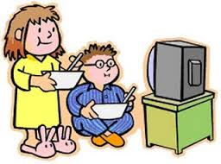
How can we handle it?
Television Violence: How it Affects Children
Parents can protect children from excessive TV violence in the following ways:
Pay attention to the programs their children are watching and watch with them.
Set limits on the amount of time they spend with the television; consider removing the TV set from the child's bedroom.
Point out that although the actor has
not actually been hurt or killed, such
violence in real life results in pain or
death.
Refuse to let the children see shows that are violent, and change the channel or turn off the TV when violent material comes on.
© 2015 albert-learning.com

Slide 7

Television Violence: How it Affects Children
Questions
© 2015 albert-learning.com
Notes:
HOME – ASSIGNMENT
1)Give synonym : Debate
2) Give antonym : Violence
3) Give meaning :
a) Expert b) Influence c) Values d) Exposed
4) Make a sentence using below word :
a) Refuse b) Handle c) Evidence

Slide 8
Reviewed By | Reviewed On | Comments / Changes Made
Mayuri | 05.09.2015 | No changes made

