Slide 1
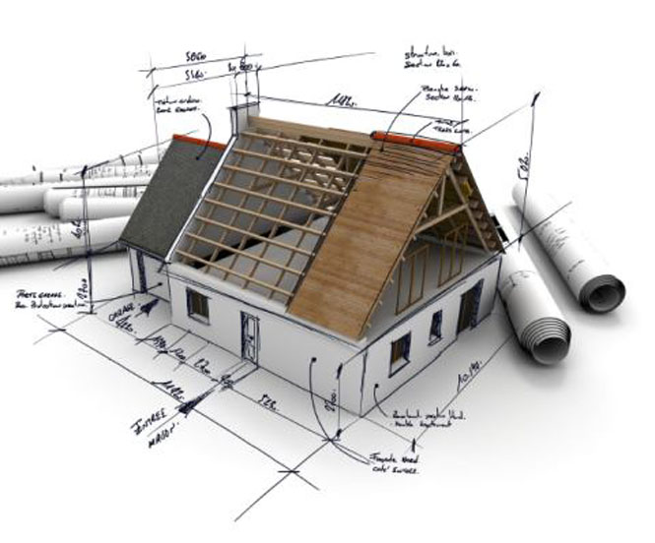
Renovating a House

Slide 2
Vocabulary
.
Have an extension: Build on to the existing house to provide more rooms
Convert the loft: Convert the attic into a livable room
Knock down a wall: Demolish a Wall
Build a patio: Build a paved area around part or the whole of the house
Re-plaster the ceiling: Take off the old plaster (covering the bricks) and replace it with new
Re-tile the bathroom: Put new tiles on the floor and walls
Re-wire the house: Put in a new electrical wiring
Install central-heating: Put in a new heating system

Slide 3
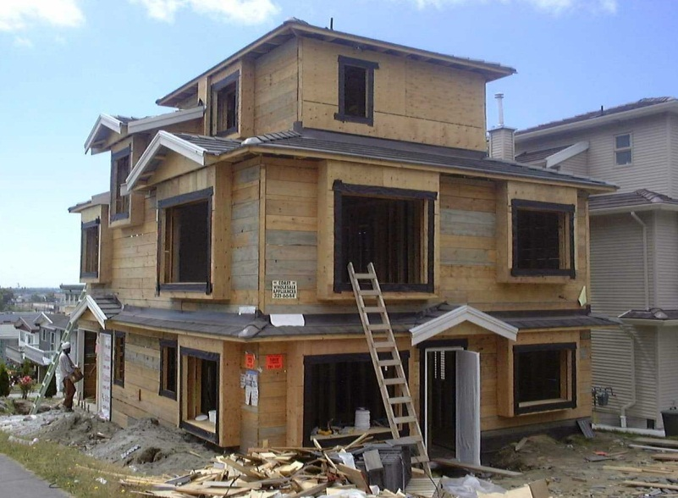

Extending a House
Converting
a Loft

Slide 4

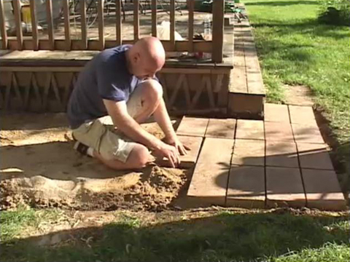
Knock down
a wall
Build a
Patio

Slide 5

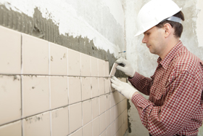
Re-plaster a
Ceiling
Re-tile a
Bathroom

Slide 6

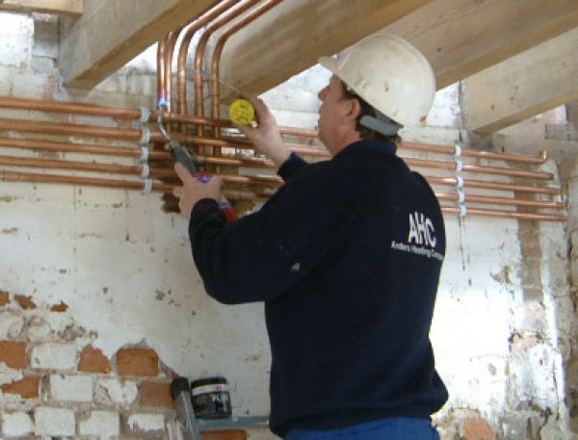
Re-wire
Your House
Install
Central-Heating

Slide 7
Vocabulary Follow-up
Re-tile a bathroom Build a Patio Convert our loft Install Central Heating
Extend our house Re-plaster our ceiling Knock down a wall Re-Wire the house
1. We feel there is shortage of space in our house we now need to ____________.
2. Our bathroom has become very old and dirty therefore we need to __________.
3. We need an extra bedroom, why don’t we ______________.
4. Our ceiling is leaking, we need to _______________.
5. There is some major fault in the electrical systems so we need to ___________.
6. We need to __________________ in our garden.
7. Since the winters are approaching we need to __________________ in our house..
8. We need extra space in our living room, we need to ____________.
Notes:
1.Extend our house
2. Re-tile our bathroom
3.Convert our loft
4.Re-plaster our Ceiling
5.Re-wire the house
6. Build a patio
7.Install central-heating
8.Knock down a wall
ASSIGNMENT
1)Give synonym :need
2) Give antonym :old
3) Give meaning :
a)Have an extension b)convert the loft c) replaster the ceiling d)rewire the house
4) Make a sentence using below word :
a)Demolish b)convert c)build

