Slide 1
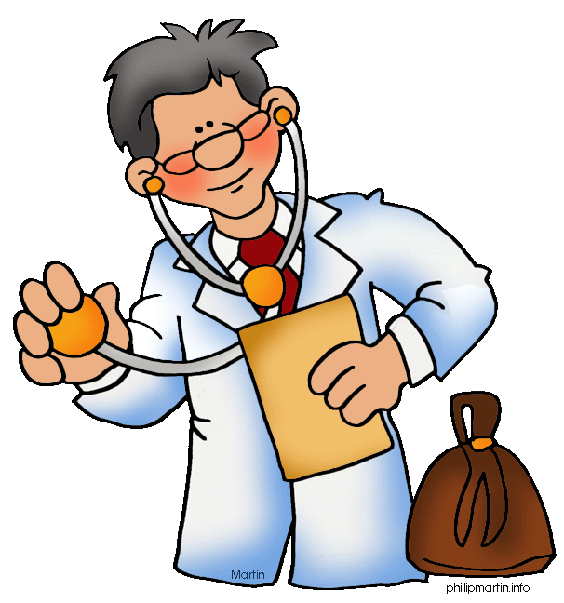
Doctor
Doctor

Slide 2
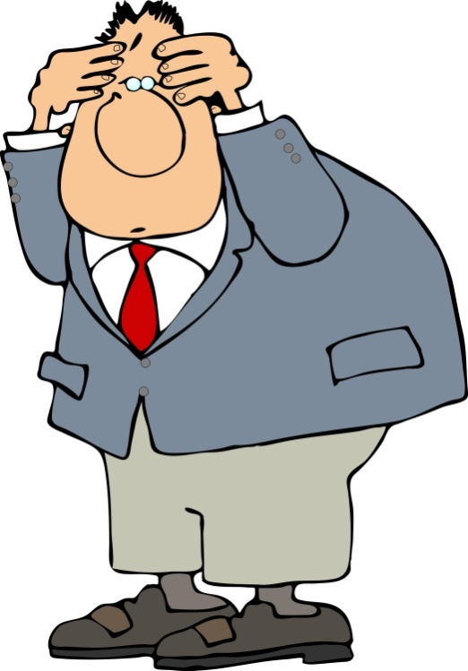
What do you call a pain in the head or neck?
a) Headache.
b) Bad head.
c) Hitch.

Slide 3
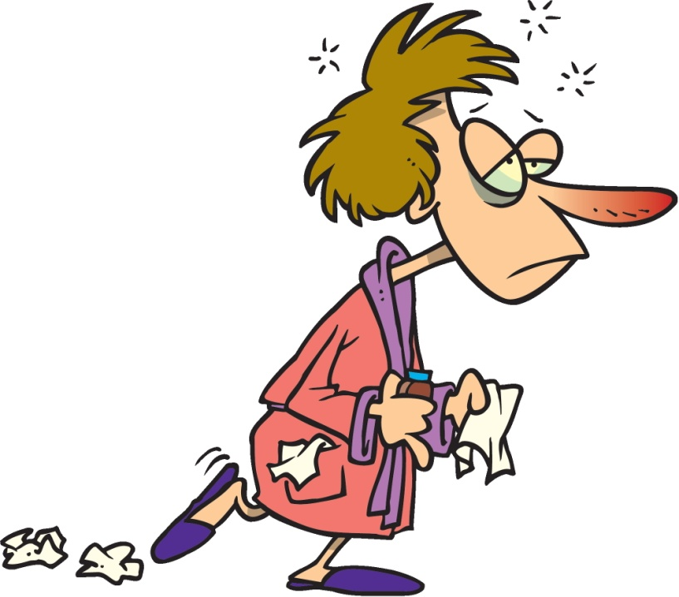
If you have chills, fever, muscle pains, you probably have …
a) a cold.
b) a flu.
c) constipation.

Slide 4
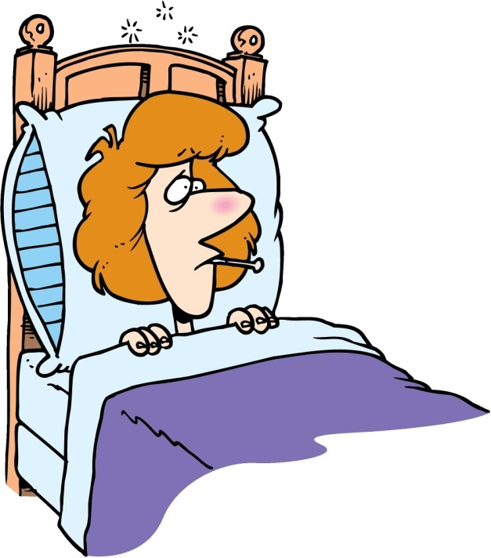
When your body temperature is above the normal range, you have …
a) a fever.
b) a cough.
c) a sore throat.

Slide 5
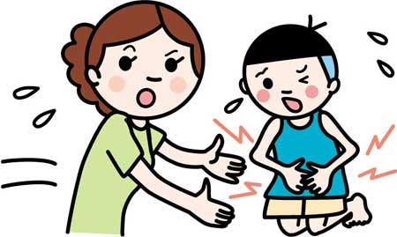
If you eat contaminated food, you’re suffering from…
a) fatigue.
b) diarrhea.
c) food poisoning.

Slide 6
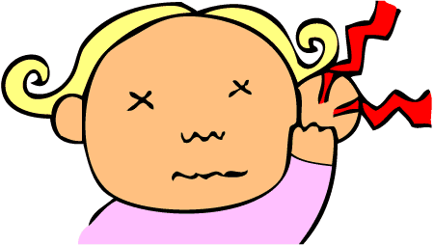
What do you call a pain in the ear?
a) Deafness.
b) Earache.
c) Bad hearing.
Notes:
Ear ache

Slide 7
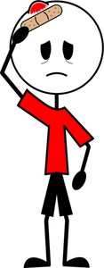
What do you call a head injury with temporary loss of brain function?
a) Amnesia.
b) Concussion.
c) Fracture.
Notes:
Concussion

Slide 8
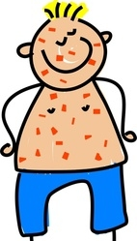
If you have red spots, conjunctivitis and four-day fever, you probably have …
a) measles.
b) mumps.
c) chicken-pox.
Notes:
Measles

Slide 9
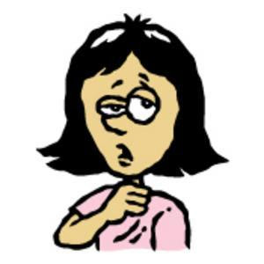
If you have a throat inflammation, you have a…
a) throat ache.
b) sore throat.
c) rash.
Notes:
sore throat.

Slide 10

If you need to wear a cast on your arm, you probably have a …
a) rash.
b) burn.
c) fracture.
Notes:
Fracture

Slide 11
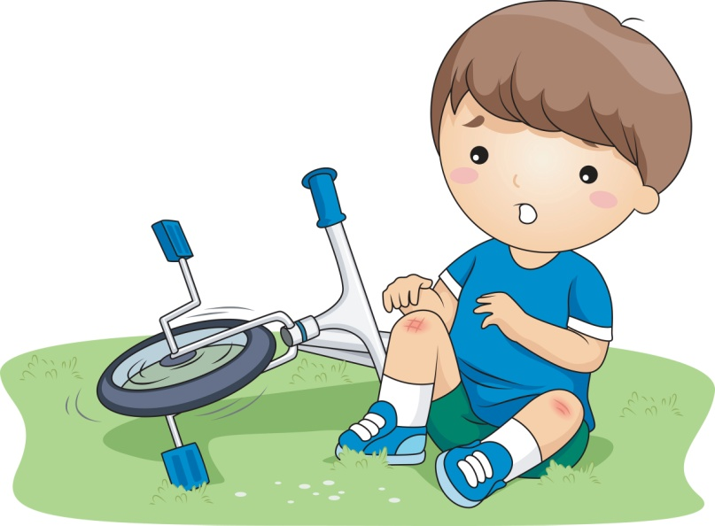
What do you call it when you fall down and a part of your skin starts to darken?
a) Sneeze.
b) Bruise.
c) Cut.
Notes:
Bruise

Slide 12
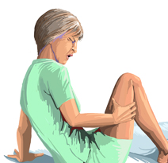
What do you call painful sensations caused by muscle contraction?
a) Insect bite.
b) Blister.
c) Cramps.
Notes:
Cramps

Slide 13
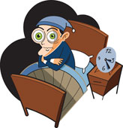
What do you call it when a person has difficulty falling asleep?
a) Insomnia.
b) Hiccups.
c) Hysteria.
Notes:
Insomnia

Slide 14
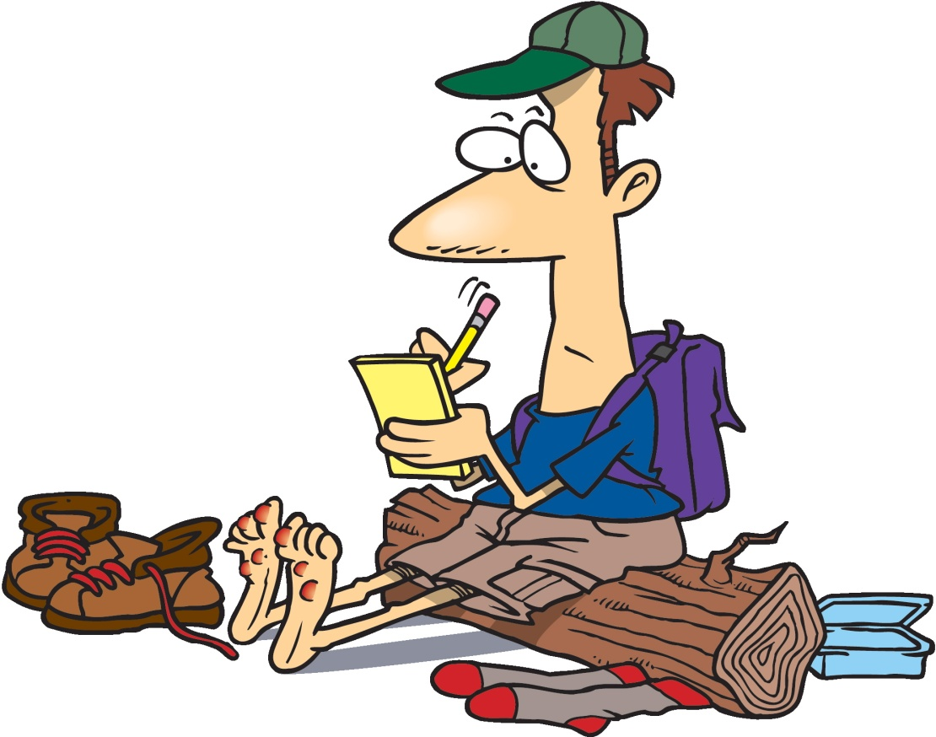
What do you call a small pocket of fluid under the skin?
a) Cut.
b) Burn.
c) Blister.
Notes:
Blister

Slide 15
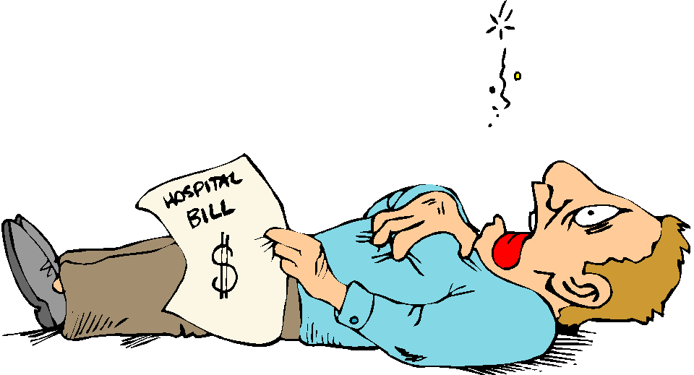
If you’re feeling a strong pain in your chest, you’re probably having a …
a) heart attack.
b) heartburn.
c) asthma attack.
Notes:
heart attack

Slide 16
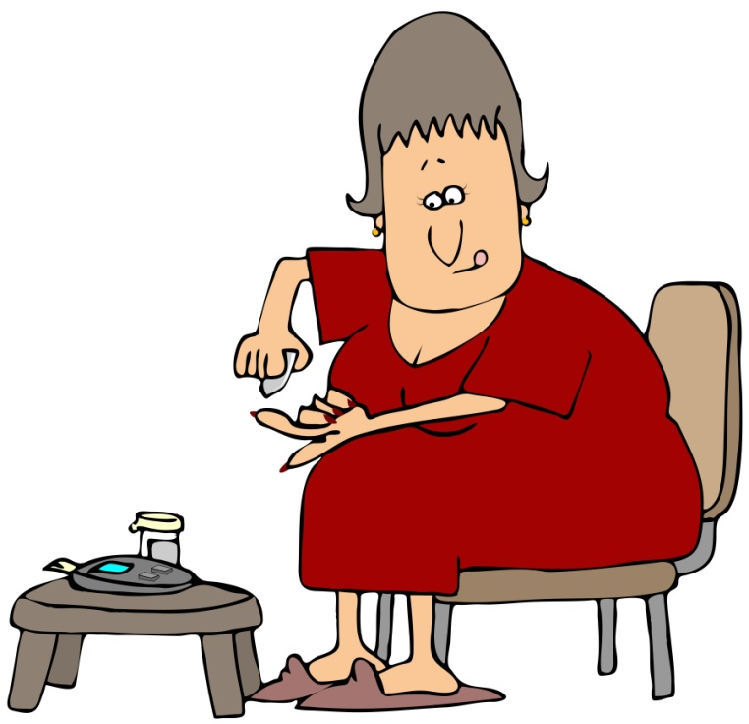
What do you call it when a person has high blood sugar?
a) Diabetes.
b) Insulin.
c) High blood pressure.
Notes:
Diabetes

Slide 17
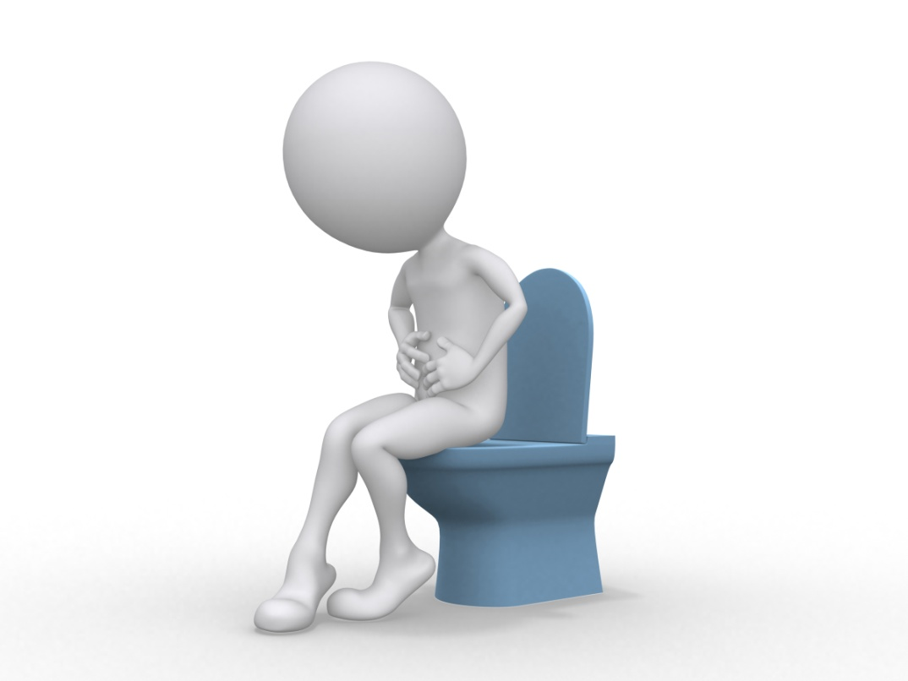
A person that has difficulty in defecating suffers from …
a) Constipation.
b) Diarrhea.
c) Appendicitis.
Notes:
Constipation

Slide 18
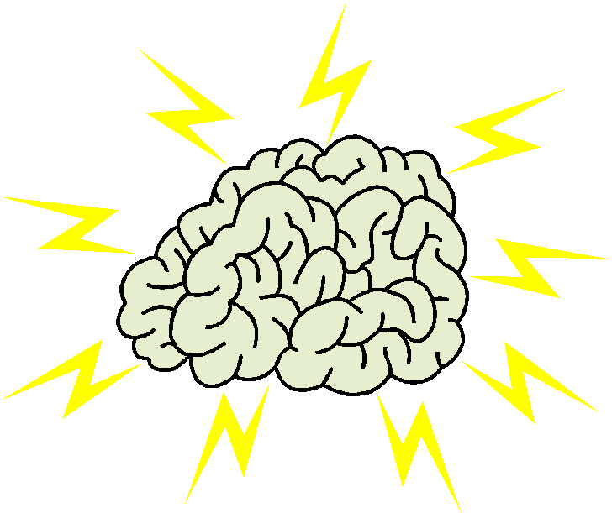
People who have repeated unprovoked seizures, suffer from…
a) epilepsy.
b) strokes.
c) acne.
Notes:
epilepsy

Slide 19
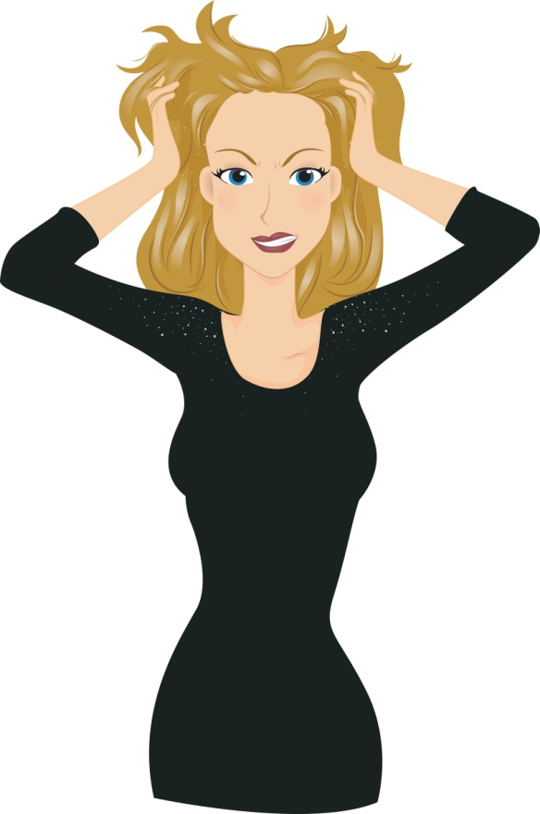
What do you call the shedding of dead skin from the scalp?
a) Sunburn.
b) Bleed.
c) Dandruff.
Notes:
Dandruff

Slide 20
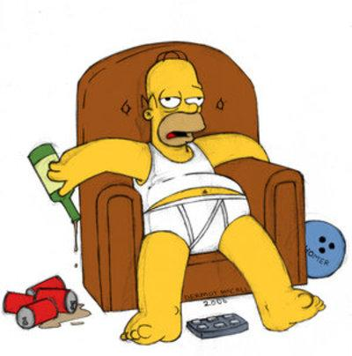
What do you call the symptoms that follow heavy alcohol consumption?
a) Nose bleed.
b) Hangover.
c) Runny nose.
Notes:
Hangover

Slide 21
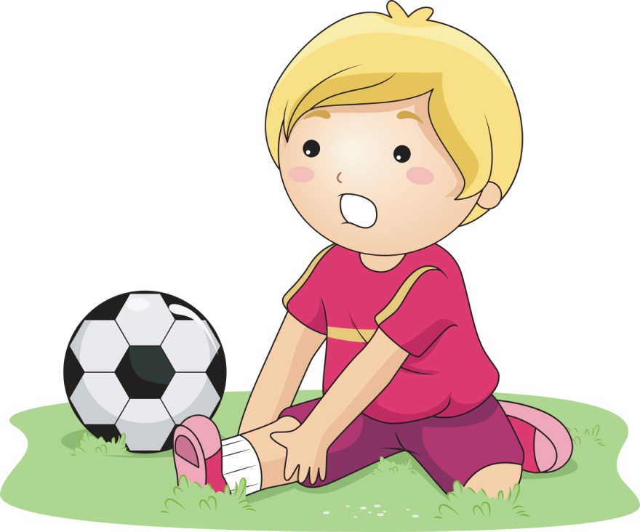
What do you call an injury to ligaments caused by overstretching them?
a) Sprain.
b) Contusion.
c) Bump.
Notes:
Sprain

Slide 22
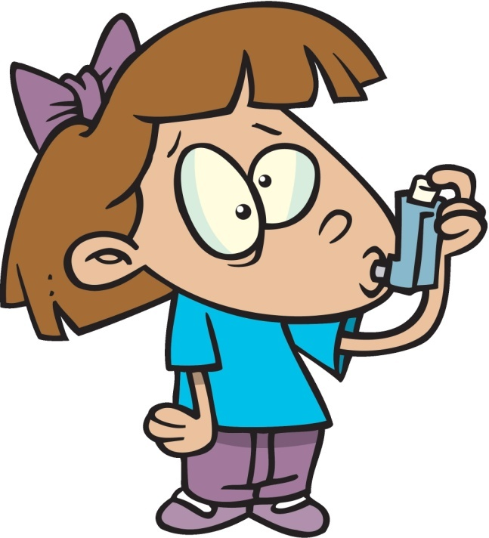
What do you call a chronic inflammatory disease of the airways?
a) Sneezing.
b) Bronchitis.
c) Asthma.
Notes:
Asthma

Slide 23
Answers
Headache.
A flu.
A fever.
Food poisoning.
Earache.
Concussion.
Measles.
Sore throat.
Fracture.
Bruise.
Cramps.
Insomnia.
Blister.
Heart attack.
Diabetes.
Constipation.
Epilepsy.
Dandruff.
Hangover.
Sprain.
Asthma.
Notes:
EXERCISE-
1)Give synonym: vomit- puke
2)Give antonym: Head- toe
3)Give meanings of the following- Headache, Fever, Fracture, Dandruff
4)Make a sentence with the words given below-
Bruise, hangover, flu

Slide 24
Reviewed By | Reviewed On | Comments / Changes Made
Honey | 21.09.2015 | No changes
Anisha | 10.03.2016 | N.A.

