Slide 1
PRONUNCIATION 8
HOW TO ENUNCIATE

Slide 2
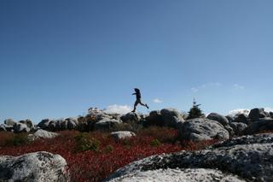
A ----- Around the rugged rocks the ragged rascal ran.

Slide 3
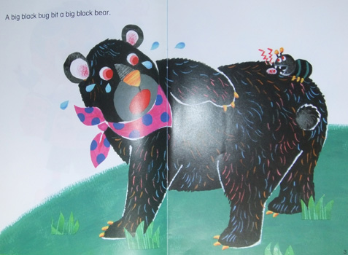
B ----- Big black bug bit a big black bear and the big black bear bled black blood.

Slide 4
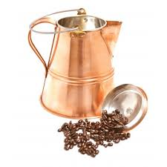
C ----- Can I cook a proper cup of coffee in a copper coffee pot?

Slide 5
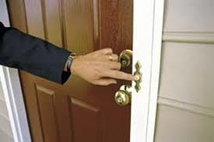
D ----- Don’t doubt the doorbell, but differ with the doorknob.

Slide 6
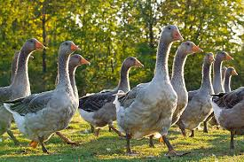
E ----- Eight gray geese grazing in a green field.

Slide 7
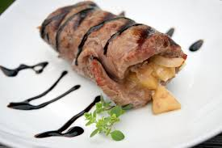
F ----- Fine white vinegar with veal.

Slide 8
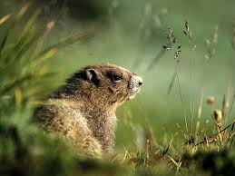
G ----- Grab the groundhog from the glazed grass.

Slide 9
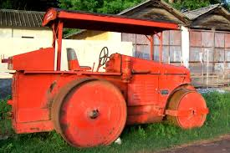
H ----- High roller, low roller, lower roller.

Slide 10
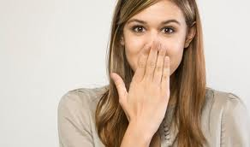
I ----- Inexplicably mimicking him hiccupping.

Slide 11
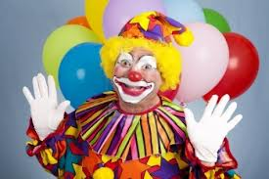
J ----- Jingle jungle jangle joker.

Slide 12
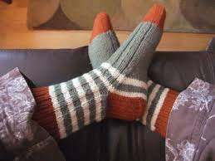
K ----- Knit kilts for nasty cold nights.

Slide 13
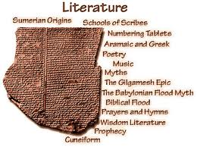
L ----- Lucy likes light literature.

Slide 14
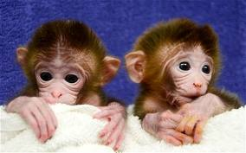
M ----- Monkeys make monopoly monotonous.

Slide 15
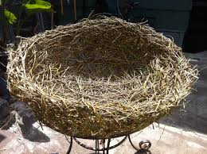
N ----- The Next nest will not necessarily be next to nothing.

Slide 16

O ----- Octopi occupy a porcupine’s mind.

Slide 17
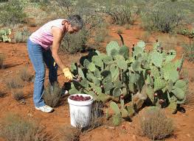
P ----- Peter Prangle, the prickly pear picker, picked three perfectly prickly pears.

Slide 18
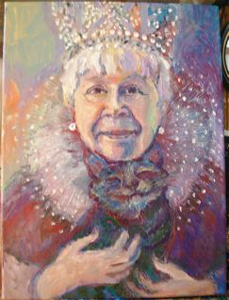
Q ----- Queen Catherine wakes the cat, and the cat quietly cries.

Slide 19
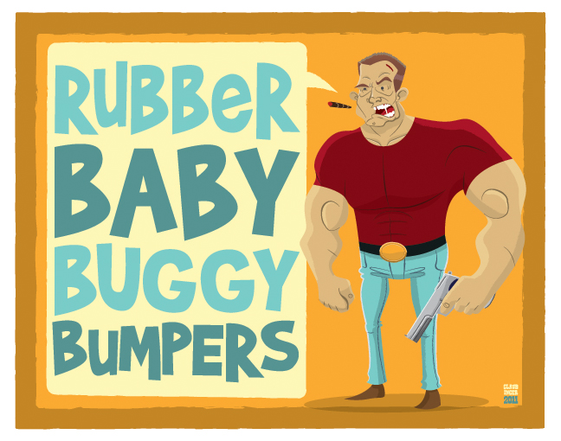
R ----- Rubber Baby Buggy Bumpers!

Slide 20
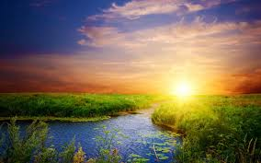
S ----- Some shun sunshine. Do you shun sunshine?

Slide 21
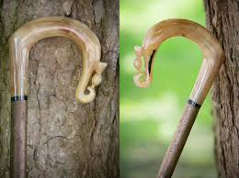
T ----- Three thick thistle sticks.

Slide 22
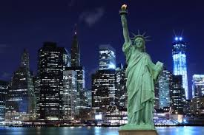
U ----- Unique New York, Unique New York, Unique New York.

Slide 23
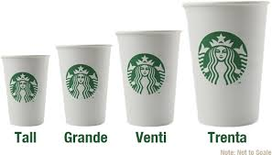
V ----- Venti, Grande, Tall - Very Grand Words for Large, Medium, Small

Slide 24
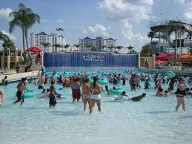
W ----- Will’s wetsuit is round and wet and rough and wide and ready to go on a
watery ride.

Slide 25
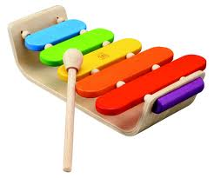
X ----- Xylophones exist or so existentialists insist.

Slide 26
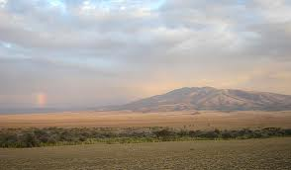
Y ----- Yoda met a Yeti on the Plains of Serengeti.

Slide 27
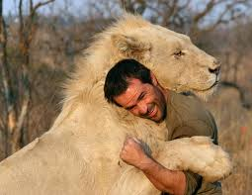
Z ----- Zoologists illogically love to read astrology

