Slide 1

PHOTO QUESTIONS
LISTENING COMPREHENSION
Photo Questions Exercise No.3 of 1 to 10

Slide 2

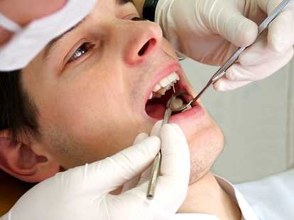
Notes:
A) The patient's eyes are closed.
(B) The dentist is wearing yellow gloves.
(C) The dentist is working on the patient's lower teeth.
(D) The dentist is working on the patient's upper teeth.

Slide 3
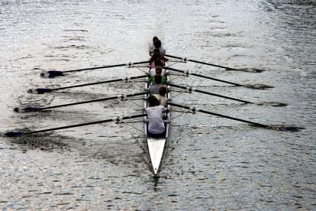
Notes:
(A) All the oars are out of the water.
(B) There are eight people rowing in the picture.
(C) The water looks very rough.
(D) The boat is turning a corner.

Slide 4
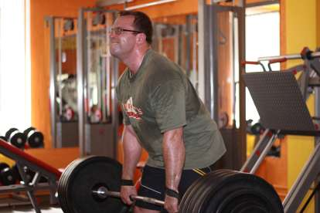
Notes:
(A) The man is leaning forward.
(B) He is lifting some wheels.
(C) The man is opening his mouth.
(D) He has taken his glasses off.

Slide 5
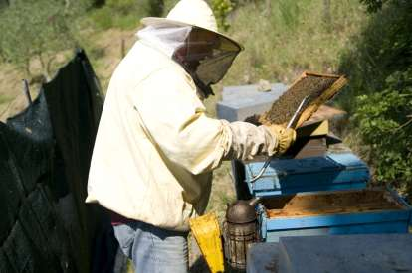
Notes:
(A) The man is wearing a hard hat.
(B) There are five blue boxes in the photo.
(C) The man is wearing gloves.
(D) The man is holding a brown rectangular item.

Slide 6
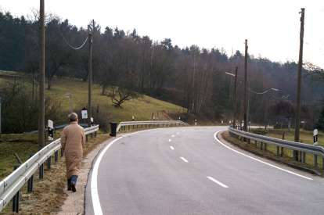
Notes:
(A) The walker is wearing a coat.
(B) The walker is walking on the road.
(C) There are no crash barriers on the road.
(D) A car is coming round the corner.

Slide 7
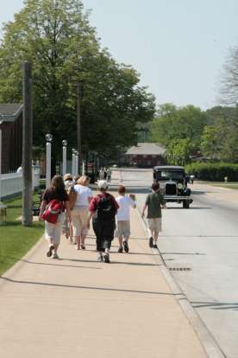
Notes:
(A) The pedestrians are walking in the road.
(B) The pedestrians are walking on the pavement.
(C) There are two cars in the picture.
(D) All the walkers are carrying bags.

Slide 8
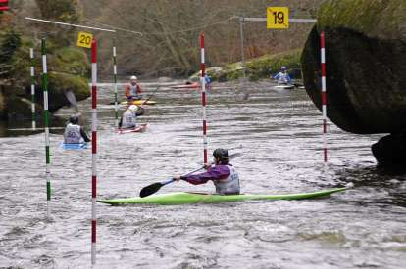
Notes:
(A) The poles in the picture are all white.
(B) The water is very rough.
(C) The boat in the front of the picture is plain green.
(D) You can see numbers on all the poles.

Slide 9
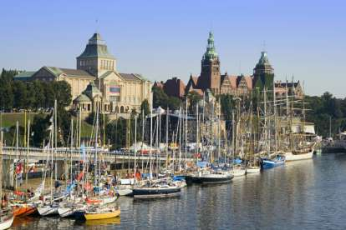
Notes:
(A) Most of the sails are not set.
(B) The photo shows an empty swimming pool.
(C) There are no historical buildings in the background.
(D) The lake is covered with ice.

Slide 10
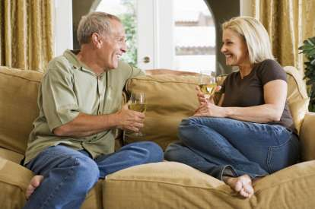
Notes:
(A) The couple look as if they are enjoying each other's company.
(B) Both of them are wearing shorts.
(C) The woman is wearing a green top.
(D) The man is wearing a white shirt.

Slide 11
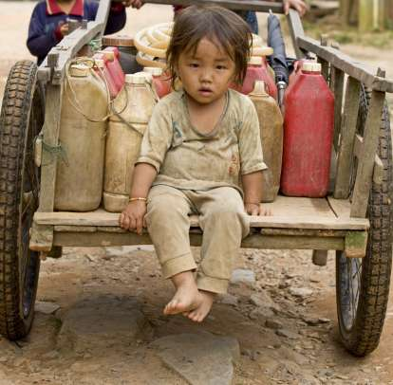
Notes:
(A) The child is dressed in nice clothes.
(B) The cart is being pulled by a donkey.
(C) The child has both hands on the wooden deck.
(D) The road is smooth concrete.

Slide 12
End of Photo Question Exercise No .3
Of
1- 10
Thank you !

