Slide 1
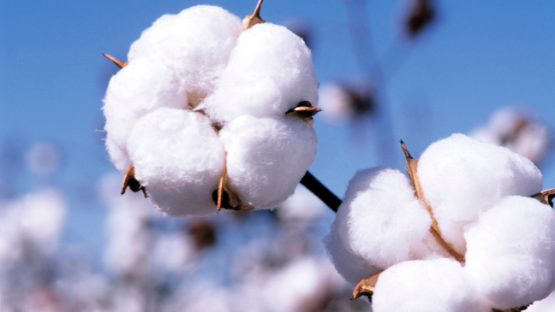
India’s transgenic cotton tragedy

Slide 2
Hopes of a genetically modified crop bonanza in India are fading fast. Maharastra state has banned the use of a particular type of transgenic cotton made by industrial giant Monsanto, saying it’s a threat to people’s lives and to other crops.
Cotton is still the only GM crop in the country, and it’s so pervasive that nearly 90% of all cotton produced in India is genetically modified.
For Monsanto though, the troubles are far from over. The company’s seeds have been banned in one Indian state, with anti-GM activists demanding a larger ban. Reports have linked BT cotton to the suicide of over 10,000 farmers in India’s cotton belt.

Slide 3
Farmers committed suicide because they borrowed loans to buy the new promising crops from Monsanto which turned them down. Unable to make the money back, the farmers ended their lives leaving their old parents, wives and children behind.

Slide 4
Comprehension
1) Why did Maharastra state has banned the use of a particular type of transgenic cotton made by industrial giant Monsanto?
2) Which is the only genetically modified crop in the country?
3) What is happening to the farmers because of these crops?
4) What is the reason behind question 3?

Slide 5
Vocabulary:
Genetically
Modified
Ban
Anti
Activists
Commit suicide
Loan
Notes:
Genetically- Of or relating to genes or heredity
Modified- changed to make better
Ban – to discontinue the use of something legally e.g. smoking is banned in indoor places in India
Anti – against something
Activists - a policy of taking direct and militant action to achieve a political or social goal. Fighting for a cause
Commit suicide - to take your life by your own will
Loan – borrowing a large amount of money from e.g. a bank, a friend. You may have to return the money with interest.

Slide 6
Writing:
How do you think the farmers’ families should be compensated for their loss?
What should happen to the company who supplied these crops to these poor people?
Do you think genetically modified crops is the answer to a better life?

Slide 7
Conversation
Have you ever taken a loan for anything? E.g. house, car, studies?
Has it been easy to pay back?
Would you ever like to live like a farmer for a day?
Do you think farmers are happy with their lives?
What do you think our lives would be without them?
What should we do to improve their livelihood?

