Slide 1

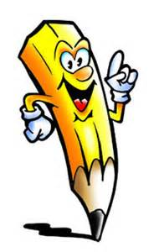

Fun Writing Exercises

Slide 2
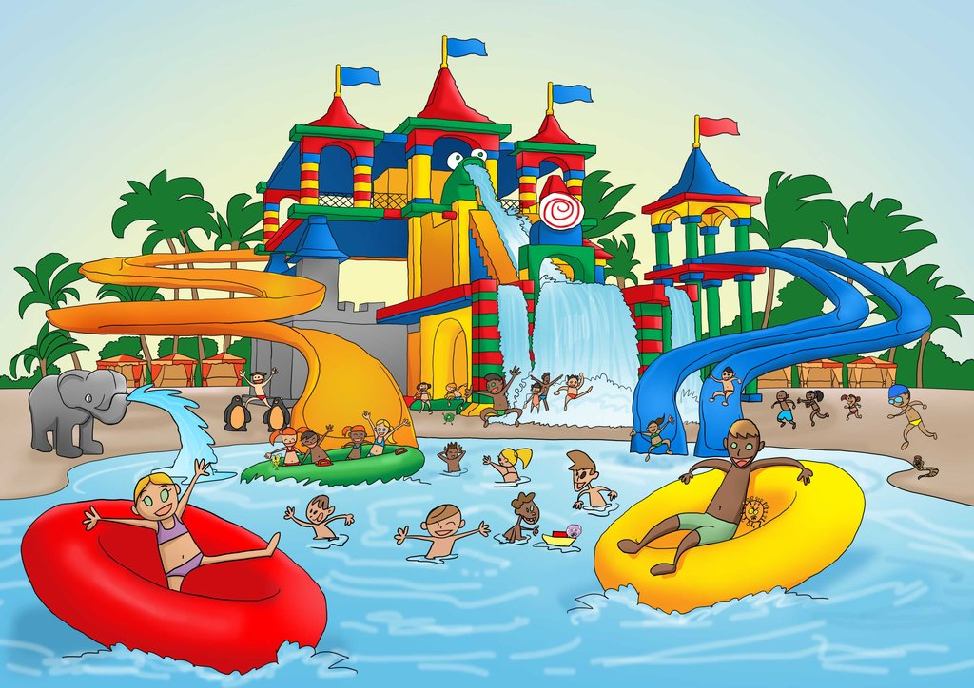
Setting the scene:
Describe your favorite place in detail, including how you feel when you are there, what it looks like, what it smells like, etc. This is a great way to imagine scenes and learn how to use words to tell others about them.

Slide 3

Brainstorming:
As a way of generating topics for writing, write down events of the day. Jot down everything that happened to you in a day. This is a great way to increase creativity. Write down everything-what you had for meals, a fight you had with your sibling, an unexpected grade you got on a test.

Slide 4
Good and Bad:
Write two good and two bad points on the following :
Television | Computer
Indoor games | Outdoor games
Mom | Dad
Siblings | Friends
Study | Play

Slide 5
Write few lines beginning with the following prompts:
Once upon a time………………………………..
I remember ……………………………………..
If I was a ………………………………………..
If I had a ……………………………………….
Can you ………………………………………
I have a ………………………………………
I never thought ………………………………..
I will ……………………………………………….

Slide 6
Color your world:
Choosing a color, going for a walk and then writing about everything you see on the walk that is that color, or everything that reminds you of that color. This is a great exercise for you because it not only exercises your writing skills, but also your bodies as well.
In the garden
On the street
At home
Notes:
Home exercise
1)Give synonym: Favorite
2) Give antonym: Indoor
3) Give meaning :
a) Choosing b ) Outdoor c) Street d) Garden
4) Make a sentence using below word:
a) Home b) Study c) Play

Slide 7
Reviewed By | Reviewed On | Comments / Changes Made
Ankita | 09.09.2015 | No changes made

