Slide 1

PHOTO QUESTIONS
LISTENING COMPREHENSION
Photo Questions Exercise No.8 of ‘1 to 10’

Slide 2
Description :
In this Listening test, you will be asked to demonstrate how well you understand spoken English.
The entire Listening test will last approximately 45 minutes. There are four parts, and directions are given for each part. You must mark your answers on the separate answer sheet. Do not write your answers in your test book.

Slide 3
Directions:
In the ‘ Toeic Photo Questions Listening Test ’ will hear four Statements or Questions about the Photograph.
These Statements / Questions will not be printed in your test book and will be spoken only once / one time only .
You will be required to ‘Select the Best Response to the Question or Statement and “tick mark” the letter (A), (B), (C) or (D) on your answer sheet.
Mark your answer on your answer sheet.

Slide 4

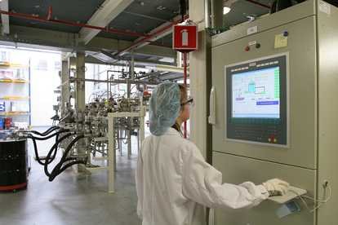
Notes:
The operator is watching television.
The operator is bareheaded.
The operator is not wearing gloves.
The operator is checking something on the screen. -- CORRECT

Slide 5
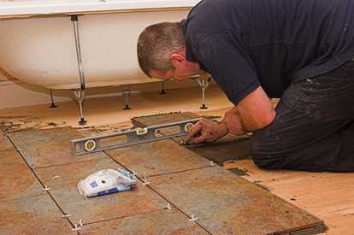
Notes:
The tiler is kneeling on the floor. -- CORRECT
The tiler is working with both hands.
There is a hammer lying on the tiles.
The bath in the picture is not supported.

Slide 6
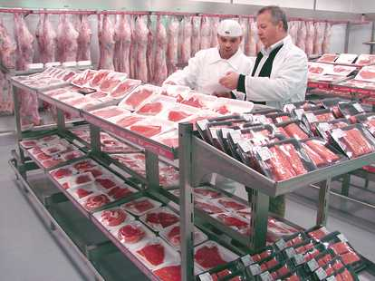
Notes:
Meat packing
Both men are wearing white caps.
You can see many carcasses hanging on a rail. -- CORRECT
Both men are dressed in blue overalls.
One man is reading a book to the other man.

Slide 7
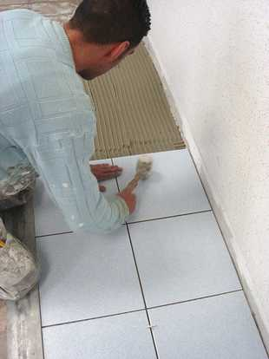
Notes:
You can see grooves in the tile adhesive. -- CORRECT
The tiler is scraping one of the tiles.
The tiler is cutting one of the tiles.
The tiles do not lie in a straight line.

Slide 8
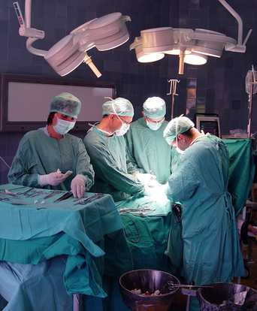
Notes:
There are only three people wearing masks.
Everyone in the theatre is wearing a mask. -- CORRECT
The person on the left is using a computer.
Everyone is wearing white uniforms.

Slide 9
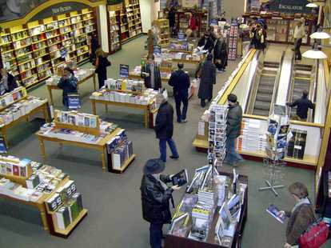
Notes:
A shopper can be seen going down the escalator.
One shopper is seen going up the escalator. -- CORRECT
There are no new books for sale on the shelves.
Everyone is seen holding a book.

Slide 10
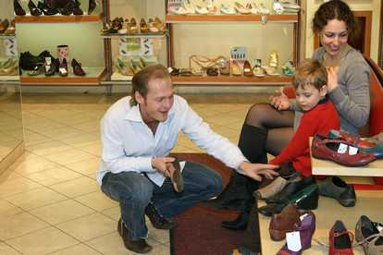
Notes:
The woman is crying.
The man is throwing a shoe on the floor.
The child is looking at the ceiling.
The man is holding a shoe in his right hand. -- CORRECT

Slide 11
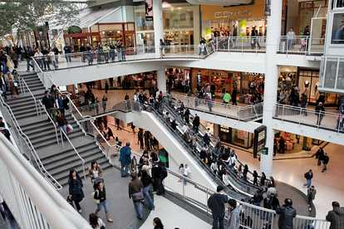
Notes:
Nobody is using the stairs.
You can go up and down to the floors by escalator. -- CORRECT
The stairway is painted white.
The floors are all coloured green

Slide 12
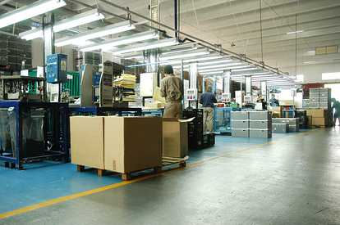
Notes:
The warehouse.:-
There are only two people in the picture.
The overhead lighting isn't working.
All the boxes are rectangular in shape. -- CORRECT
The man nearest the camera is wearing shorts.

Slide 13
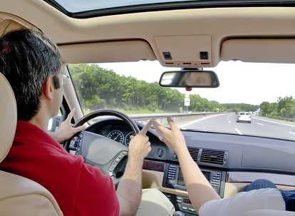
Notes:
Inside the car:-
The driver has both hands on the steering wheel. -- CORRECT
The car is a righthand drive model.
The passenger is pointing a hand towards the right.
The driver is wearing an orange top.

Slide 14
End of Photo Questions Exercise No.8
of
1 to 10
Thank you !

