Slide 1
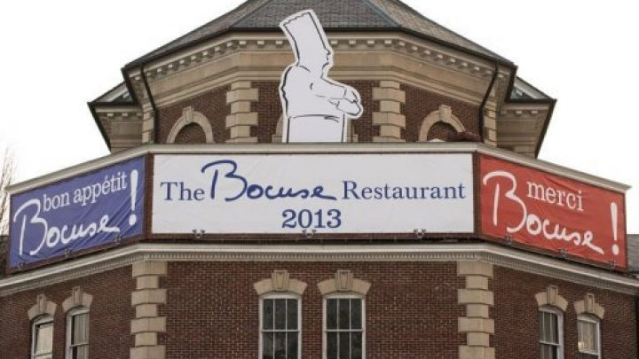
French chef Paul Bocuse opens NY restaurant
http://www.france24.com/en/20130217-french-chef-paul-bocuse-opens-ny-restaurant-cia

Slide 2
News : Reading
Three-star Michelin chef Paul Bocuse who named the Culinary Institute of America's 2011 "Chef of the Century", inaugurated the new Bocuse Restaurant .
The Culinary Institute of America last year closed its Escoffier Restaurant. After renovations, the menu was revamped to feature contemporary French.
At the CIA's campus on the banks of the frozen Hudson River, hundreds of students attended Bocuse's lecture on Friday to hear him speak about his life and dole out both advice and encouragement.
"Cook the way you like, with local, quality products," Bocuse told the students. "This is very important.“
In honor of his birthday on Monday, the students had prepared a gigantic cake of five layers with a big "B" on top as a surprise.

Slide 3
News : Reading
"Paul Bocuse is simply stated, the most important chef in history," said CIA president Tim Ryan.
Mr Paul, who arrived on Thursday from Europe, could not stay until servers cracked open the 1926 Armagnac wine.
He had to travel to Florida with his son, who now heads up the Chefs de France restaurant at Walt Disney World's Epcot theme park.
The aging chef now walks with difficulty, and revealed that he can't hear very well, but those are small matters to him. Asked about his legacy, he preferred to speak about the future.
"For me, it's not a problem," Bocuse said. "Because after me, there are still many very good chefs, so we still have some great moments ahead. Yesterday, we were with a group of friends in France and today, we're with a group of friends around the world."

Slide 4
Comprehension
Who was named Culinary Institute of America's 2011 "Chef of the Century"?
What word of advice and encouragement did Paul Bocuse give?
What did students prepare in honor of Paul Bocuse birthday?
What did CIA president Tim Ryan had to say about Paul Bocuse?
What did Paul Bocuse say when asked about his legacy?

Slide 5
Vocabulary
Explain:
Inaugurated
Renovations
Attended
Encouragement
Gigantic
Legacy
Notes:
Inaugurated - Begin or introduce
Renovations - the act of improving by renewing and restoring.
Attended - Be present at (an event, meeting, or function).
Encouragement - The act of encouraging. ; The state of being encouraged ; One that encourages.
Gigantic - Of very great size or extent; huge or enormous.
Legacy - heritage

Slide 6
Writing
Write sentences or words on the following questions:
What do you like about French Restaurant or Cuisine ?
Do you like cooking and why?
Is legacy over-rated, would you like to leave behind legacy of your own?

Slide 7
Conversation
Which restaurant did you last visit?
What did you like about the restaurant and how was the experience?
Do you think ageing can make a difference in the way we work?
What kind of food do you like?
What is more important for you before you select a place to eat – is it taste of food or the ambience?
Can you name some of the best chefs in the world?

Slide 8
Reviewed By | Reviewed On | Comments / Changes Made
Gauri | 03.03.2016 | Grammatical error and alignment in slide 2; alignment in slide 3; Corrected questions in slide 7

