Slide 1
AT THE GROCER’S SHOP

Slide 2
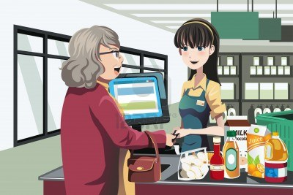
1.WHAT DO YOU WANT TO BUY?
GOOD MORNING MAM!
WHAT DO YOU WANT TO BUY?
NOTE:MAKE THE KID READ THE ABOVE CONVERSATION BETWEEN TWO PEOPLE IN A GROCERY SHOP.

Slide 3
2.PLACING THE ORDER
I WANT 2 KILOS OF SUGAR, A LITRE OF MILK AND A LOAF OF WHEAT BREAD.
NOTE:MAKE THE KID READ THE ABOVE CONVERSATION BETWEEN TWO PEOPLE IN A GROCERY SHOP.

Slide 4
2.PLACING THE ORDER
I’M SORRY.THERE’S ONLY GRAIN BREAD AVAILABLE.DO YOU WANT THEM?
NOTE:MAKE THE KID READ THE ABOVE CONVERSATION BETWEEN TWO PEOPLE IN A GROCERY SHOP.

Slide 5
2.PLACING THE ORDER
THAT’S OK!I SHALL HAVE A LOAF OF GRAIN BREAD.
NOTE:MAKE THE KID READ THE ABOVE CONVERSATION BETWEEN TWO PEOPLE IN A GROCERY SHOP.

Slide 6
2.WHAT ELSE DO YOU WANT?
WHAT ELSE DO YOU WANT?
NOTE:MAKE THE KID READ THE ABOVE CONVERSATION BETWEEN TWO PEOPLE IN A GROCERY SHOP.

Slide 7
2.DO YOU WANT ANYTHING ELSE?
NO!THIS IS ENOUGH!HOW CAN I MAKE THE PAYMENT?
NOTE:MAKE THE KID READ THE ABOVE CONVERSATION BETWEEN TWO PEOPLE IN A GROCERY SHOP.

Slide 8
3.ASKING FOR MODE OF PAYMENT
YOU HAVE CASH OR CARD?
NOTE:MAKE THE KID READ THE ABOVE CONVERSATION BETWEEN TWO PEOPLE IN A GROCERY SHOP.

Slide 9
3.ASKING FOR MODE OF PAYMENT
CAN I MAKE THE PAYMENT THROUGH CREDIT CARD?
NOTE:MAKE THE KID READ THE ABOVE CONVERSATION BETWEEN TWO PEOPLE IN A GROCERY SHOP.

Slide 10
3.ASKING FOR MODE OF PAYMENT
NO PROBLEM.
WE ACCEPT CARDS.
NOTE:MAKE THE KID READ THE ABOVE CONVERSATION BETWEEN TWO PEOPLE IN A GROCERY SHOP.

Slide 11
4.GREETING THE CUSTOMER
THANK YOU.PLEASE VISIT US AGAIN.
NOTE:MAKE THE KID READ THE ABOVE CONVERSATION BETWEEN TWO PEOPLE IN A GROCERY SHOP.

Slide 12
4.GREETING THE CUSTOMER
IT WAS NICE SHOPPING HERE.THANK YOU.
NOTE:MAKE THE KID READ THE ABOVE CONVERSATION BETWEEN TWO PEOPLE IN A GROCERY SHOP.

Slide 13
NOTE:MAKE THE KID READ THE ABOVE DIALOGUE BETWEEN 2 PEOPLE IN A GROCERY SHOP.

Slide 14
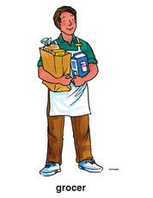
WRITE THE ANSWERS
WHAT DO YOU WANT TO BUY?
……………………………………………………………………
NOTE:MAKE THE KID TO WRITE THE ANSWERS IN THE BLANKS TO THE QUESTION ASKED.

Slide 15
WRITE THE ANSWERS
DO YOU WANT ANYTHING ELSE?
……………………………………………………………………
NOTE:MAKE THE KID TO WRITE THE ANSWERS IN THE BLANKS TO THE QUESTION ASKED.

Slide 16
TRY A CONVERSATION WITH YOUR TEACHER
NOW BUILD A CONVERSATION WITH THE BASIC QUESTIONS LEARNED IN THE EARLIER SLIDES.
a)LIST OF GROCERIES WANTED
b)MODE OF PAYMENT
c)GREETING THE CUSTOMER
YOU ASK THE QUESTIONS AND LET YOUR TRAINER ANSWER.
NOTE:MAKE THE KID TO BUILD CONVERSATIONS WITH YOU WITH THE ABOVE CLUES.

Slide 17


