Slide 1

Top 10 job interview questions

Slide 2

Top 10 job interview questions
1.TELL ME ABOUT YOURSELF
Start with your name
Where are you from
Education/ qualification
Job experience
Personal information(brief)
E.G.
My Name is Jenny. I am from Paris. I have a degree in IT and MBA In HR. I have 2 years experience in Infosys and I am 28 and I Like travelling and music.

Slide 3

Top 10 job interview questions
2.WHY DO YOU WANT TO WORK IN OUR COMPANY?
What you like about their company
Relate it to your long term career goals
E.G.
Sir/madam,
It’s a great privilege for anyone to work in a reputed company like yours. When I read about the job profile I felt that my skills are matching your requirements. Here I can showcase my technical skills to contribute to the company growth.

Slide 4

Top 10 job interview questions
3.WHAT ARE YOUR STRENGTHS?
Adaptability
Hard working
Honest
Flexibility
Optimistic
Fast decision making
Persistence
Self motivated

Slide 5

Top 10 job interview questions
4.WHAT ARE YOUR WEAKNESS?
Impatient
Sensitive
More talkative
Trust people very quickly
I can’t say no when someone ask for help
Take decision very quickly
Gets nervous when talk to strangers
To speak lie is difficult for me
I am bit lazy about which I am not Interested.
E.G.
I can’t say no when someone ask for help and I am a bit lazy about which I am not interested

Slide 6

Top 10 job interview questions
5.WHY SHOULD I HIRE YOU?
share your knowledge
work experience
skills related to job
E.G.
Sir /Madam,
1.As I am a fresher, I have theoretical knowledge but I can do hard work for my organization. And I will put all my efforts for the good progress of organization. Being punctual and sincere, I can finish the work given to me on time and try my best to fulfill all the needs of company from me.
2.With reference to my work experience, I satisfy all the requirements for this job. I am sincere with my work and would never let you down in anyway. I promise you will never regret for decision to appoint me in your organization.

Slide 7

Top 10 job interview questions
6.TELL ME WHAT YOU KNOW ABOUT THIS COMPANY?
Introduce yourself to company details
new projects
Awareness about management officials names
Company’s current issues
Information of competitors
E.G.
It is one of the best fastest growing company in France. The work environment of the company is very good. Employees feel proud to be part of the company as company provides full support to their employees in professional front . It has many branches across the world so I have a good opportunity to show my talent.

Slide 8
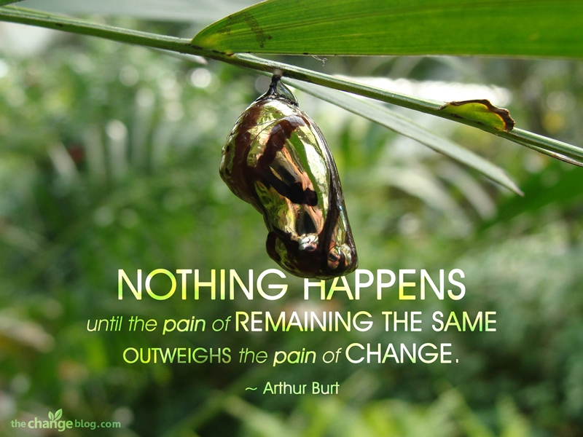
Top 10 job interview questions
7.WHY ARE YOU LOOKING FOR A JOB CHANGE?
Appreciate working with last company
Share your experience
Relate reason for Change of job to career goals
E.G.
I want to thank XYZ. Co. for the knowledge ,experience an d the opportunity they provide me to develop my expertise. According to me changes are necessary for everyone to enhance their skill, Knowledge and for personal growth and financial growth as well. You rorganization is a good platform where I can grow as a professional.

Slide 9

Top 10 job interview questions
8. WHAT ARE YOUR SALARY REQUIREMENTS?
Fresher's should never quote a figure
Experience candidate can express.
Always say as per the company norms for the job.
E.g.
Fresher:
This a jet start for me. Being a fresher I want to improve my knowledge and skills and gain experience. So I expect a considerable of salary according to my ability and your company norms which will fulfill my economic needs.
Experienced:
I have 7 years of experience in HR. field. My current CTC is 60 k pa(Euros). Still I am expecting salary as per company norms as per my designation and my qualification and experience which can help me maintain the standard of personal and economic needs,

Slide 10
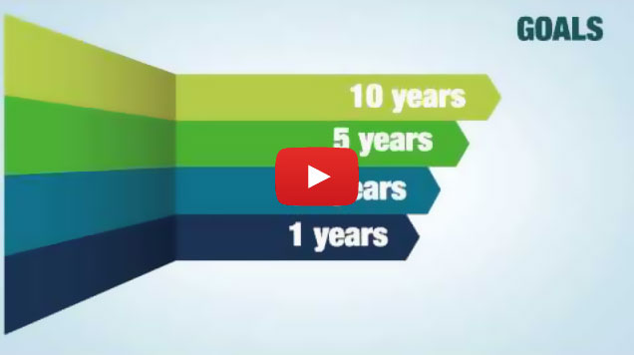
Top 10 job interview questions
9.WHAT ARE YOUR CAREER GOALS?
Short term goal
Long term goal
E.G.
Firstly my goal is to get a job in reputed company where I can utilize my skills and improve my career path.
But my long term goal is to be in respectable position in that organization and to reach the peak as per my talent and capabilities. I am very Ambitious.

Slide 11

Top 10 job interview questions
10. DO YOU HAVE ANY QUESTIONS
Appreciate the opportunity
Leaves/holidays
Discuss about Salary/ incentives/perks
appraisals
Training period
E.G.
Thank you for giving me this opportunity. Sir I would like to know about salary scale for this job in your organization . What are the motivating factors(perks/ incentives/ commission). Proposed appraisal plans. Duration of training period, notice period

Slide 12

Top 10 job interview questions

