Slide 1

PHOTO QUESTIONS
LISTENING COMPREHENSION
Photo Questions Exercise No.5 of ‘1 to 10’

Slide 2

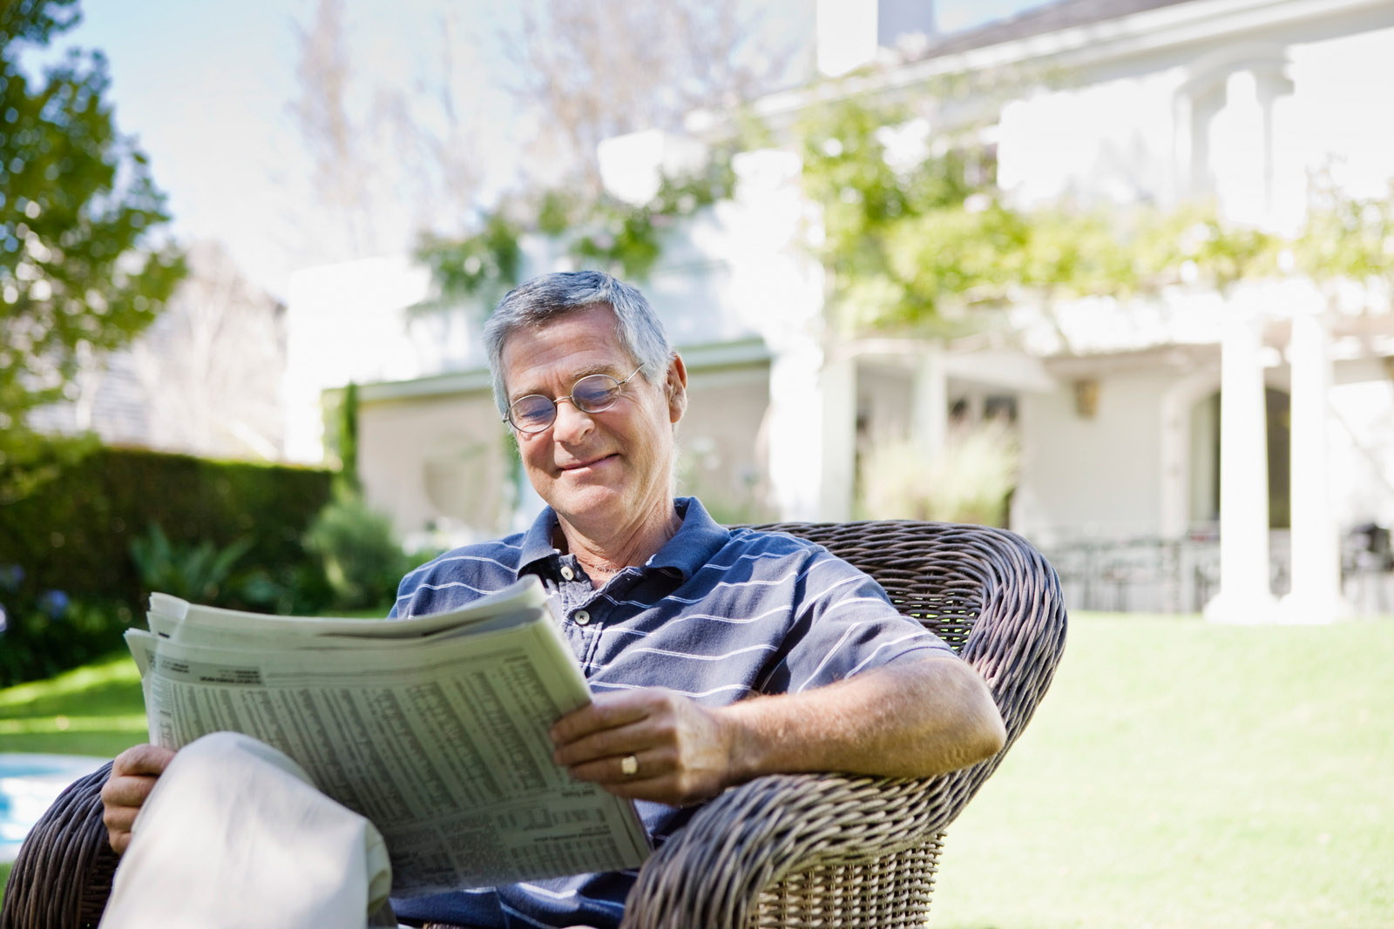
Notes:
(A) The chairs are made of plastic.
(B) The person is reading a newspaper.
(C) There are six chairs in the picture.
(D) It is pouring with rain.

Slide 3
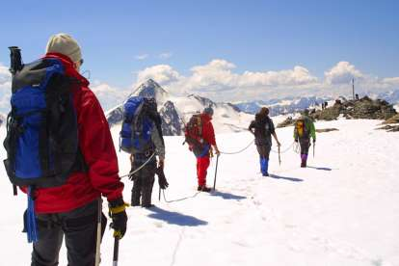
Notes:
(A) There are only a few clouds in the picture.
(B) There are six walkers in the picture.
(C) The man nearest the camera is carrying a red backpack.
(D) You can see the shadow of the man nearest the camera

Slide 4
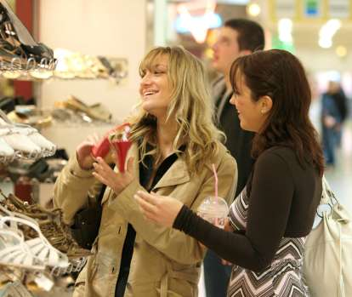
Notes:
(A) Both women are wearing jackets.
(B) One of the woman is carrying a white bag.
(C) The sales clerk is holding a red shoe in her hand.
(D) The women are shopping for sports shoes

Slide 5
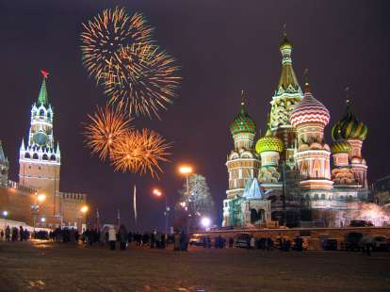
Notes:
(A) The architecture is typically western.
(B) You can see the moon clearly.
(C) Fireworks have been let off.
(D) All the buildings are in the dark.

Slide 6
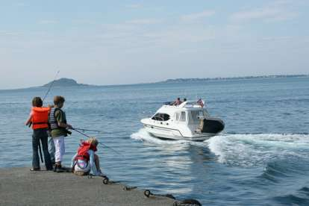
Notes:
(A) The three children are standing.
(B) The boat is going towards a mountain.
(C) The children all have red backpacks.
(D) The water looks very rough.

Slide 7
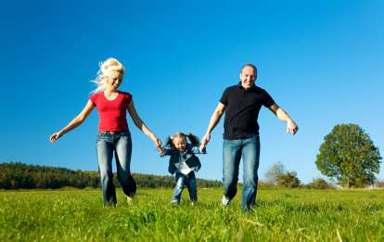
Notes:
(A) The woman is looking at the child.
(B) The man is holding the child with both hands.
(C) There are many clouds in the sky.
(D) The grass is very short.

Slide 8
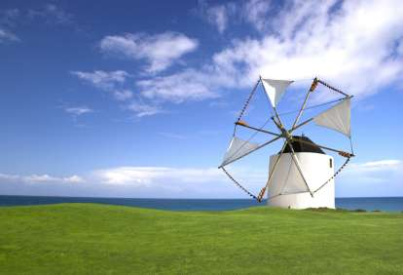
Notes:
(A) There are no mountains in the background.
(B) All the sails are set.
(C) The beacon tower is white.
(D) There is a satellite receiver on top of the airport tower.

Slide 9
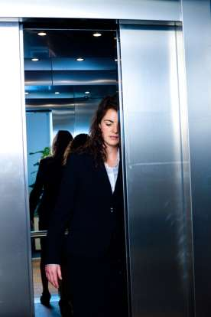
Notes:
(A) The girl is wearing a watch.
(B) The person in the picture is not looking at the camera.
(C) The elevator is crowded with people.
(D) The elevator has stopped on the fifth floor.

Slide 10
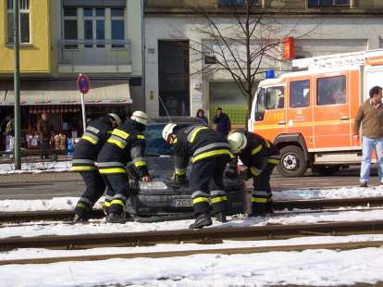
Notes:
(A) There is only one rescue vehicle in the picture.
(B) One of the buildings in the picture is on fire.
(C) A large crowd is watching the rescue efforts.
(D) There are two people trapped in the car.

Slide 11
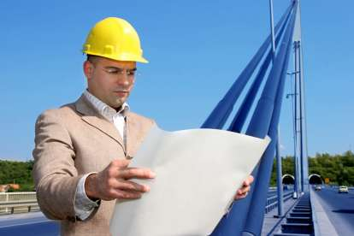
Notes:
(A) The man has on a white tie.
(B) The man appears to be standing on a bridge.
(C) The road is busy with cars and trucks.
(D) The hat he is wearing is to keep his head warm.

Slide 12
End of Photo Questions Exercise No.5
of
1 to 10
Thank you !

