Slide 1
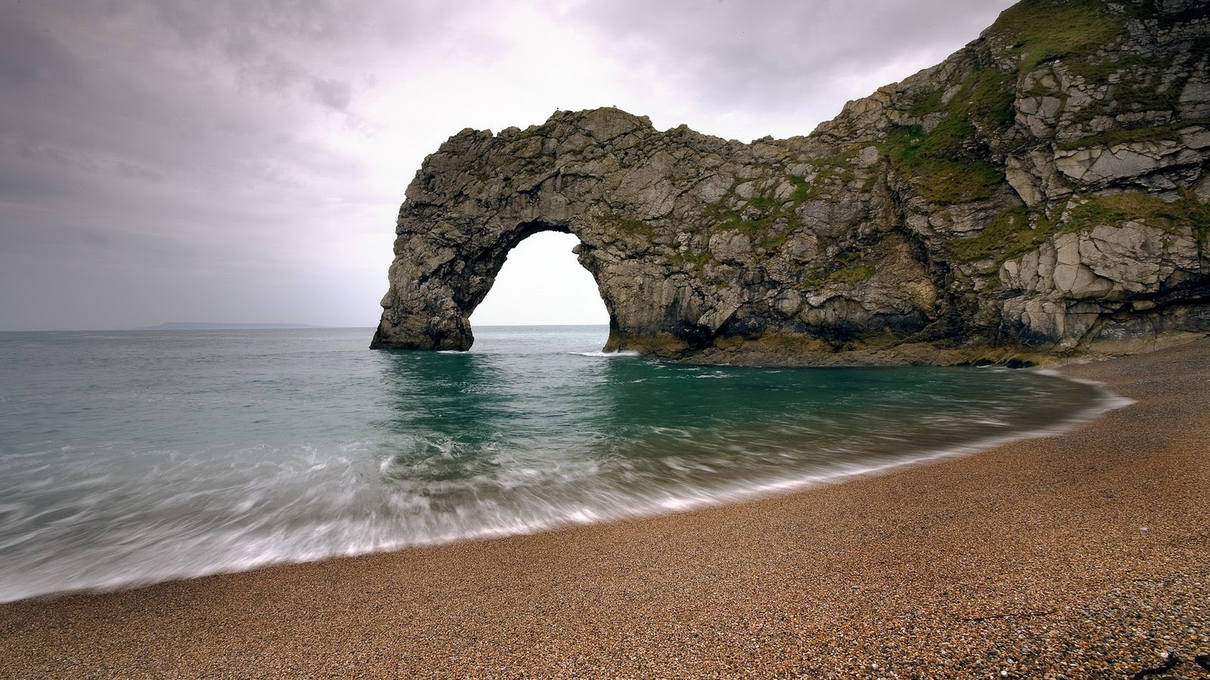
Natural Scenery

Slide 2
Our earth is full of beautiful scenery. Here are some of the words you will ever need to describe the landscape.

Slide 3
Vocabulary
Cliff
Cliffs are the high mountains that you can often see at the edge of the sea. The best thing about cliffs is that they offer a panoramic view over the sea.
Erosion :The process of eroding or being eroded by wind, water, or other natural agents
Bay: A bay is a curved-part of the seashore.
Coast: The sea-shore and the land close to it. Beaches are a part of the coast.
Coastline: The outline of a coast.
Bay: A bay is a curved-part of the seashore.
Spectacular: Beautiful in a dramatic and eye-catching way: "spectacular scenery".
Summit: Top
Breath taking : Inspiring or exciting
Valley: A low area of land between hills or mountains, typically with a river or stream flowing through it

Slide 4
Vocabulary
ENGLISH | FRENCH
Cliff | Falaise
Erosion | érosion
Coastline | Littoral
Bays | Baies
Spectacular | Spectaculaire
Summit | Sommet
Breathtaking | à couper le souffle
Valleys | Vallées

Slide 5
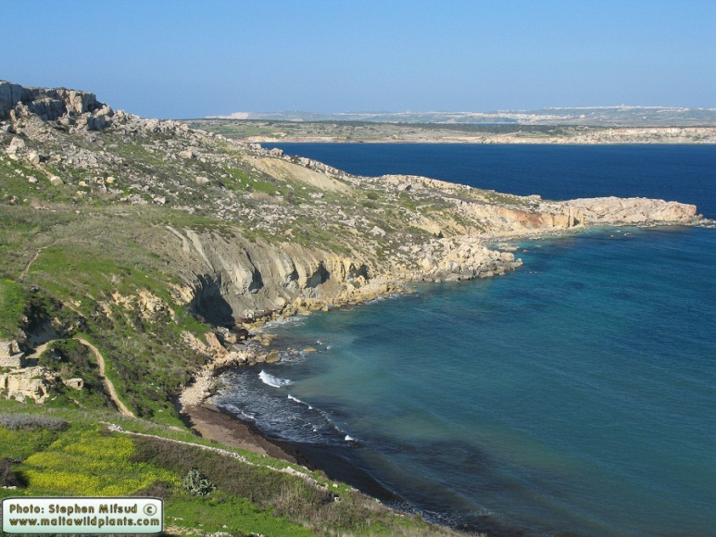
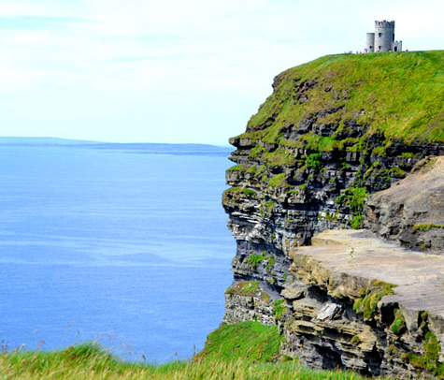
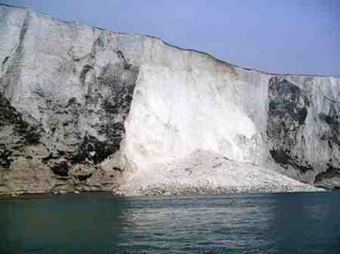
Edge of the Sea
Coastline
Often at the edge of the sea there are cliffs (high mountains), which give a great view over the sea. But they can also be dangerous, especially if they are eroded, when rocks and earth fall away into the sea.
Cliff
Erosion

Slide 6
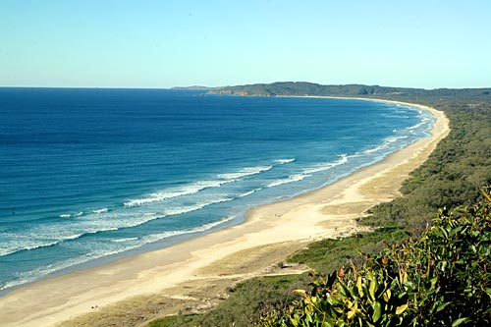
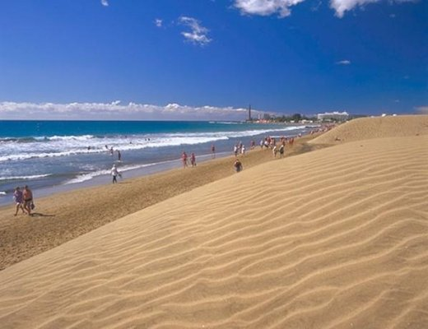
Beach
A beach is a sea-shore covered in sand or pebbles. Beaches attract tourists from all over the world.
Most people prefer sandy beaches rather than pebble beaches (beaches with small stones). The coastline can be straight, or it can have bays which are often semi-circular in shape.

Slide 7
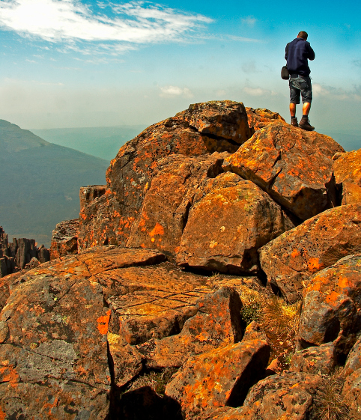
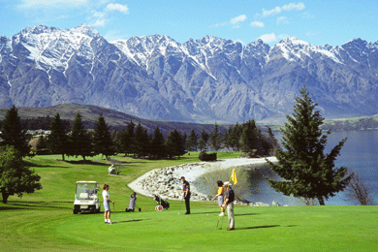
Mountains
Mountain ranges are spectacular as you can often see snow-capped peaks against the skyline
From the top of a mountain (the summit or the peak), there are breathtaking views.

Slide 8
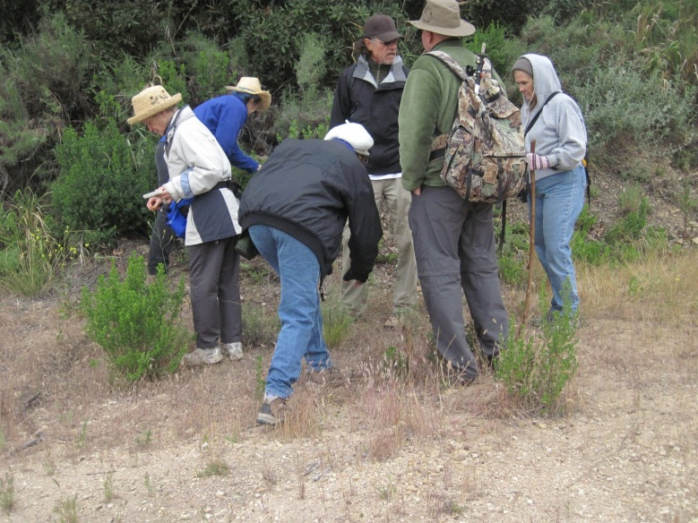
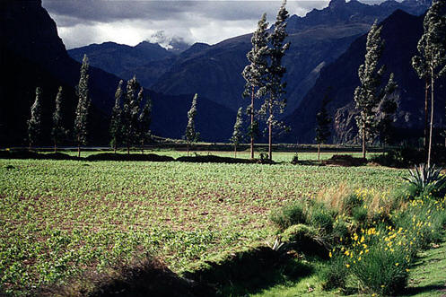
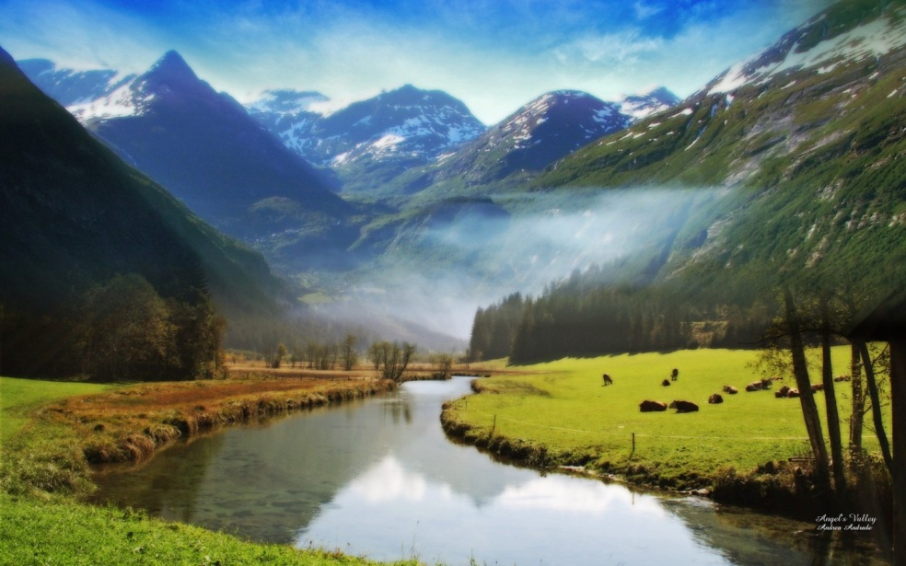
Not much grows on mountains, as generally the terrain (ground) is rocky, but the air is often pure.
However, the valleys (low areas encircled by the mountains) are more fertile.

Slide 9
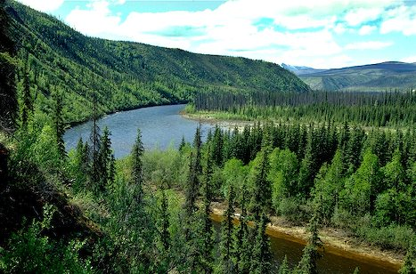
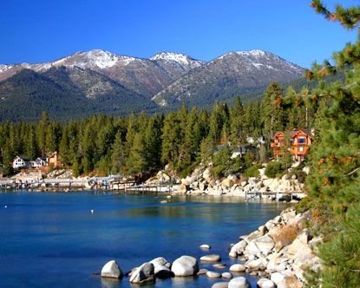
River
Lake

Slide 10
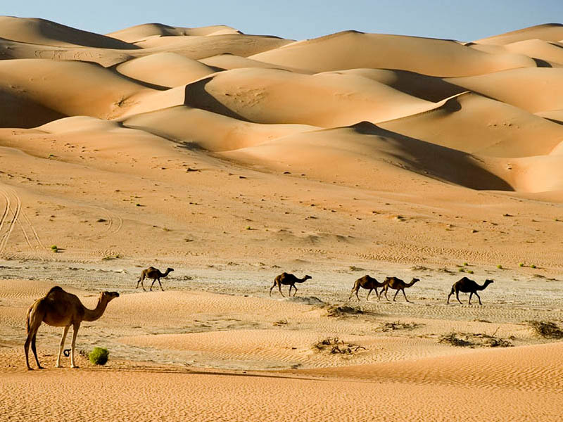
A desert is a large area of very dry, often sandy, land. Desert areas are not very habitable.

Slide 11
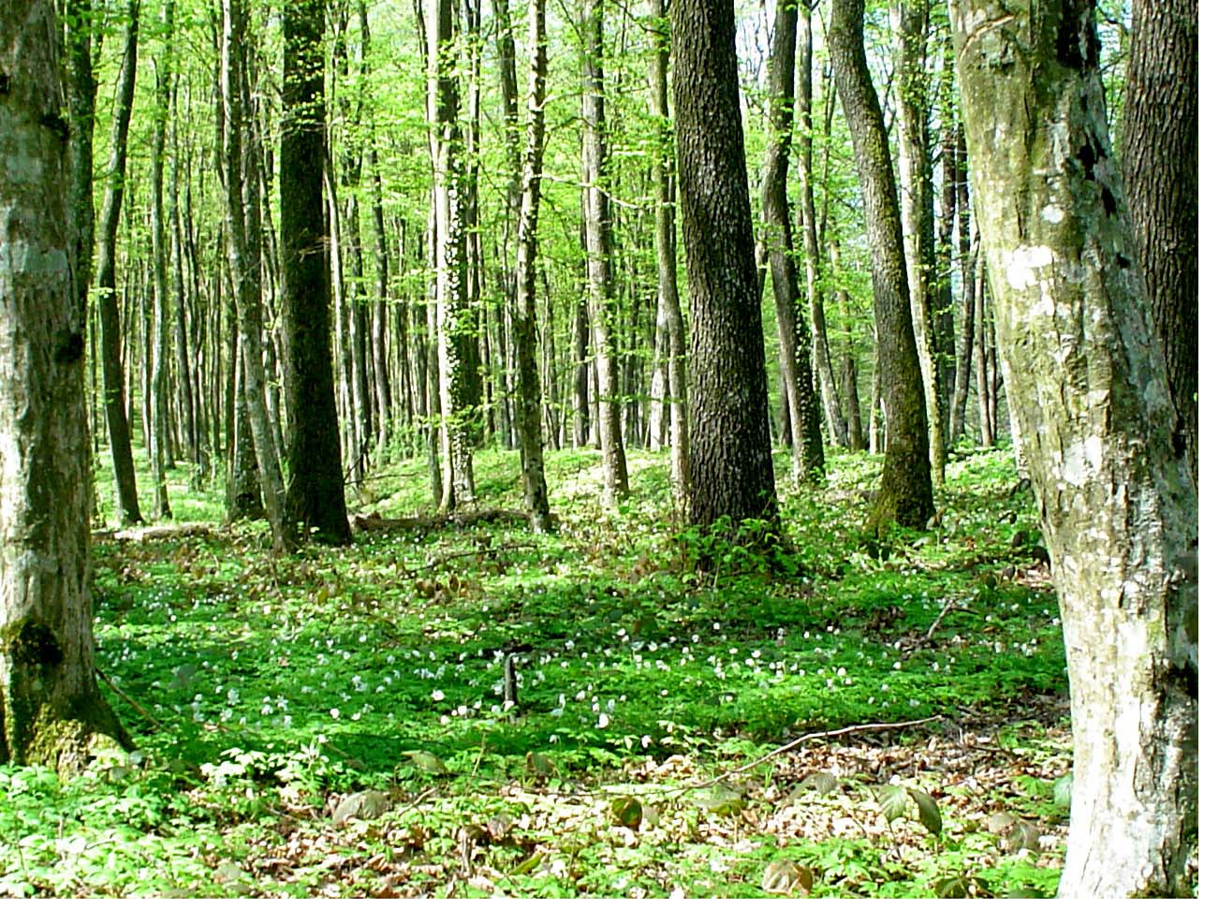
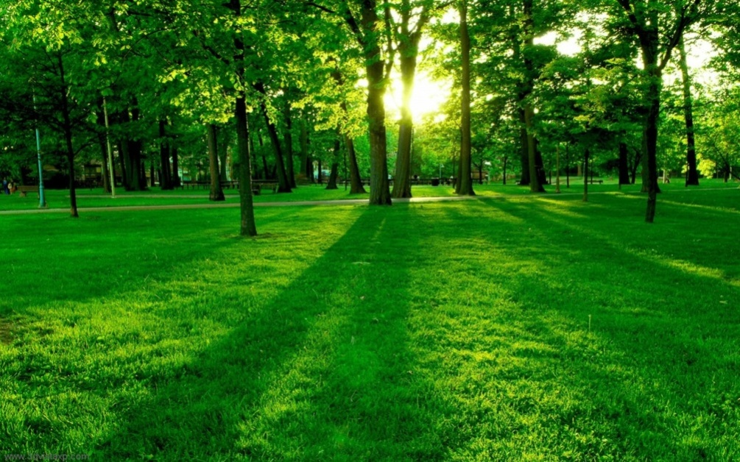
Forests are large areas of land covered with trees..
Woods are small forests that stretch over shorter areas

Slide 12
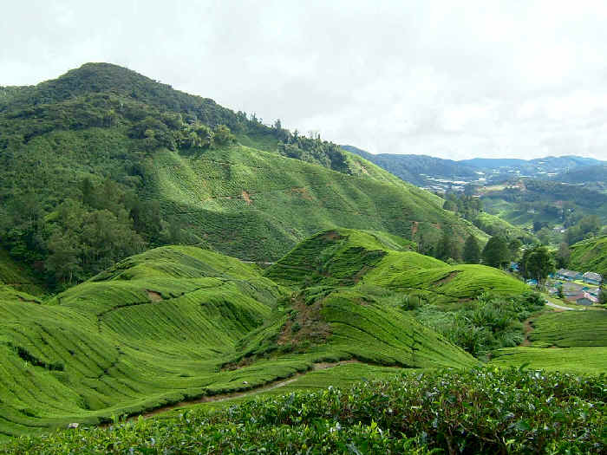
A hill is a high piece of land with sloping sides. The top of a hill is called a hilltop. Hills often sport attractive scenery.

Slide 13
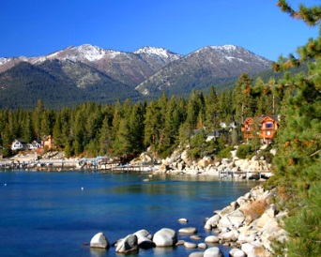
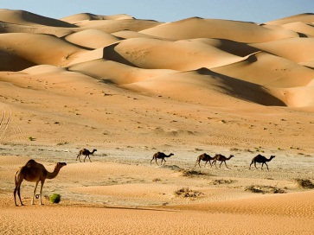
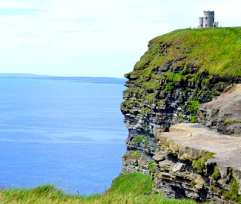
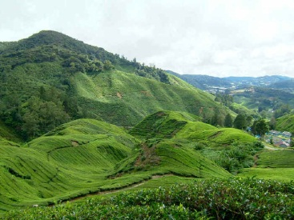

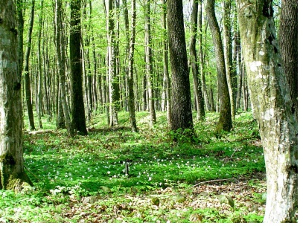
Match the following
1.Cliff
2.Beach
3.Mountain
4.Lake
5.Desert
6.Forest
7.Hill
b
e
a
c
f
d
g
Notes:
1-c
2-d
3-e
4-b
5-a
6-g
7-f

