Slide 1
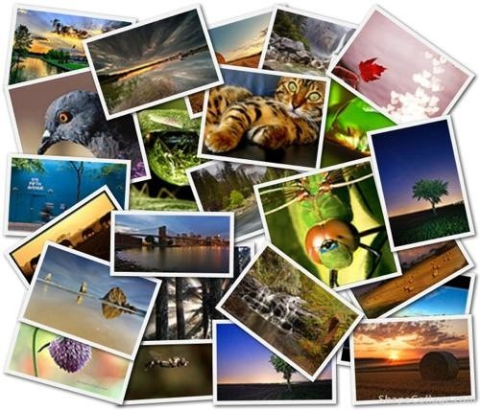
Describe the picture

Slide 2

Write atleast 4 lines on each picture
_____________________________________
__________________________________
__________________________________
__________________________________

Slide 3

Corporate image
1.________________________________
2. ____________________________________
3. ________________________________
4. ________________________________

Slide 4

Football logos
1.__________________________________
2._________________________________
3._________________________________
4.____________________________________

Slide 5

Social Networks
1.______________________________________
2.______________________________________
3.______________________________________
4.______________________________________

Slide 6
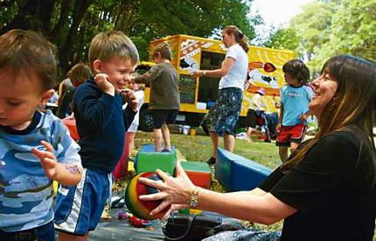
Park
1.___________________________________
2.____________________________________
3.___________________________________
4._____________________________________________

Slide 7
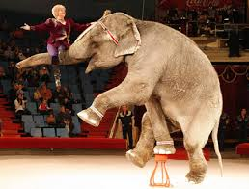
Circus
1.___________________________________
2.___________________________________
3._____________________________________
4.____________________________________

