Slide 1
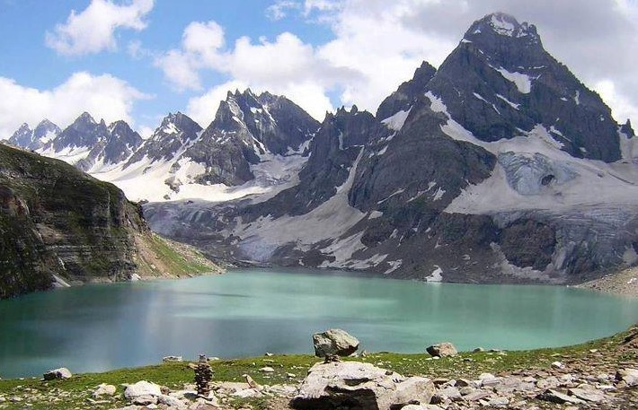
KASHMIR

Slide 2
Vocabulary
Autonomous : Having the freedom to act independently
Monarchs : A sovereign head of state, especially a king, queen, or emperor
Annexed : Add as an extra or subordinate part, especially to a document
Descendants : A person, plant, or animal that is descended from a particular ancestor
Paramount : Above others in rank or authority; superior in power or jurisdiction
Former : Having previously been a particular thing
Affiliated : Officially attached or connected to an organization
Demurred : Raise objections or show reluctance
Incursions : An invasion or attack, especially a sudden or brief one

Slide 3
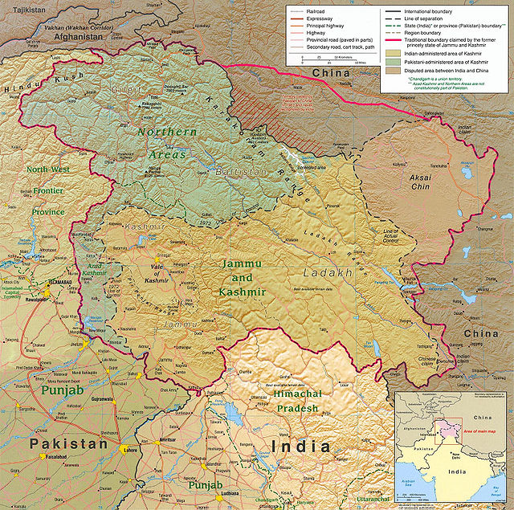
Kashmir is the northwestern
region of South Asia.
Until the mid-19th century,
the term Kashmir geographically
denoted only the valley between
the Great Himalayas and the
Pir Panjal mountain range.
Today, it denotes a larger
area that includes the
Indian-administered state
of Jammu and Kashmir
(which consists of Jammu,
the Kashmir Valley, and
Ladakh), the
Pakistan-administered
autonomous territories of
Azad Kashmir and
Gilgit–Baltistan,
and the Chinese-administered
regions of
Aksai Chin and
the Trans-Karakoram Tract

Slide 4
Some information about Kashmir
In the first half of the 1st millennium, the Kashmir region became an important centre of Hinduism and later of Buddhism.
In 1349, Shah Mir became the first Muslim ruler of Kashmir.
For the next five centuries, Muslim monarchs ruled Kashmir, including the Mughals, who ruled from 1526 until 1751, and the Afghan Durrani Empire, which ruled from 1747 until 1820.
That year, the Sikhs, under Ranjit Singh, annexed Kashmir.
In 1846, after the Sikh defeat in the First Anglo-Sikh War, and upon the purchase of the region from the British under the Treaty of Amritsar, the Raja of Jammu, Gulab Singh, became the new ruler of Kashmir.
The rule of his descendants, under the paramountcy (or tutelage) of the British Crown, lasted until 1947, when the former princely state of British India became a disputed territory, now administered by three countries: India, Pakistan, and the People's Republic of China.

Slide 5
Reasons behind the dispute
The Kashmir Conflict arose from the Partition of British India in 1947 into modern India and Pakistan.
Both countries subsequently made claims to Kashmir, based on the history and religious affiliations of the Kashmiri people.
The princely state of Jammu and Kashmir, which lies strategically in the north-west of the subcontinent bordering Afghanistan and China, was formerly ruled by Maharaja Hari Singh under the paramountcy of British India. In geographical and legal terms, the Maharaja could have joined either of the two new countries.
Although urged by the Viceroy, Lord Mountbatten of Burma, to determine the future of his state before the transfer of power took place, Singh demurred.
In October 1947, incursions by Pakistan took place leading to a war, as a result of which the state of Jammu and Kashmir remains divided between India and Pakistan.

Slide 6
Statistics from the BBC
Administered by | Area | Population | Muslim | Hindu | Buddhist | Other
India | Kashmir Valley | 4 million | 95% | 4% | _ | _
 | Jammu | 3 million | 30% | 66% | _ | 4%
 | Ladakh | 0.25 million | 46% | _ | 50% | 3%
Pakistan | Azad Kashmir | 2.6 million | 100% | _ | _ | _
 | Gilgit–Baltistan | 1 million | 99% | _ | _ | _
China | Aksai Chin | _ | _ | _ | _ | _

Slide 7
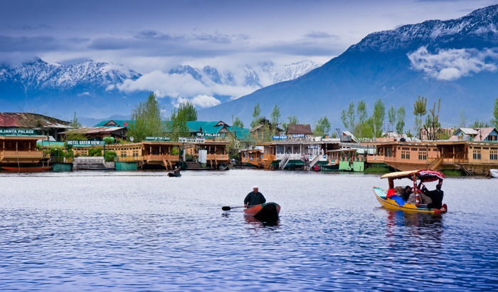
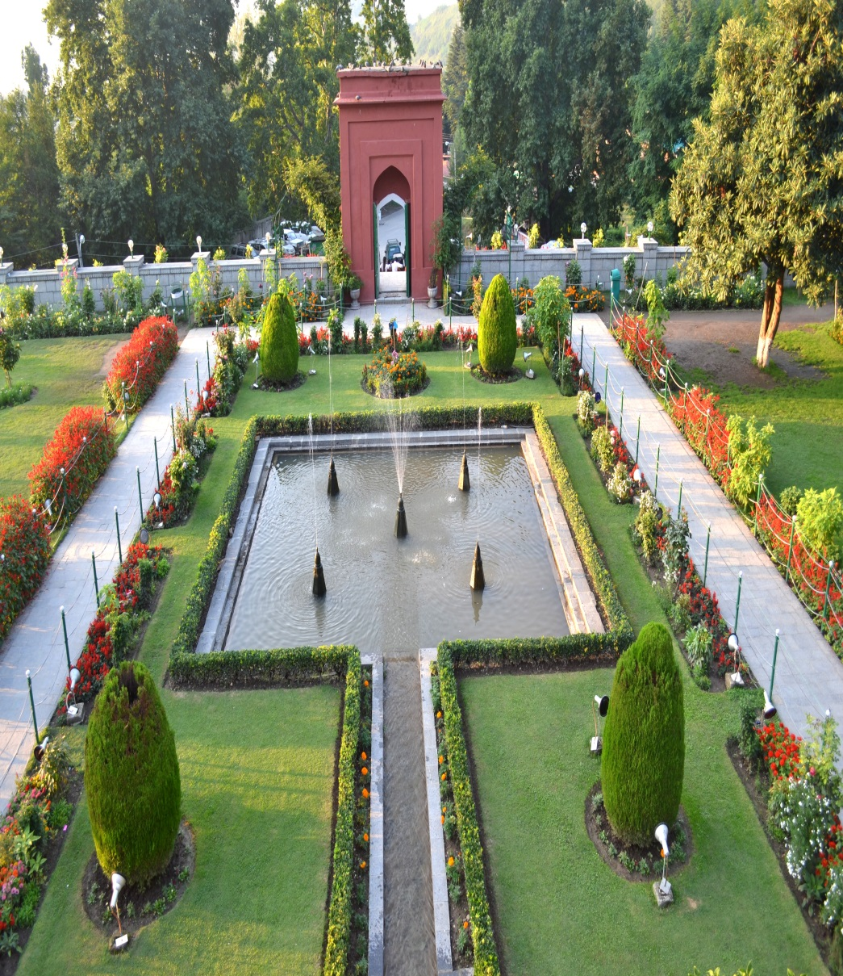
TOURIST ATTRACTIONS IN KASHMIR
Dal Lake
Shalimar Garden

Slide 8
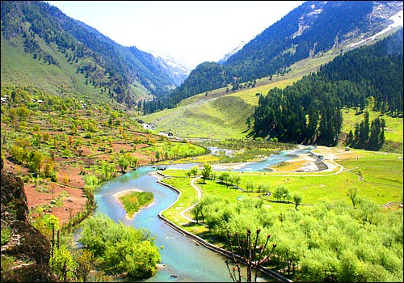
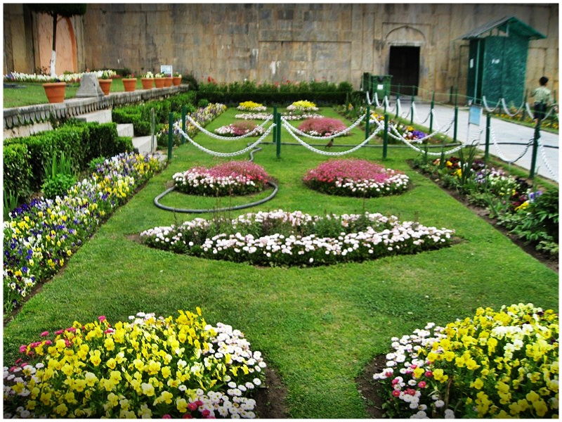
TOURIST ATTRACTIONS IN KASHMIR
Betaab Valley
Nishat Garden

Slide 9
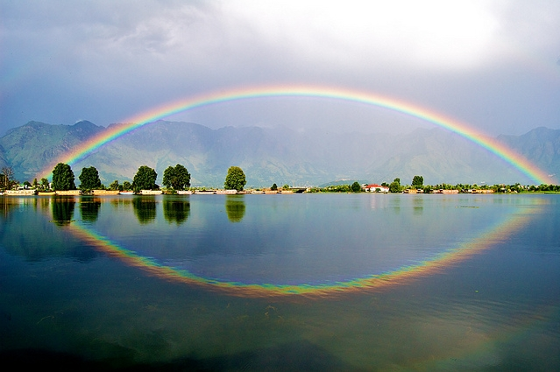
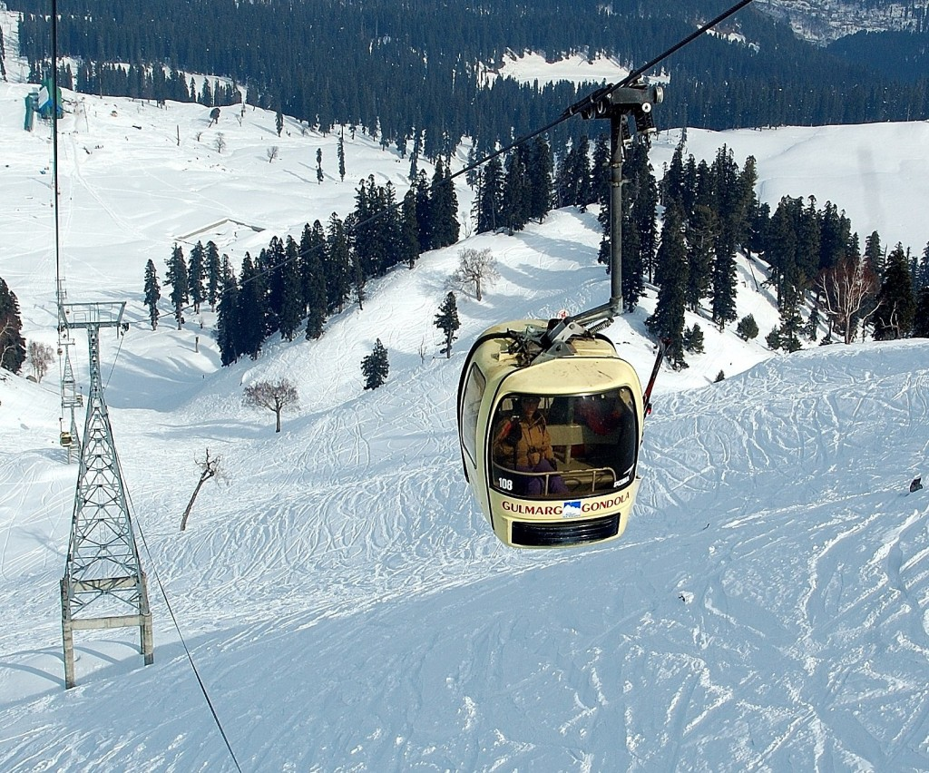
TOURIST ATTRACTIONS IN KASHMIR
Nagin Lake
Gulmarg, Gondala

