Slide 1

PHOTO QUESTIONS
LISTENING COMPREHENSION
Photo Questions Exercise No.6 of ‘1 to 10’

Slide 2
Description :
In this Listening test, you will be asked to demonstrate how well you understand spoken English.
The entire Listening test will last approximately 45 minutes. There are four parts, and directions are given for each part. You must mark your answers on the separate answer sheet. Do not write your answers in your test book.

Slide 3
Directions:
In the ‘ Toeic Photo Questions Listening Test ’ will hear four Statements or Questions about the Photograph.
These Statements / Questions will not be printed in your test book and will be spoken only once / one time only .
You will be required to ‘Select the Best Response to the Question or Statement and “tick mark” the letter (A), (B), (C) or (D) on your answer sheet.
Mark your answer on your answer sheet.

Slide 4

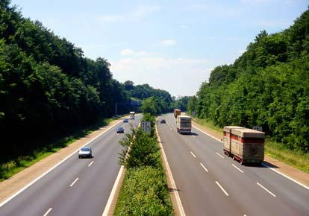
Notes:
Traffic is building up on the motorway.
There are more lorries on this motorway than cars.
Traffic is flowing freely on the motorway. -- CORRECT
The vehicles are travelling too close to one another on the motorway.

Slide 5
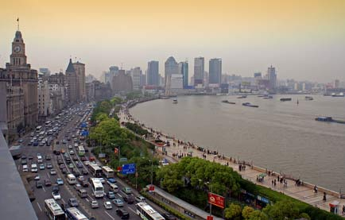
Notes:
(A) There are more craft on the water than there are cars on the road.
(B) This photo shows us a busy rush hour scene.
(C) Most of the buildings in the picture are typical domestic residences.
(D) There is no evidence of any people walking in the photo.

Slide 6
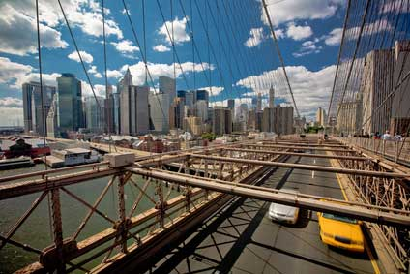
Notes:
The white car looks as if it is going to overtake the yellow car. -- CORRECT
The skyscrapers in the picture are under the bridge.
Several people can be seen trying to cross the road.
It looks as if it is going to rain.

Slide 7
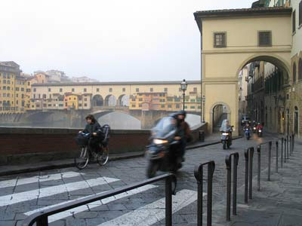
Notes:
People are trying to cross the road.
The buildings are all brightly coloured.
The cyclist on the left is riding a pedal cycle. -- CORRECT
There are six arches visible in the picture.

Slide 8
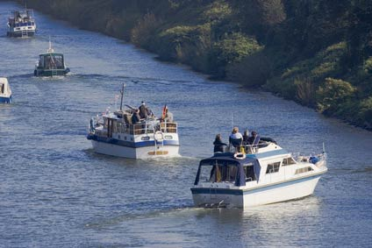
Notes:
All the people in the motorboats are waving their arms.
The water is deep green in colour.
All the motorboats are clearly visible.
You can only see four boats clearly. -- CORRECT

Slide 9
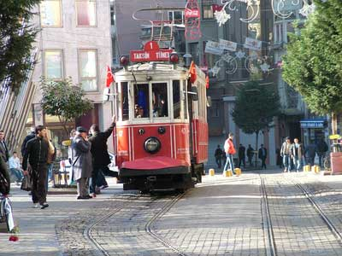
Notes:
There are two women to be seen in the photo.
You can see one man getting off the tram. -- CORRECT
You can see one man getting on the tram.
There are two men wearing red in the photo.

Slide 10
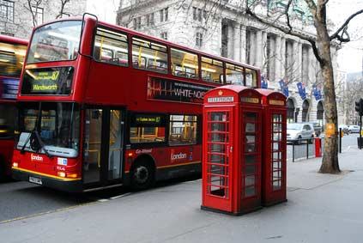
Notes:
No one is sitting on the seats on the top of the bus. -- CORRECT
The bus has three decks.
The trees are full of leaves.
Someone is using the telephone in one of the kiosks.

Slide 11
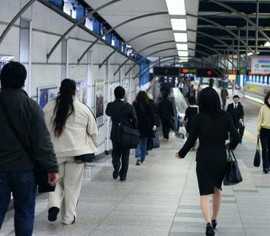
Notes:
Everyone is walking away from the camera.
The woman in the white jacket has short hair.
You can see blue sky at the top of the picture.
No one in the picture is running. -- CORRECT

Slide 12
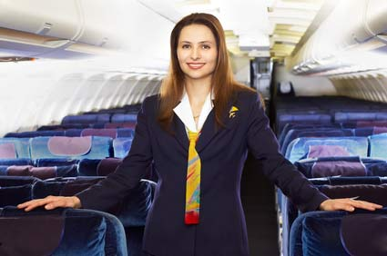
Notes:
The air hostess is sitting down.
The air hostess is talking to the passengers.
You cannot see anyone sitting in the seats. -- CORRECT
The seats in the plane are all bright red.

Slide 13

Notes:
The two people in the picture are looking at the screen on a laptop. -- CORRECT
The two people in the picture are watching television.
The man is looking miserable.
The woman is shaking hands with the man.

Slide 14
End of Photo Questions Exercise No.6
of
1 to 10
Thank you !

