Slide 1

PHOTO QUESTIONS
LISTENING COMPREHENSION
Photo Questions Exercise No.2 of 1 to 10

Slide 2

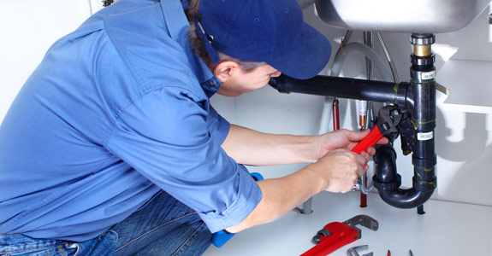
Notes:
(A) The man is using a screwdriver.
(B) The man is using a spanner.
(C) The man is using one hand only.
(D) The man is standing upright.

Slide 3
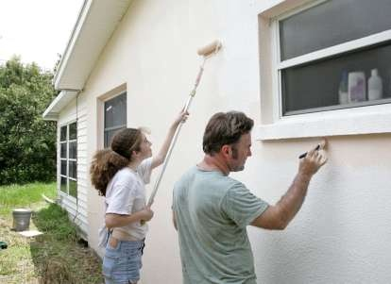
Notes:
(A) The man and the woman are both using paint brushes.
(B) They are painting the roof of the house.
(C) The man is wearing a white top.
(D) The woman is using a paint roller.

Slide 4
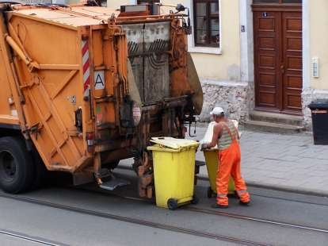
Notes:
(A) All the wheelie bins in the picture are green.
(B) The man is bareheaded.
(C) The refuse collector is wearing orange trousers.
(D) All the wheelie bin lids are closed.

Slide 5
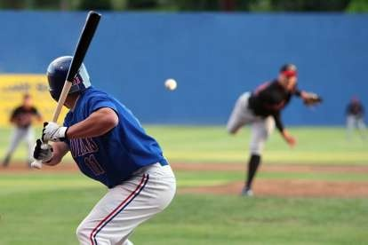
Notes:
(A) The man on the right has only one leg.
(B) The man nearest the camera is holding a golf stick.
(C) The man nearest the camera is wearing a helmet.
(D) The man on the right is throwing two balls in the air.

Slide 6
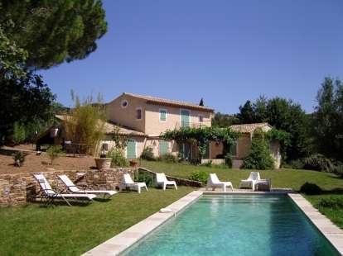
Notes:
(A) The picture shows a swimming pool in someone's backyard.
(B) All the sun loungers are blue.
(C) There are two people swimming.
(D) It looks like a storm is about to start.

Slide 7
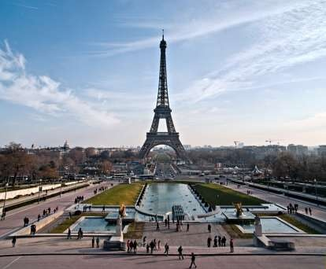
Notes:
(A) The streets are packed with cars.
(B) The tower in the picture is an office building.
(C) The picture was taken at night.
(D) It looks like a beautiful day to be outside.

Slide 8
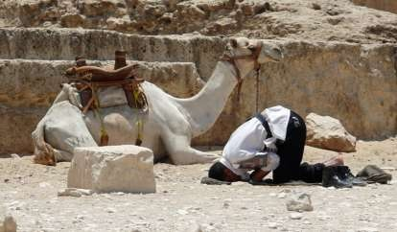
Notes:
(A) The camel is looking at the camera.
(B) The man is wearing a brown top.
(C) The camel is taking a rest.
(D) The man is sitting up.

Slide 9
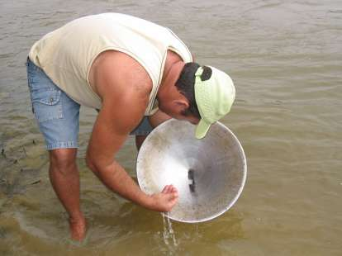
Notes:
(A) It looks like a very cold day.
(B) The man is wearing a white cap.
(C) The person in the picture is fishing.
(D) The water looks clear blue.

Slide 10
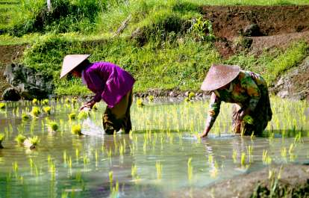
Notes:
(A) The two people in the picture are fishing.
(B) The crop they are working on looks like corn.
(C) The workers are up to their waist in water.
(D) One of the workers is wearing a purple shirt.

Slide 11
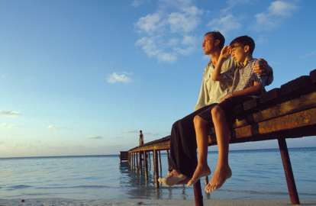
Notes:
(A) The boy and man are looking at each other.
(B) Both people are getting ready to fish.
(C) The man is wearing long pants.
(D) There are two boats tied to the dock.

Slide 12
End of Photo Question Exercise No .2
Of
1- 10
Thank you !

