Slide 1

TOEIC
PHOTO QUESTIONS
LISTENING COMPREHENSION
Photo Questions Exercise No.1 of ‘1 to 10’

Slide 2
Description :
In this Listening test, you will be asked to demonstrate how well you understand spoken English.
The entire Listening test will last approximately 45 minutes. There are four parts, and directions are given for each part. You must mark your answers on the separate answer sheet. Do not write your answers in your test book.

Slide 3
PART 2
Directions:
In the ‘ Toeic Photo Questions Listening Test ’ will hear four Statements or Questions about the Photograph.
These Statements / Questions will not be printed in your test book and will be spoken only once / one time only .
You will be required to ‘Select the Best Response to the Question or Statement and “tick mark” the letter (A), (B), (C) or (D) on your answer sheet.
Mark your answer on your answer sheet.

Slide 4

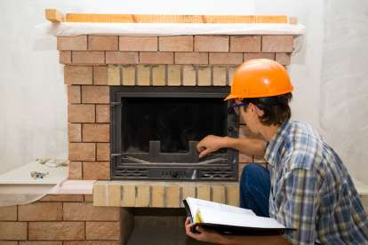
1.1
Notes:
The man is adjusting a TV set.
(B) The man is wearing gloves and glasses.
(C) The man is trying to light a fire.
(D) The man is holding a book in his left hand.

Slide 5
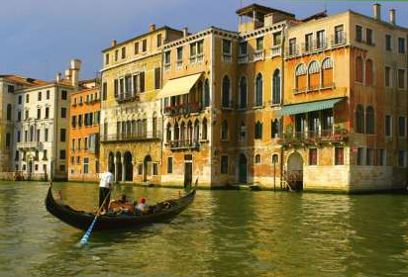
1.3
Notes:
(A) All the buildings are painted white.
(B) There are two gondolas in the picture.
(C) The gondolier is standing up in the gondola.
(D) The sky is very dark.

Slide 6
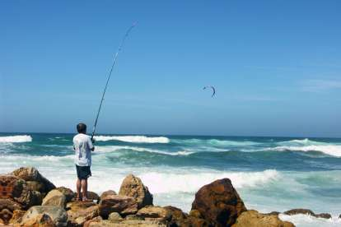
1.4
Notes:
(A) The man holds a fish in his hand.
(B) The man is standing between rocks.
(C) The sea is completely calm.
(D) You can see several vessels on the horizon.

Slide 7
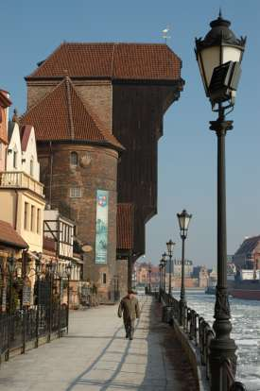
1.5
Notes:
(A) There are three people in the picture.
(B) You can see the shadow of the barrier on the ground.
(C) The man is walking away from the camera.
(D) The street lamps are all on.

Slide 8
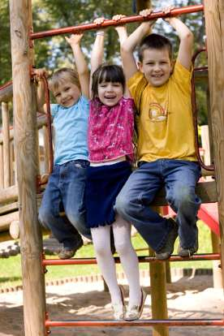
1.6
Notes:
(A) All three children are holding on to the bar.
(B) The girl's feet are touching the ground.
(C) The children are standing on an escalator.
(D) The children are holding each other.

Slide 9
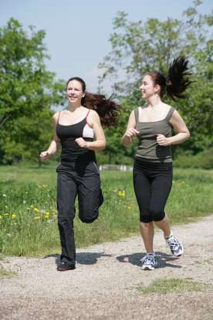
1.7
Notes:
(A) Both women are wearing black shoes.
(B) Both women are jogging with their heads up.
(C) There are no trees in the picture.
(D) The grass looks very brown.

Slide 10
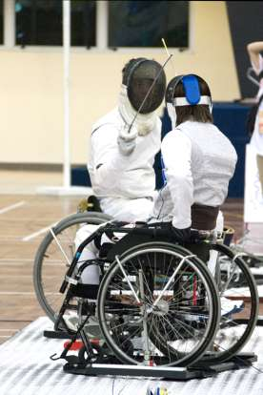
1.8
Notes:
(A) Both fighters are standing upright.
(B) Both fighters are sitting in easy chairs.
(C) One of the fighters is riding a bike.
(D) You can see one of the fighters holding his epée.

Slide 11
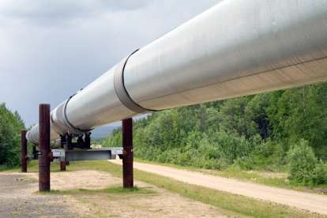
1.9
Notes:
(A) The pipe has no visible means of support.
(B) There are no bushes either side of the picture.
(C) You can see some bands round the pipe.
(D) There are some people walking along the path.

Slide 12
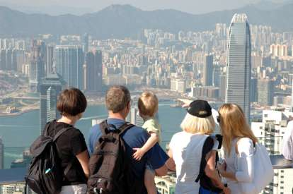
1.10
Notes:
(A) Two of the people are wearing black backpacks.
(B) The baby being held appears to be crying.
(C) The mountain tops in the background are covered with snow.
(D) It looks like it's about to rain.

Slide 13
End of Photo Questions Exercise No.1
of
1 to 10
Thank you !

