Slide 1

PHOTO QUESTIONS
LISTENING COMPREHENSION
Photo Questions Exercise No.10 of ‘1 to 10’

Slide 2
Description :
In this Listening test, you will be asked to demonstrate how well you understand spoken English.
The entire Listening test will last approximately 45 minutes. There are four parts, and directions are given for each part. You must mark your answers on the separate answer sheet. Do not write your answers in your test book.

Slide 3
Directions:
In the ‘ Toeic Photo Questions Listening Test ’ will hear four Statements or Questions about the Photograph.
These Statements / Questions will not be printed in your test book and will be spoken only once / one time only .
You will be required to ‘Select the Best Response to the Question or Statement and “tick mark” the letter (A), (B), (C) or (D) on your answer sheet.
Mark your answer on your answer sheet.

Slide 4

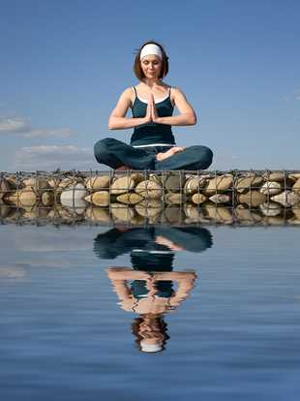
Notes:
Yoga
The woman's eyes are wide open.
The woman is sitting on some cushions.
You can see the reflection of the woman in the water. -- CORRECT
The woman is wearing a white hat.

Slide 5
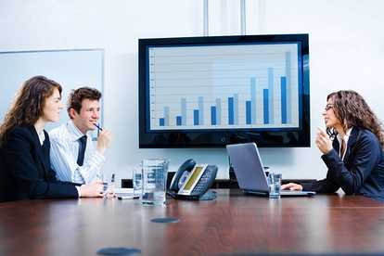
Notes:
A business meeting
The man in the picture is eating his pencil.
You can see a videophone on the table. -- CORRECT
The woman on the right is looking at the laptop keyboard.
The chart on the wall shows columns in black.

Slide 6
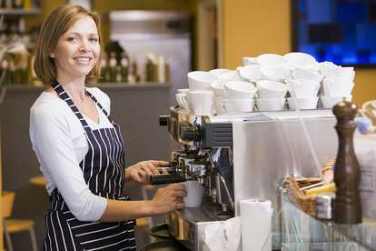
Notes:
Behind the counter
There are several white cups on top of the machine. -- CORRECT
The woman is wearing an apron with green stripes.
The woman is holding two cups.
The woman is looking really cross.

Slide 7
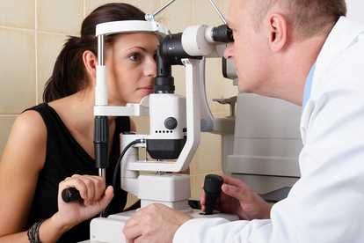
Notes:
The sight test
The man is looking at the woman's hair.
The man is looking at the woman's right eye.
The man is looking at the woman's left eye. -- CORRECT
You can see the man's right ear.

Slide 8
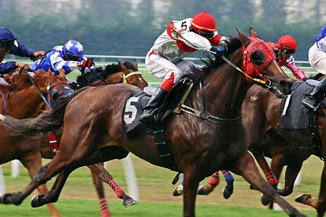
Notes:
he horse race
All the jockeys are wearing red caps.
Horse number five is in front of the others.
One jockey is wearing a blue and white cap. -- CORRECT
Horse number five has brown hair.

Slide 9
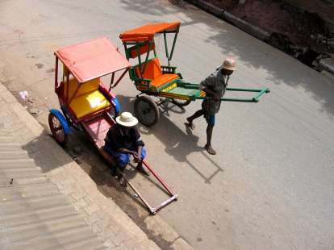
Notes:
Rickshaws
Both rickshaw drivers are sitting down.
Both rickshaw canopies are blue.
Neither rickshaw has a passenger. -- CORRECT

Slide 10
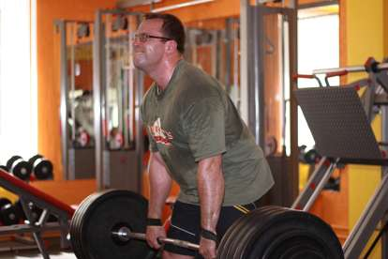
Notes:
Weightlifting
The man is leaning forward. -- CORRECT
He is lifting some wheels.
The man is opening his mouth.
He has taken his glasses off.

Slide 11
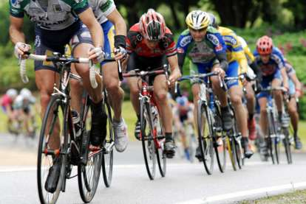
Notes:
Bicycle race
The men are standing on their bikes.
The men are racing on their bicycles. -- CORRECT
The man nearest to the camera has just fallen off his bicycle.
Three of the men are taking a break.

Slide 12
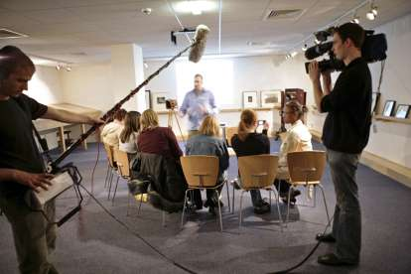
Notes:
Studio interview
Some of people in the photo are probably going to be interviewed. -- CORRECT
Most of the people in the photo are standing.
One of the men is taking photographs.
A group of people is sitting around a desk.

Slide 13
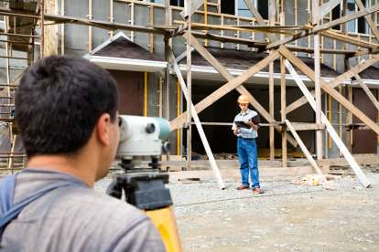
Notes:
Surveyors on site
One of the two men is reading the newspaper.
One of the men is wearing a helmet. -- CORRECT
The man in blue jeans is not standing in front of scaffolding.
Both men are sitting on a bench.

Slide 14
End of Photo Questions Exercise No.10
of
1 to 10
Thank you !

