Slide 1
Let’s Play
The
Guessing
Game

Slide 2
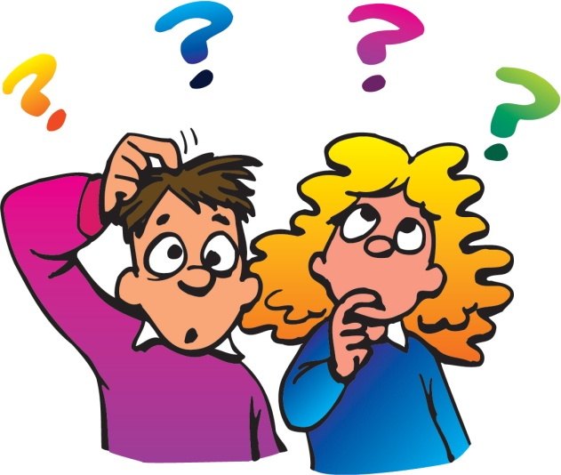
Guess
the animal

Slide 3
What am I?
I am also a well known farm animal,
I am covered in black and white markings that are unique to me!
I provide milk which is used to make cheese, butter and yoghurt.
Notes:
Answer: Cow

Slide 4
Who am I?
Even though I am an insect, I’m covered in fur!
I live in a colony with many others, I love eating nectar and pollen which I get from flowers, You would recognize me from the bold stripes on my body.
Notes:
Answer: Bumblebee

Slide 5
What am I?
I have wings but I'm not a bird. I am small and colourful. I live in gardens and fields and forests. I used to be a caterpillar. I am a...
Notes:
Answer: Butterfly

Slide 6
Now your
turn

Slide 7
Guess
the food
item

Slide 8
Who am I?
I am in the protein group.
I come from a farm animal.
Open me up and you’ll see two parts.
I am popular in many breakfast recipes.
I can be served in many ways, like scrambled,
poached, or boiled.
Notes:
Answer: Egg

Slide 9
What am I?
Many people think that I am a vegetable, but I am actually a fruit. People like to use me to make spaghetti sauce and pizza sauce .
Notes:
Answer: Tomato

Slide 10
What am I?
I am made from a bean. Long ago I was used to make a bitter drink. Today I am found in candy, cake, and even ice cream.
Notes:
Answer: Chocolate

Slide 11
Now your
turn

Slide 12
Guess
the object

Slide 13
Who am I?
I am used to make pencils and paper. Animals make their homes in me. I give shade on hot, summer days.
Notes:
Answer : Tree

Slide 14
Who am I?
I am small and made of plastic, and I am electrical. I can be found in the home.
I'm not expensive to buy, or to run, but if you buy me you hope you won't ever need me. Who knows, I might even save your life one day.
Notes:
Answer: smoke detector

Slide 15
What am I?
Each one of them has an important message. Many have a word or two. Some have pictures and some have numbers. Some of them are yellow and some are red. Some are near country roads and many are on city streets. If we follow them, we will be much safer.
Notes:
Answer: Street Signs

Slide 16
Now your
turn

Slide 17
Guess
the
celebrity

Slide 18
Who am I?
I was born on 8th Jan, 1935
I died on 16th Aug, 1977
My hometown is Memphis
My first hit was “Heartbreak Hotel”
My wife’s name is Priscilla
I am the “King of Rock’n’Roll”
Notes:
Answer : Elvis Presley

Slide 19
Who am I?
I was born on 28th Oct, 1967.
My middle name is Fiona.
My company name is Red Om Films. I am one of highest-paid actresses. I starred in many romantic comedies. My husband is Daniel Moder. One of my best films is “Pretty Woman”.
Notes:
Answer: Julia Roberts

Slide 20
Who am I?
I was born on 1st July, 1961.
I died on 31st Aug, 1997.
I had outstanding community spirit. I got married in St. Paul’s Cathedral. I had two sons. I was the Princess of Wales. My husband was Prince Charles.
Notes:
Answer: Princess Diana

Slide 21
Who am I?
I was born on 26th Aug, 1910.
I died on 5th Sept, 1997.
I was given the name: Agnesë Bojaxhiu. I am the founder of Missionaries of Charity.
I was a humanitarian for the poor. I am known as Blessed Teresa of Calcutta.
Notes:
Answer: Mother Teresa

Slide 22
Who am I?
I was born on 16th Aug, 1958
My last name is Ciccone.
My first career was in modern dance.
My first husband is Sean Penn.
One of my hits are “Like a Virgin.”
Notes:
Answer: Madonna

Slide 23
Now your
turn

