Slide 1
Let’s Play
The
Guessing
Game

Slide 2
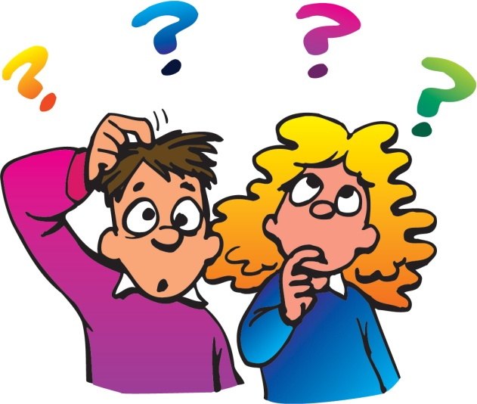
Guess
the
celebrity

Slide 3
Who am I?
I was born on 8th Jan, 1935
I died on 16th Aug, 1977
My hometown is Memphis
My first hit was “Heartbreak Hotel”
My wife’s name is Priscilla
I am the “King of Rock’n’Roll”
Notes:
Answer : Elvis Presley

Slide 4
Who am I?
I was born on 28th Oct, 1967.
My middle name is Fiona.
My company name is Red Om Films. I am one of highest-paid actresses. I starred in many romantic comedies. My husband is Daniel Moder. One of my best films is “Pretty Woman”.
Notes:
Answer: Julia Roberts

Slide 5
Who am I?
I was born on 1st July, 1961.
I died on 31st Aug, 1997.
I had outstanding community spirit. I got married in St. Paul’s Cathedral. I had two sons. I was the Princess of Wales. My husband was Prince Charles.
Notes:
Answer: Princess Diana

Slide 6
Who am I?
I was born on 26th Aug, 1910.
I died on 5th Sept, 1997.
I was given the name: Agnesë Bojaxhiu. I am the founder of Missionaries of Charity.
I was a humanitarian for the poor. I am known as Blessed Teresa of Calcutta.
Notes:
Answer: Mother Teresa

Slide 7
Who am I?
I was born on 16th Aug, 1958
My last name is Ciccone.
My first career was in modern dance.
My first husband is Sean Penn.
One of my hits are “Like a Virgin.”
Notes:
Answer: Madonna

Slide 8
Now your
turn

