Slide 1
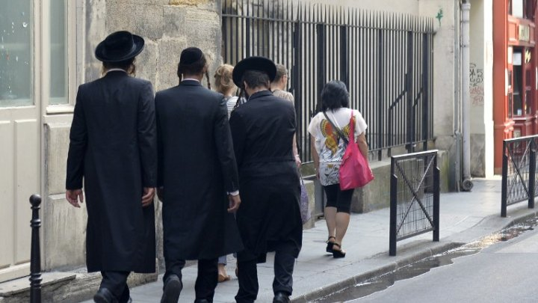
Social media must curb hate speech, says France

Slide 2
France is calling for the international regulation of social networks in order to crack down on “racist and anti-Semitic propaganda,” a senior minister said on Thursday at the UN’s first-ever summit on tackling anti-Semitism.
“There are hate videos [online], calls for death, propaganda that have not been responded to, and we need to respond,” Harlem Désir, France’s State Secretary for European Affairs, told reporters on the sidelines of the General Assembly meeting.
“[Those who propagate] terrorism, religious fanaticism, jihadism and radical Islam use the Internet enormously,” he said." We must limit the dissemination of these messages.”
Désir lambasted social networks for what he described as a failure to take responsibility for “racist or anti-Semitic” content published on their platforms, citing Facebook and Twitter as examples. “We want to be clear with what we have seen – that those networks are used to promote violence, discrimination, and hatred. The answer from these companies has been to say that ‘we are not responsible for what is said’.”
In response, France wants to create a legal framework that would “place the responsibility on those who are passing the message, even if they are not deciding the message,” he said.
Notes:
Anti Semitic - a person who discriminates against or is prejudiced or hostile toward Jews.
the dissemination - spreading widely
Propaganda - information, ideas, or rumors deliberately spread widely to help or harm a person, group, movement, institution, nation, etc.
Fanaticism -

Slide 3
‘Difficult’ issue of freedom of expression
Désir was keen to stress that the proposed law would not target freedom of expression, a principle for which some four million people in France marched in support after the terror attacks, which began on the morning of January 7 with the massacre of “blasphemous” cartoonists at satirical magazine Charlie Hebdo.
“It’s very difficult because we are profoundly attached to the principle of freedom of expression,” he said. “There needs to be a clear distinction between freedom of expression, which is a fundamental right, and the liberty to incite hate, discrimination, and death.”
Comparing hate speech with the dissemination of child pornography, he called for a consensual international effort to curtail it. “This can’t be done country by country,” he said, adding that the European Union member heads of state would address the issue on February 12.
The US Ambassador to the United Nations, Samantha Power, described Désir’s plan as an “interesting proposal” that would require consulting both the general public and the private sector.

Slide 4
Comprehension
1) What is France calling for?
2) Who is Harlem Désir?
3) Why has Désir lambasted social networks?
4) According to Désir which clear distinction is needed?
5) Who is US Ambassador to the United Nations?
6) Name the two social networking sites mentioned here.
Notes:
the international regulation of social networks in order to crack down on “racist and anti-Semitic propaganda
France’s State Secretary for European Affairs
for their failure to take responsibility for “racist or anti-Semitic” content published on their platforms
4) There needs to be a clear distinction between freedom of expression, which is a fundamental right, and the liberty to incite hate, discrimination, and death.”
5) Samantha Power
6) Facebook and tweeter

Slide 5

Vocabulary
1) Anti-Semitic
2) Propaganda
3) Fanaticism
4) Dissemination
5) Satirical
6) Lambaste
Notes:
Anti-Semitic: that shows hatred of Jews or involves the unfair treatment of Jews
Propaganda: ideas or statements that may be false or exaggerated and that are used in order to gain support for a political leader, party, etc.
3) Fanaticism: extreme beliefs or behaviour, especially in connection with religion or politics.
4) Dissemination: the act of spreading information or knowledge so that it reaches many people
5) Satirical: using satire to criticize somebody/something
Satire - a way of criticizing a person, an idea or an institution in which you use humour to show their faults or weaknesses; a piece of writing that uses this type of criticism
6) Lambaste - to attack or criticize somebody/something very severely, especially in public

Slide 6

Conversation
1) Do you agree with Mr. Harlem Désir? Why?
2) What do you think about social networking sites?

Slide 7
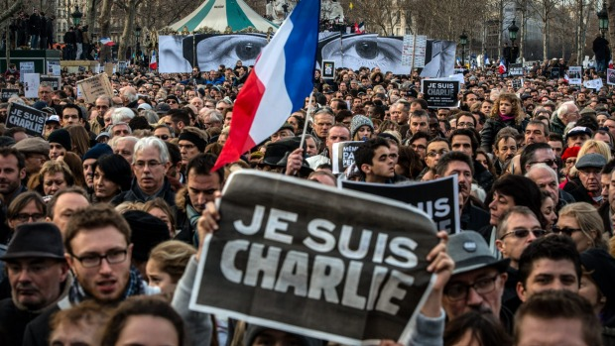
Conversation
1) What is ‘freedom of expression’ according to you?
2) What can be done to curb hate speech?

Slide 8


