Slide 1
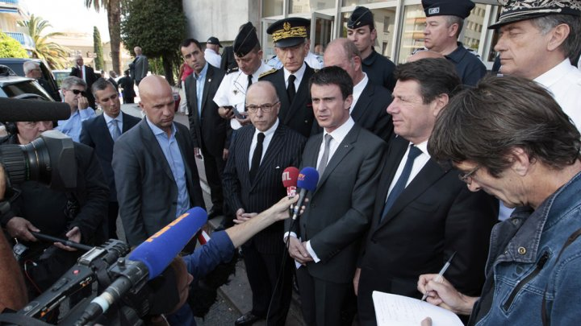
French Protestant church approves move to bless gay couples

Slide 2
News Reading
The United Protestant Church of France, which counts around 250,000 members across the country, adopted the reform during a national synod held in the Mediterranean city of Sète meant to coincide with the International Day Against Homophobia and Transphobia.
Ninety-four representatives of the protestant group voted in favour of the measure, with only three voting against it, a church spokesman told the press on Sunday.
“The synod has decided to go a step forward in supporting those couples by opening the possibility of holding liturgical celebrations when they are requested,” the Church leader Laurent Schlumberger said.

Slide 3
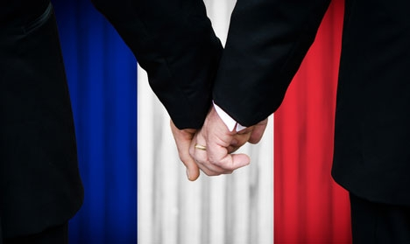
“It’s an option, not an obligation,” Schlumberger noted. “Every pastor and every parish is free to implement this change.”
“The decision was adopted overwhelmingly and calmly, and has allowed us to move forward together, even if different positions within our Church remain on this subject,” he added.
France’s Socialist-led government legalised marriage and adoption by same-sex couples in May 2013, but the reform sparked massive protests which were led, in part, by some of the country’s most prominent Catholic institutions.

Slide 4
Comprehension
1) What is the topic about?
2) How many representatives of the protestant group voted in favour of the measure?
3) How many members across the country, adopted the reform during a national synod held in the Mediterranean city of Sète?
4) Reform sparked massive protests which were led, in part, by some of the country’s most__________________________.

Slide 5
Vocabulary
1) Coincide
2) Homophobia
3) Transphobia.
4) Liturgical
5) Overwhelmingly
Notes:
1)Coincide: to occupy the same place in space, the same point or period in time, orthe same relative position:
2)Homophobia: unreasoning fear of or antipathy toward homosexuals andhomosexuality.
3) Transphobia: unreasoning hostility, aversion, etc., toward transgender people.
4) Liturgical : a form of public worship; ritual.
5) Overwhelmingly: so great as to render resistance or opposition useless

Slide 6
Writing
1) Write 2 lines on this topic.
2) Make sentences on the following:
a) Coincide
b) Liturgical
3) Will this protestation help?

Slide 7
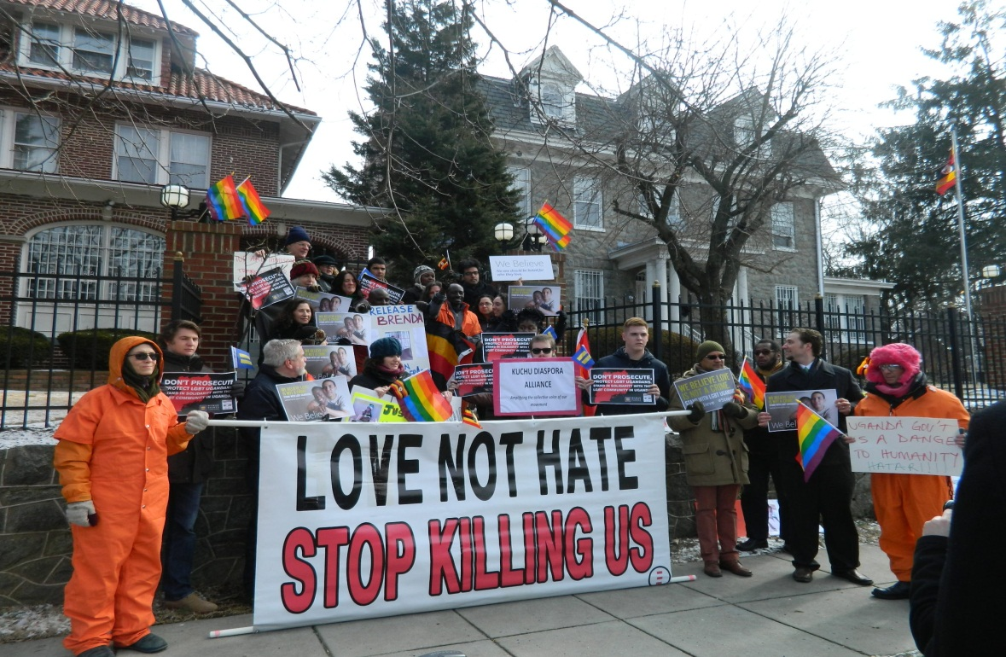
Conversation
1) What is your point of view about this topic?
2) Are you against this topic? If no, why/if yes, why?
3) How will you conclude this topic?

