Slide 1
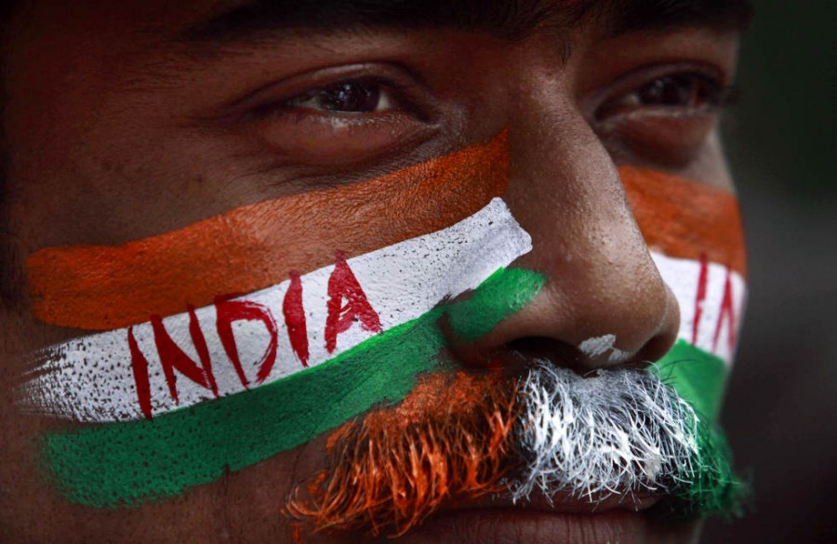
Quiz on India

Slide 2
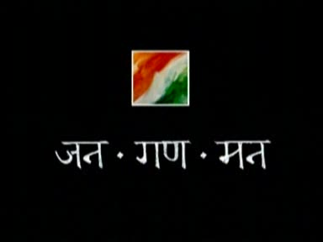
Indian National Anthem
THE INDIAN NATIONAL ANTHEM was originally composed in Bengali by Rabindranath Tagore,Nobel Prize Winner poet, was adopted in its Hindi version as the National Anthem of country on 24 January 1950.But It was 1st sung much earlier, it was sung on 27th December 1911 at the Kolkata session of the Indian National Congress (INC). The complete song consists of 5 stanzas. Playing time of the National Anthem is about 52 seconds.

Slide 3
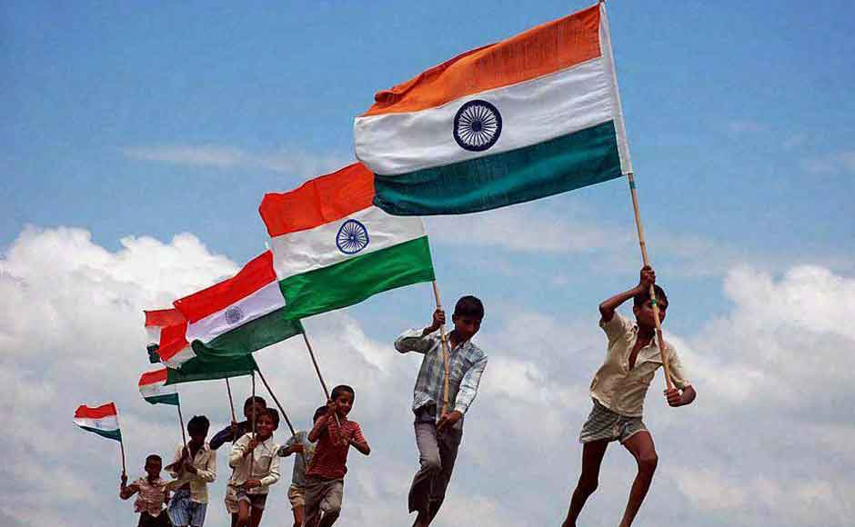
Indian National Flag
INDIAN NATIONAL FLAG was designed as a symbol of freedom. The flag is a horizontal tricolor. It has deep saffron color on the top, white in the middle and dark green at the bottom. Hence it is also called as 'Tiranga'. The saffron color stands for courage, sacrifice, white stands, for purity & truth whereas green stands, for faith and fertility. In the center of the white band, there is the wheel of law. The design of the National Flag of India was adopted constituent assembly of India on 22nd July,1947.On 26th January 2002, the flag code was changed. After 52 years, the citizens of India are free to fly the Indian flag over their homes, offices and factories on any day.

Slide 4
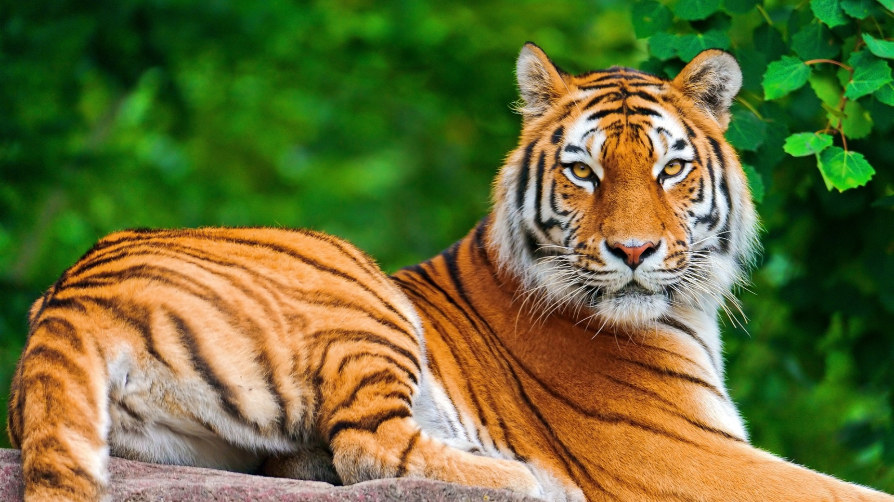
Indian National Animal
THE TIGER is the national animal of India. Tigers are now getting extinct. The Government of India, in 1973,started 'Project Tiger 'program, in an effort to save and increase the tiger population.

Slide 5
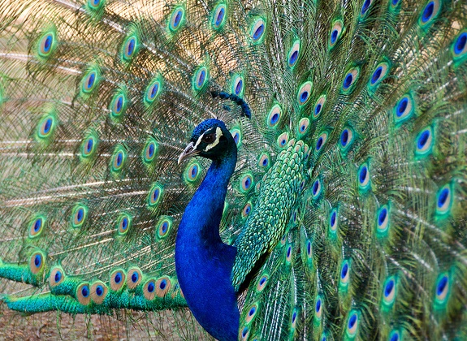
Indian National Bird
THE PEACOCK is the national bird of India. It is protected under the Indian Wildlife (Protection) Act, 1972 i.e. hunting and killing is strictly prohibited. In India, people believe that whenever the peacock spread its feathers , it indicates that rain is about to come. In a way it is partly true also. Whenever it sees dark clouds ,it outspreads its feathers & starts dancing .

Slide 6
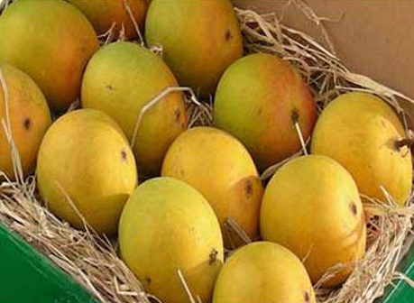
Indian National Fruit
THE MANGO ( Aim in Hindi) is the national fruit of India. There are many varieties of mangoes which are grown in India .

Slide 7
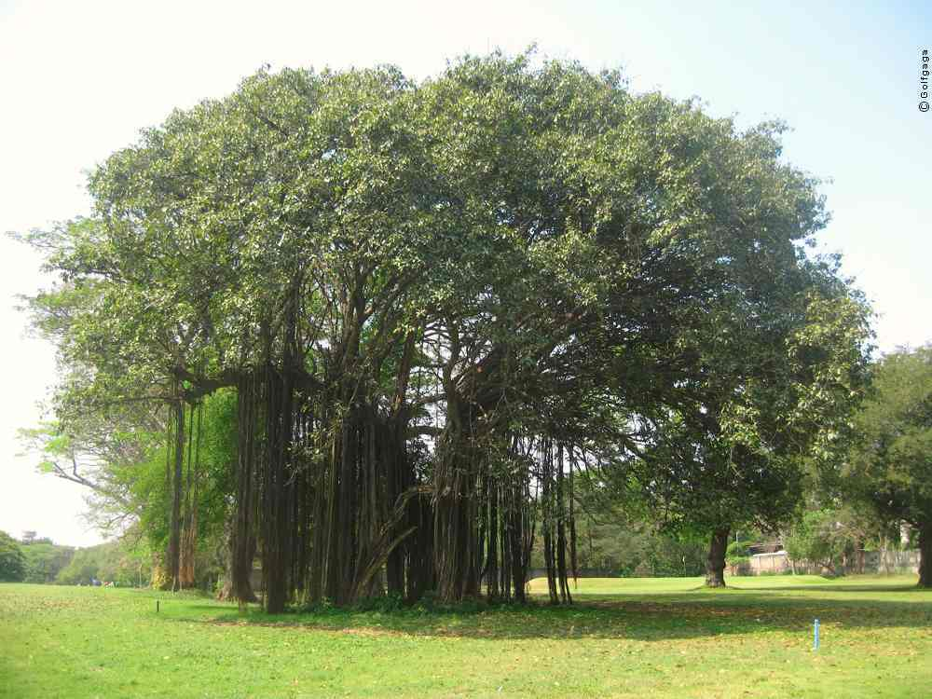
Indian National Tree
THE BANYAN ( Barged बरगद in Hindi) is the National tree of India .Its is considered very sacred and many of the people worship Barged tree .

Slide 8
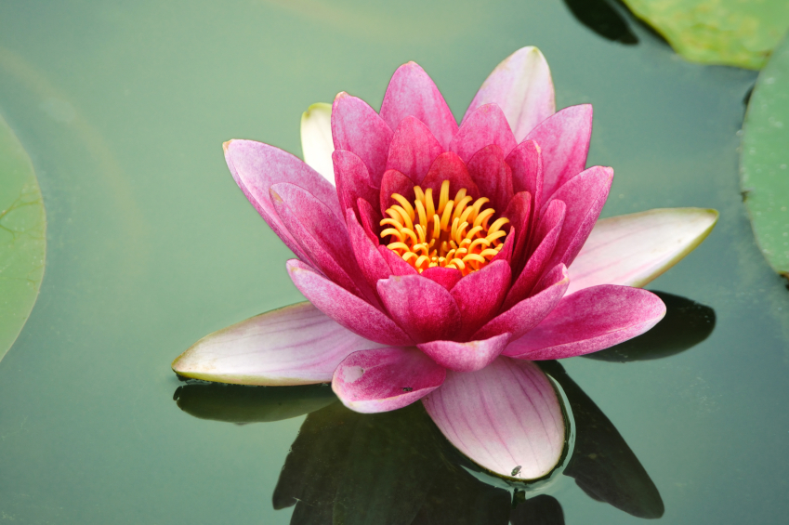
Indian National Flower
LOTUS (कमल in Hindi) is the National Flower of India. It grows in shallow waters. The leaves and flowers float in the water .

Slide 9

Indian National Sport
HOCKEY is the National sport of India .

Slide 10
Indian National Song
VANDĒ MĀTARAM is the national song of India. It was written by Bankim Chandra Chatterjee in a highly Sanskritized form of the Bengali language. It appeared in his book 'Anandamatha' which was published in 1882 although the song itself was actually written 6 years prior in 1876.
“ वन्दे मातरं वन्दे मातरम् सुजलां सुफलां मलयज शीतलाम् शश्य श्यामलां मातरं वन्दे मातरम्. सुब्रज्योत्स्ना पुलकित यामिनीम् पुल्ल कुसुमित द्रुमदल शोभिनीम् सुहासिनीं सुमधुर भाषिनीम् सुखदां वरदां मातरं वन्दे मातरम्..”

Slide 11
1. Who has written National Anthem of India?
Rabindera Nath Tagore
Bankim Chnadra
Gulzar
Jawahar Lal Nehru
2. Which flower grows in water and is also National Flower of India?
Apple
Mango
Lotus
Rose

Slide 12
3. Which is the National Anthem of India?
Jan Gan Man
Vande Matram
Jai Jawan ,Jai Kisan
Dhinkachika
4. Which is national bird of India?
Lion
Sparrow
Crow
Peacock

Slide 13
5. Which tree is worshiped and is also national tree of India?
Apple
Lotus
Mango
Banyan
6. Which is national fruit of India?
Apple
Lotus
Orange
Mango

Slide 14
7. Which color of Indian National flag indicates peace?
White
Blue
Yellow
Green
8. Which is Indian National Sport?
Hide and Seek
Cricket
Hockey
Kabbaddi

Slide 15
9. Which is National Song of The Country?
Jan Gan Man
Vande Matram
Jai Jawan ,Jai Kisan
Dhinkachika
10. Name the National animal of India.
Lion
Giraffe
Elephant
Tiger

