Slide 1
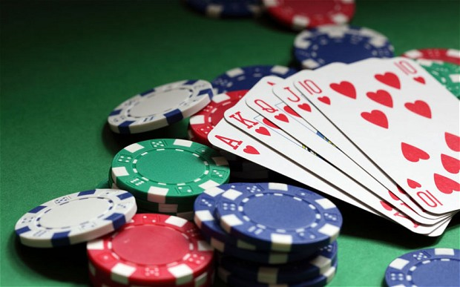
 | GAMBLING

Slide 2
Vocabulary
Wagering-an arrangement to risk money on the result of a particular event.
Stakes-money that somebody invests in a company.
Compulsive-difficult to stop or control.
Consequence-a result of something that has happened.
Isolation-the act of separating somebody/something; the state of being separate.
Burnout-the state of being extremely tired or ill, either physically or mentally.
Abuse-the use of something in a way that is wrong or harmful.

Slide 3
What is Gambling?
Gambling is the wagering of money or something of material value (referred to as "the stakes") on an event with an uncertain outcome with the primary intent of winning additional money and/or material goods. Gambling thus requires three elements be Gambling is also a major international commercial activity, with the legal gambling market totaling an estimated $335 billion in 2009.present: consideration, chance and prize.
Origins
Bag with 65 Inlaid Gambling Sticks, Tsimshian (Native American), 19th century, Brooklyn Museum
Many popular games played in modern casinos originate from Europe and China. Games such as craps, roulette, and blackjack originate from different areas of Europe. A version of keno, an ancient Chinese lottery game, is played in casinos around the world. In addition, pai gow poker a hybrid between and poker is also played.

Slide 4
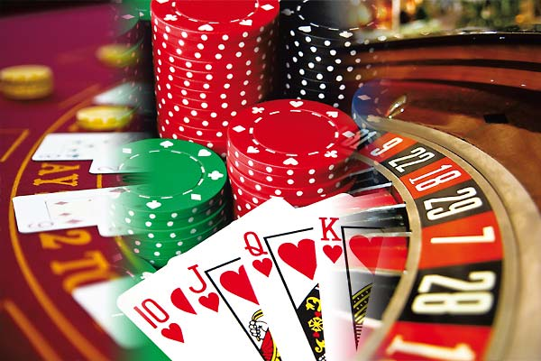
Types of Gambling?
Casino games

Slide 5
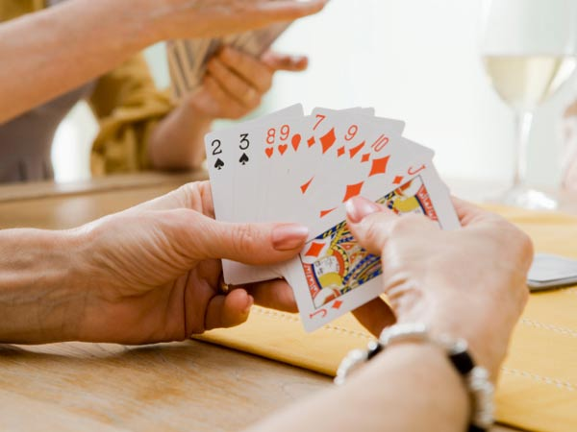
Card Gambling

Slide 6
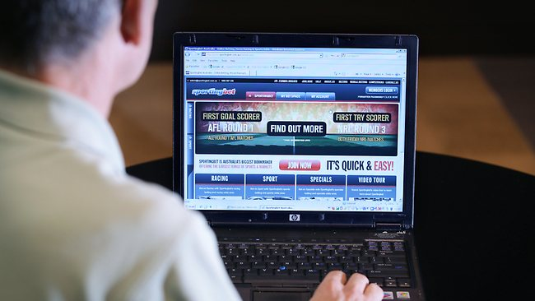
Online Gambling

Slide 7
Gambling Addiction
Gambling addiction, also known as compulsive gambling, is a type of impulse-control disorder. Compulsive gamblers can’t control the impulse to gamble, even when they know their gambling is hurting themselves or their loved ones. Gambling is all they can think about and all they want to do, no matter the consequences. Compulsive gamblers keep gambling whether they’re up or down, broke or flush, happy or depressed. Even when they know the odds are against them, even when they can’t afford to lose, people with a gambling addiction can’t “stay off the bet.”
Gamblers can have a problem, however, without being totally out of control. Problem gambling is any gambling behavior that disrupts your life. If you’re preoccupied with gambling, spending more and more time and money on it, chasing losses, or gambling despite serious consequences, you have a gambling problem.

Slide 8
Impact of Gambling
Money problems: When family members learn that savings, property or belongings have been lost, it can make them feel scared, angry and betrayed.
Emotional problems and isolation: Gambling problems cause strong feelings among family members, which make it harder to solve problems. Many partners of those with gambling problems do not want to be emotionally or physically close with the person who has hurt them. Family members may avoid other people, because they feel ashamed. This makes it hard to get love and support.
Physical and mental health: The stress of gambling problems sometimes causes health problems, for both the person who gambles and the family. This can include anxiety, depression and stress-related problems such as poor sleep, ulcers, bowel problems, headaches and muscle pains.
Burnout: Many families under stress have trouble coping. One member may try to keep things in control by taking on more tasks. This can lead to burnout. Family members often forget to take care of themselves or to have fun.
Physical and emotional abuse: Family violence is more common when families are in crisis. Gambling problems can lead to physical or emotional abuse of a partner, elder parent or child. If this is happening in your family, get help right away

Slide 9
Conversation
1. Give your views on Gambling?
2. Have you gambled anytime?
3. Should gambling be legalised?
4. Will you indulge in gambling?
Notes:
HOME – ASSIGNMENT
1)Give synonym : crisis
2) Give antonym : love
3) Give meaning :
a)wagering b)stake c)compulsive d)consequence
4) Make a sentence using below word :
a)indulge b)give c)avoid

Slide 10
Reviewed By | Reviewed On | Comments / Changes Made
Kumar | 09.09.2015 | None

