Slide 1
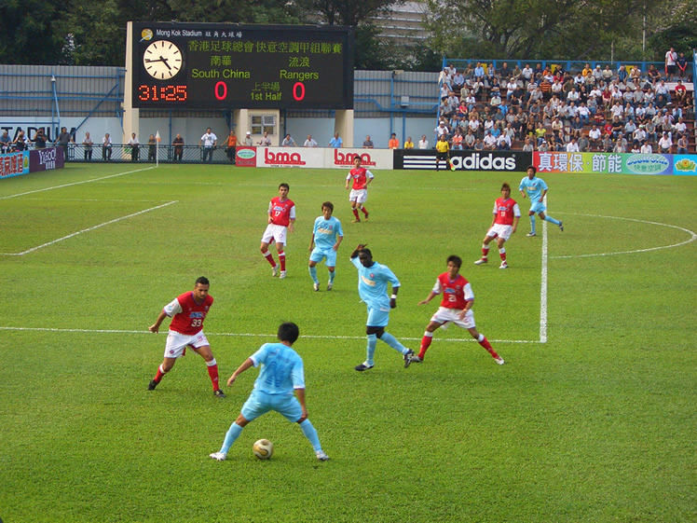
SOCCER

Slide 2
Game
A Form of football played between two teams of 11 players, in which the ball may be advanced by kicking or by bouncing it off any part of the body but the arms and hands, except in the case of the goalkeepers, who may use their hands to catch, carry , throw , or stop the ball. It is one of the most popular sport in the world.
Notes:
Form: In this context ( A version of football, or a type of football )
Advanced: placed ahead or forward.

Slide 3
Requirements to play soccer
Field : is the playing surface for the game of football made of turf.
Stadium: is designed to host soccer matches.
Venue: is the county or place where the match is taking place.
Fixture: Which teams are going to play each other.
Players: There are 11 players on the field and 3 substitutes are allowed
Ball: Round shaped.
Goal posts: is often a rectangular structure that is placed at each end of the playing surface. Each structure usually consists of two vertical posts.
Referees: the referees (2) are responsible for enforcing the Laws of the Game during the match.
Manager: a manager is responsible for running a football club or a national team.

Slide 4
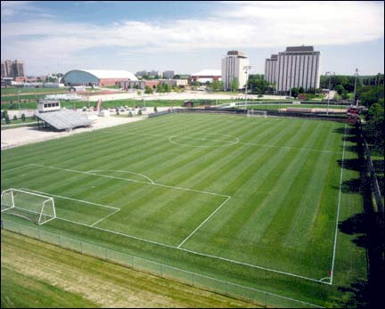
Field- Soccer is played on a field

Slide 5

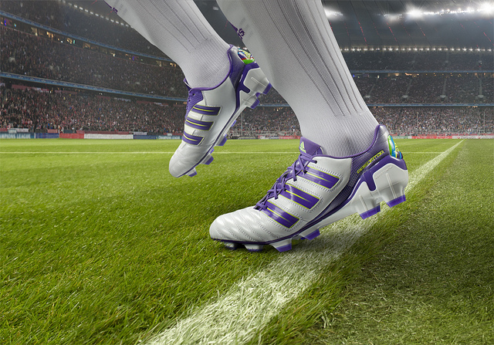
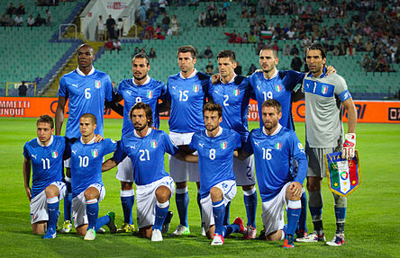
Soccer kit
Ball
Shoes
Jersey

Slide 6
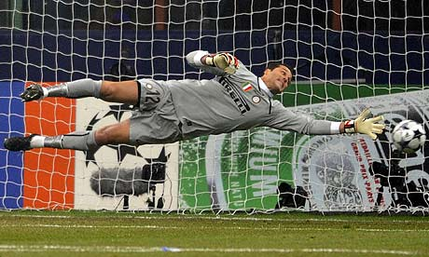
Goalkeeper
Goalkeeper, often shortened to keeper or goalie, is one of the major positions of football. It is the most specialized position in the sport. His job is to prevent goals by stopping the opposition to kick or head into the net between the goal post.

Slide 7
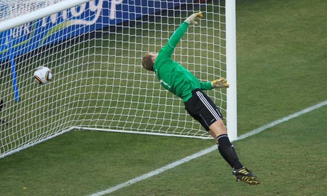
Goal
Goal refers to a method of scoring in soccer. A goal is the sole method of scoring, and thus the final score is expressed in the total number of goals scored by each team. Each and every goal is cheered by the crowd.

Slide 8
FIFA
International Federation of Association Football.
FIFA is responsible for the organization of football's major international tournaments, notably the World Cup which commenced in 1930 and the Women's World Cup which commenced in 1991.
Notes:
Notably: most importantly
Commenced: started

Slide 9
Major Soccer competitions
FIFA world cup ( Held every four years ).
Euro cup ( Held every four years )
Champions league ( an annual European competition for football clubs )
FA cup (The Football Association Challenge Cup, known worldwide as the FA Cup, is an annual knockout cup competition in English football; it is the oldest association football competition in the world )

Slide 10
Major Football Leagues around the world
England: EPL ( English premier league )
France: France Ligue 1
Germany: Bundesliga
Italy: Serie A
Spain: La liga

Slide 11
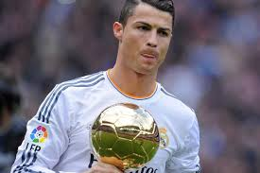
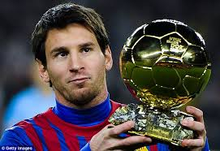
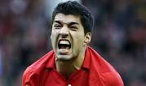
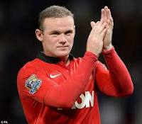
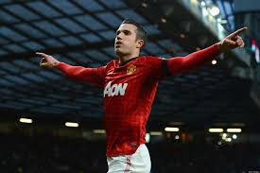
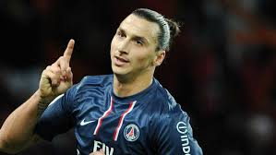
Famous Footballers
Christiano Ronaldo
Lionel Messi
Luis Suárez
Wayne Rooney
Robin van persie
Zlatan Ibrahimovic

Slide 12
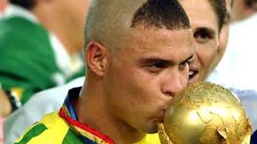
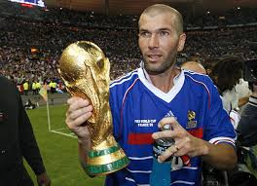
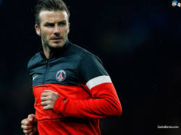
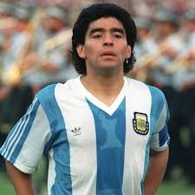
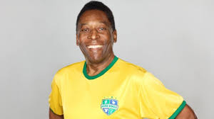
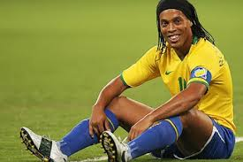
Legends of the game
Ronaldo
Zinedine Zidane
David Beckham
Maradona
Pele
Ronaldinho
Notes:
HOME – ASSIGNMENT
1)Give synonym : popular
2) Give antonym : old
3) Give meaning :
a)Venue b)Stadium c)Field d)Players
4) Make a sentence using below word :
a)commence b)play c)throw

Slide 13
Reviewed By | Reviewed On | Comments / Changes Made
Kumar | 09.09.2015 | None

