Slide 1
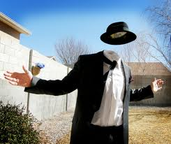
Strange things around the world

Slide 2

This supersonic jet prototype uses external cameras and displays instead of windows.

Slide 3
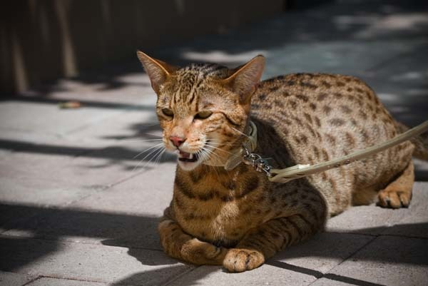
This cat breed, the Ashera, can be sold for millions of dollars

Slide 4
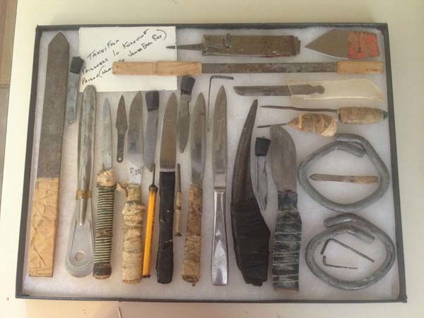
This is a collection of confiscated prison shanks.

Slide 5
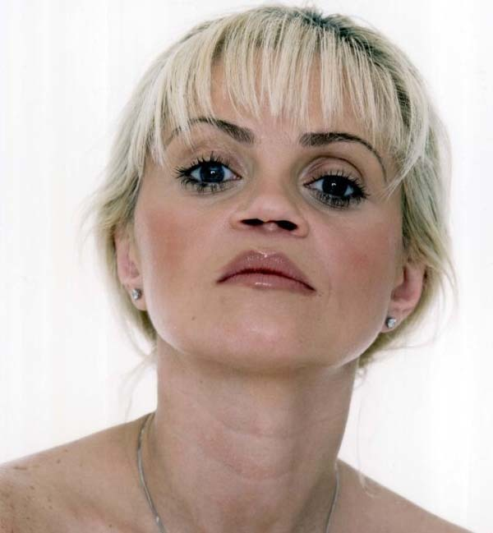
Daniella Westbrook, an English actress, and her nose after 10 years of cocaine abuse.

Slide 6
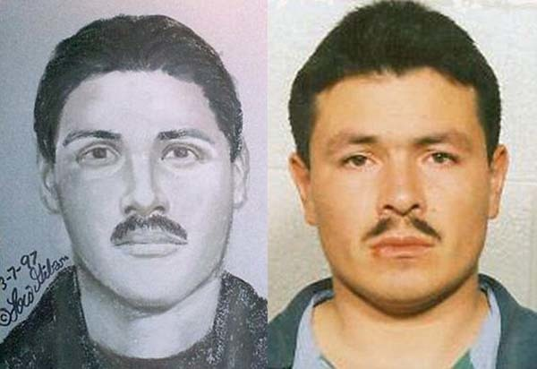
Lois Gibson has worked as a police sketch artist for 34 years. She has helped solved over 1,000 cases, earning her a spot in the Guinness Book of World Records.

Slide 7
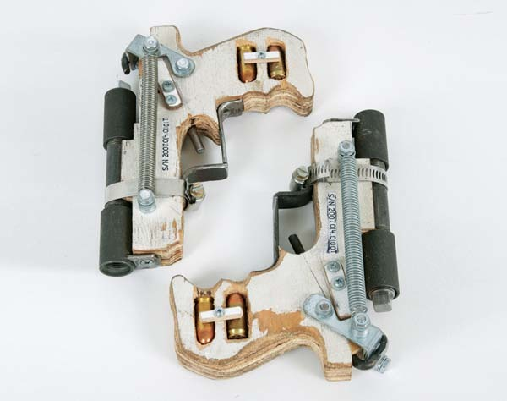
These are two, fully functional guns made in prison from random objects.

Slide 8
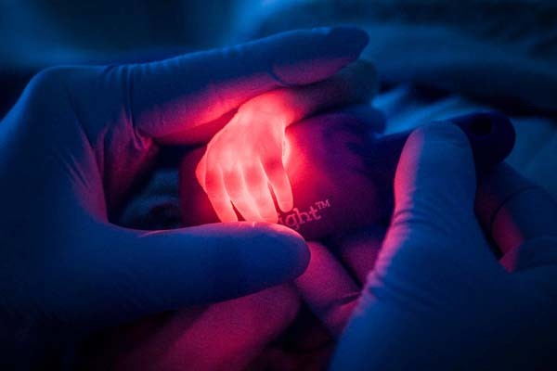
A nurse attempts to find a vein in a premature baby's hand.

Slide 9
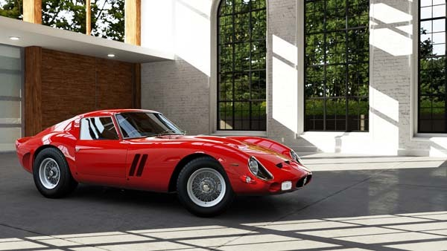
This car? It's a 1969 Ferrari 250 GTO... and it costs $35,000,000.

Slide 10
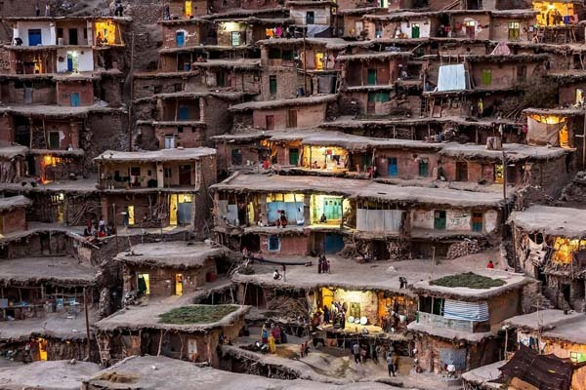
People go about their day, living in a mountain village in Iran.

Slide 11
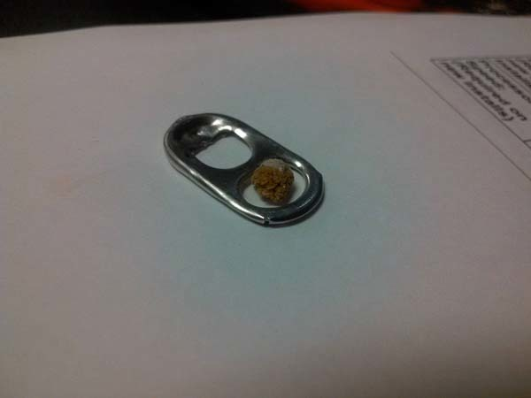
This kidney stone passed through a man's urinary tract.

