Slide 1
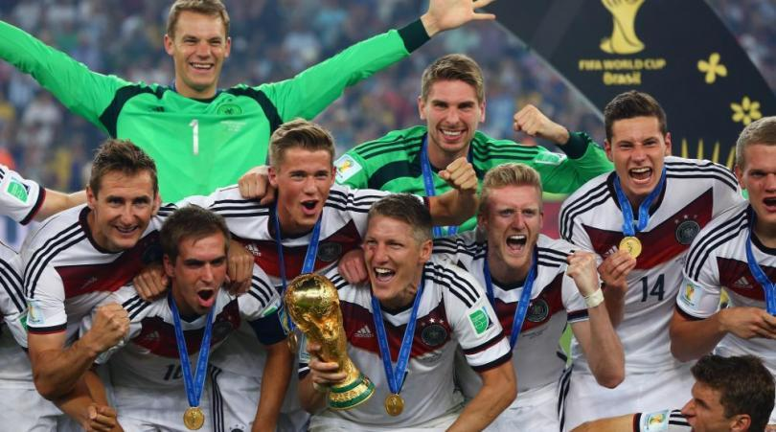
Germany Win World Cup Brasil 2014 - 2014 FIFA World Cup Trophy is UP! (13/07/2014)
Germany capped an eventful 2014 World Cup with a nail-biting 1-0 victory against Argentina to bag its fourth tournament title.
After 32 days of competition and 64 matches, the 2014 World Cup finally came to a close with Germany’s victory over Argentina in extra time at Brazil’s Maracana stadium.

Slide 2
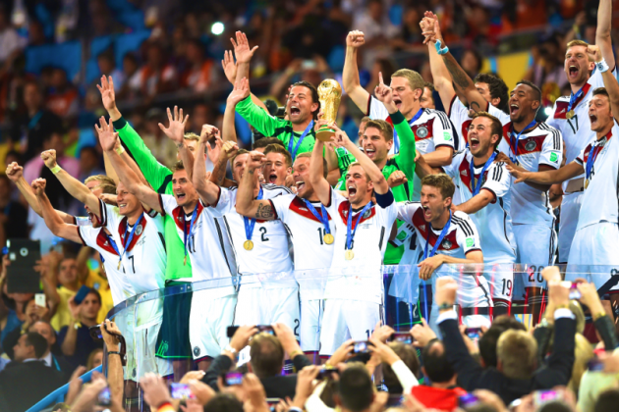
Substitute Mario Gotze scored in the 113th minute to propel Germany to their fourth FIFA World Cup title with a 1-0 victory over Argentina on Sunday at the Estadio do Maracana in Rio de Janeiro.

Slide 3
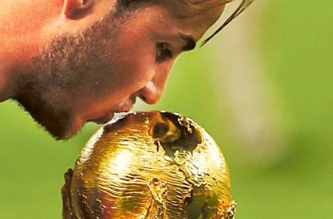
Germany’s Mario Goetze kisses the World Cup trophy as he celebrates their 2014 World Cup final win against Argentina at the Maracana stadium in Rio de Janeiro July 13, 2014.

Slide 4
Uruguay star striker Luis Suarez is under investigation by FIFA after he allegedly bit an Italian opponent towards the end of a match on Tuesday that saw Italy eliminated from the World Cup.
The “bite” took place in the Italian penalty area ten minutes before the end of the match. Immediately afterwards, Suarez seemed to fall on the ground, apparently feigning injury.
Suarez’s “victim” Giorgio Chiellini then furiously opened his shirt to show the referee where he claimed he was bitten.
No penalty was given to Italy, whose team were still complaining about the incident when Uruguay’s Diego Godin scored with an 81st-minute header to secure their 1-0 victory.

Slide 5
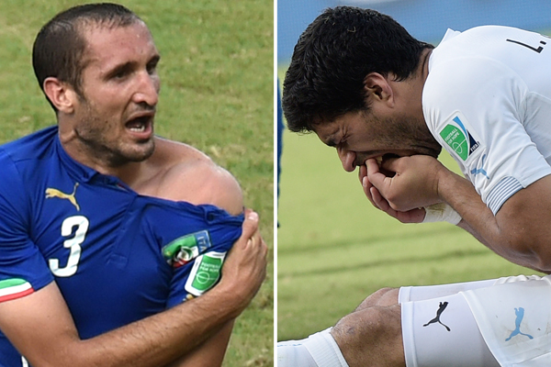
Luis Suarez’ World Cup dream ended with a four-month plus a nine match international ban after the Uruguan striker bit Italy’s Giorgio Chiellini. It was the third such attack by Suarez in less than four years.

Slide 6
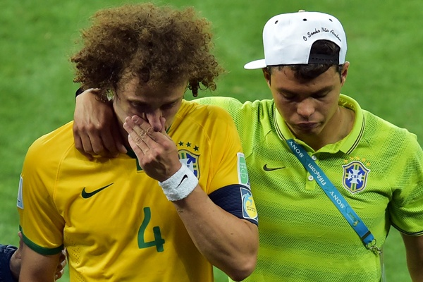
Humiliation and despair for Brazil’s David Luiz and Thiago Silva as the 2014 World Cup host nation gets swept out of the tournament with an embarrassing 7-1 semi-final defeat against Germany.

Slide 7
9 Unbelievable Facts About World Cup Players:
From Pelé to Klose, all editions of the World Cup have had some memorable players.
Here are 9 astounding facts about footballers who made the 2014 World Cup worth watching:
1.Faryd Mondragón Will (Likely) Be the Oldest Player in World Cup History, turning 43 on June 21st. 2014
2,Memphis Depay was a rising star for the Netherlands squad- he's quick, clever and has a powerful foot.
He also nearly became a rapper! At a certain point his manager, Fred Rutten, made him choose between rapping and football for a career.
3.Cameroon's Fabrice Olinga, at 18 years old was the youngest player at Brazil 2014.
4.With 14 World Cup goals already in his kit pocket, Klose was the most prolific player heading into this year's tourney.

Slide 8
5,Klose could also become the third player to score in four editions of the World Cup. Currently, Pelé and Seeler are the two players who have ever scored goals in four editions of the World Cup. Both set this record in the editions from 1958-1970
6,Reza Ghoochannejhad, the wildly talented Iranian striker who goes by Gucci, aspires to play the violin in a philharmonic orchestra when he retires from football. He has played the instrument since he was a child.
7.Lovren is a 24-year-old Croatian defender who would probably design the most stylish kit for his team if given the opportunity. He started his own fashion line, called Russell Brown, that is created, designed, and produced in Croatia.
8.The rise of Ghana's star, Albert Adomah ,his ascent from an amateur club to being sponsored by John Motson at Barnet to being selected for the Ghana squad for the World Cup.
9. Fabian Schär has an aptitude for numbers. The FC Basel-bred defender is a talented player appearing in this World Cup who is also a banker.
Notes:
HOME – ASSIGNMENT
1)Give synonym : Capped
2) Give antonym : Eliminated
3) Give meaning :
Penalty b) claimed c) embarrassing d) Defender
4) Make a sentence using below word :
a) Furiously b) victory c) opportunity

Slide 9
Reviewed By | Reviewed On | Comments / Changes Made
Vidyesh | 10.09.2015 | N.A

