Slide 1

PHOTO QUESTIONS
LISTENING COMPREHENSION
Photo Questions Exercise No.4 of 1 to 10

Slide 2
Description :
In this Listening test, you will be asked to demonstrate how well you understand spoken English.
The entire Listening test will last approximately 45 minutes. There are four parts, and directions are given for each part. You must mark your answers on the separate answer sheet. Do not write your answers in your test book.

Slide 3
Directions:
In the ‘ Toeic Photo Questions Listening Test ’ will hear four Statements or Questions about the Photograph.
These Statements / Questions will not be printed in your test book and will be spoken only once / one time only .
You will be required to ‘Select the Best Response to the Question or Statement and “tick mark” the letter (A), (B), (C) or (D) on your answer sheet.
Mark your answer on your answer sheet.

Slide 4


Notes:
(A) The man is waving his fists.
(B) The three people are sitting at a square table.
(C) There are two cups of coffee on the table.
(D) Only one woman is using the laptop.

Slide 5
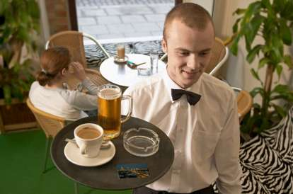
Notes:
(A) The waiter is wearing a black bow tie.
(B) The waiter is carrying a tray in his left hand.
(C) There are four items on the tray.
(D) You can see two customers sitting at the table.

Slide 6
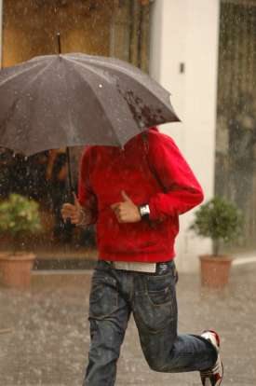
Notes:
(A) You can clearly see the man's face.
(B) The umbrella is red.
(C) The man is wearing a watch on his left wrist.
(D) The man is strolling down the street.

Slide 7
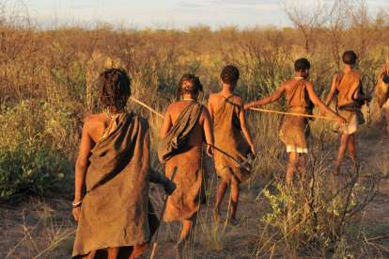
Notes:
(A) All the walkers are dressed in black.
(B) All the walkers are carrying sticks.
(C) The sun is shining down on the walkers.
(D) The walker at the back is running

Slide 8
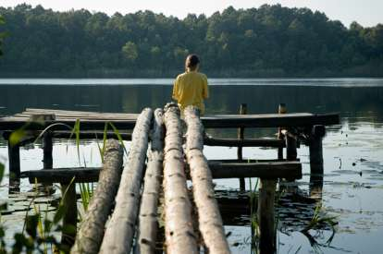
Notes:
(A) The person in the picture is standing up.
(B) The person is wearing a blue top.
(C) There are four logs in the picture.
(D) There are five logs in the picture.

Slide 9
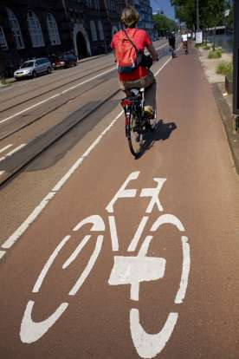
Notes:
(A) You can see the white outline of a motorbike.
(B) You can only see one cyclist.
(C) The cyclist nearest the camera is wearing a red top.
(D) The cyclist nearest the camera is driving on the left of the road.

Slide 10
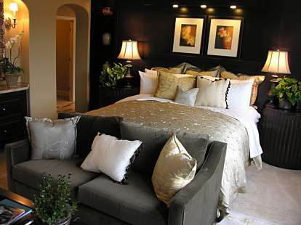
Notes:
(A) There are four cushions on the sofa.
(B) The bedside lights have been switched off.
(C) You can see a single bed.
(D) There are two pictures above the bed.

Slide 11
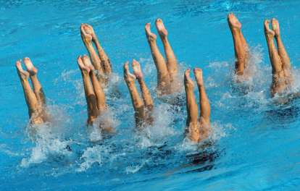
Notes:
(A) You can see eight pairs of legs.
(B) Some of the swimmers are wearing shoes.
(C) One of the swimmers has her knees bent.
(D) There are no splashes of water to be seen

Slide 12
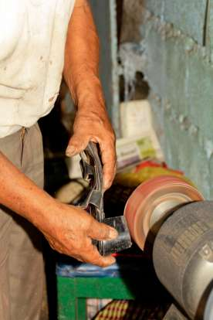
Notes:
(A) The worker is wearing a watch.
(B) The worker is a young teenager.
(C) The man is cutting a piece of steel.
(D) The man is using both hands.

Slide 13
End of Photo Questions Exercise No.4
of
1 to 10
Thank you !

