Slide 1

PHOTO QUESTIONS
LISTENING COMPREHENSION
Photo Questions Exercise No.9 of ‘1 to 10’

Slide 2
Description :
In this Listening test, you will be asked to demonstrate how well you understand spoken English.
The entire Listening test will last approximately 45 minutes. There are four parts, and directions are given for each part. You must mark your answers on the separate answer sheet. Do not write your answers in your test book.

Slide 3
Directions:
In the ‘ Toeic Photo Questions Listening Test ’ will hear four Statements or Questions about the Photograph.
These Statements / Questions will not be printed in your test book and will be spoken only once / one time only .
You will be required to ‘Select the Best Response to the Question or Statement and “tick mark” the letter (A), (B), (C) or (D) on your answer sheet.
Mark your answer on your answer sheet.

Slide 4

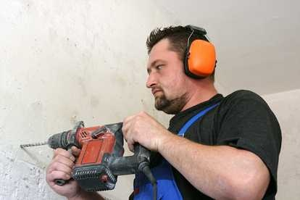
Notes:
Drilling
The man is wearing an orange hat.
He is only using one hand.
He is using both hands. -- CORRECT
He has a grey beard.

Slide 5
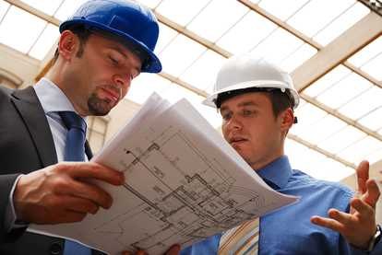
Notes:
Looking at the building plans
The men are reading a newspaper.
Both men are wearing soft hats.
Both men have beards.
The men are looking at some building plans. -- CORRECT

Slide 6
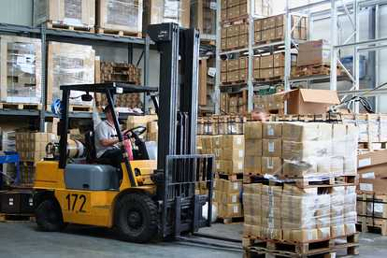
Notes:
At the packing station
The man is driving a small car.
The man is operating a forklift truck. -- CORRECT
You can see six levels of shelving.
There are five numbers visible in the picture.

Slide 7
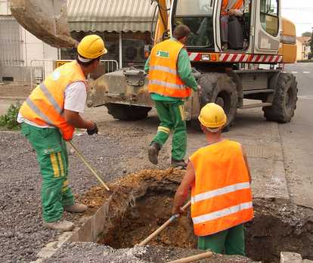
Notes:
Roadworks
Three men are wearing green trousers. -- CORRECT
One man is kneeling on the ground.
All the men are wearing hard hats.
The men are all facing the camera.

Slide 8
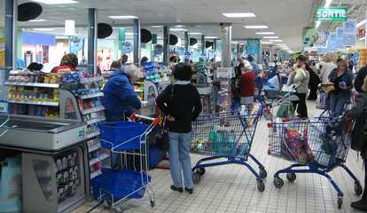
Notes:
The checkout
The shoppers are pulling their trolleys.
The shoppers are waiting in queues. -- CORRECT
The exit sign is in green letters.
The exit sign tells you where you can enter.

Slide 9
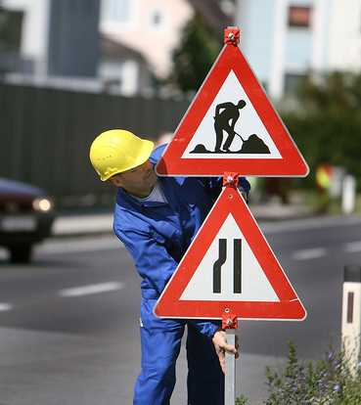
Notes:
Traffic signs
The man is fixing a pole with two square signs on it.
One sign warns you about a school.
One sign tells you about the speed limit.
The man is fixing a pole with two triangular signs on it. -- CORRECT

Slide 10
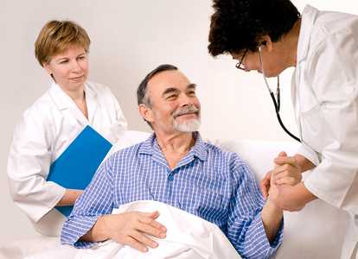
Notes:
At the hospital
The patient is looking happy. -- CORRECT
The patient is wearing a plain blue pyjama top.
One doctor is holding both the patient's hands.
The woman on the left is holding a green folder.

Slide 11

Notes:
The laptop on the round table
The man is waving his fists.
The three people are sitting at a square table.
There are two cups of coffee on the table.
Only one woman is using the laptop. -- CORRECT

Slide 12
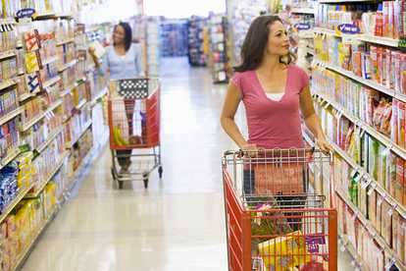
Notes:
Two women with their trolleys
There are two women shopping in the picture. -- CORRECT
Both women are wearing pink tops.
Both trolleys are full to the brim.
The sides of the trolleys are bright yellow.

Slide 13
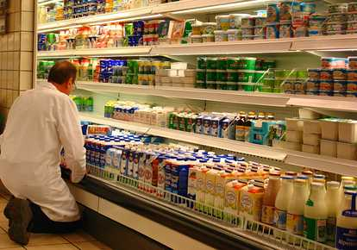
Notes:
The cold cabinet
The man is kneeling in front of the cabinet. -- CORRECT
The cabinet contains packets of cereal.
The man in the white coat is bald.
You can see six separate shelves.

Slide 14
End of Photo Questions Exercise No.9
of
1 to 10
Thank you !

