Slide 1

PHOTO QUESTIONS
LISTENING COMPREHENSION
Photo Questions Exercise No.7 of ‘1 to 10’

Slide 2
Description :
In this Listening test, you will be asked to demonstrate how well you understand spoken English.
The entire Listening test will last approximately 45 minutes. There are four parts, and directions are given for each part. You must mark your answers on the separate answer sheet. Do not write your answers in your test book.

Slide 3
Directions:
In the ‘ Toeic Photo Questions Listening Test ’ will hear four Statements or Questions about the Photograph.
These Statements / Questions will not be printed in your test book and will be spoken only once / one time only .
You will be required to ‘Select the Best Response to the Question or Statement and “tick mark” the letter (A), (B), (C) or (D) on your answer sheet.
Mark your answer on your answer sheet.

Slide 4


Notes:
All the workers are standing upright.
You can see a crane at the top of the picture. -- CORRECT
Some of the workers are smoking.
You can see ten workers in total.

Slide 5
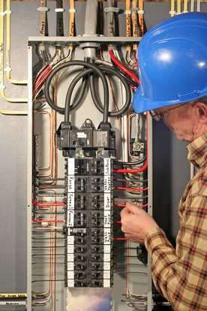
Notes:
The man is holding a black wire in his hand.
The man is holding a red lead in his hand. -- CORRECT
The man is checking the lead with his right hand.
The man is wearing a plain yellow shirt.

Slide 6
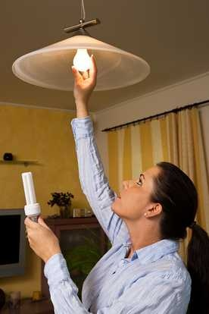
Notes:
She is holding an energy saving bulb in her right hand.
She is holding an energy saving bulb in her left hand. -- CORRECT
She is touching a lamp that has been switched off.
She is looking down at the floor.

Slide 7
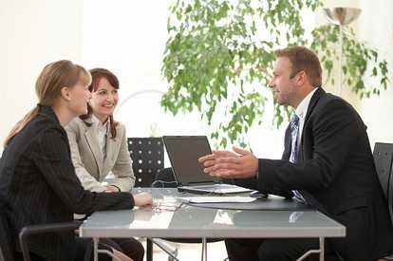
Notes:
Both women are dressed the same.
The man is clapping his hands.
The laptop on the table is open. -- CORRECT
The table top is coloured green.

Slide 8
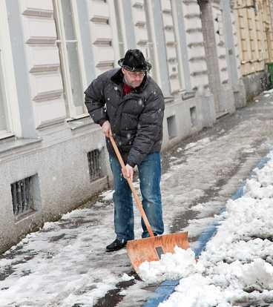
Notes:
The man isn't wearing a hat.
It is still snowing.
The man is wearing gloves.
The man is scraping the snow away from him. -- CORRECT

Slide 9
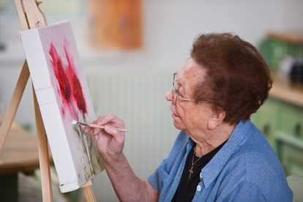
Notes:
The main colour on the canvas is blue.
The colour on the artist's brush is white. -- CORRECT
The artist is wearing dark glasses.
The canvas is placed at a right angle.

Slide 10
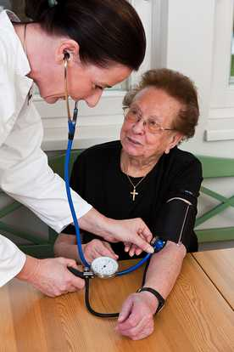
Notes:
The doctor is listening to some music.
The patient is wearing a small silver cross. -- CORRECT
The doctor is checking pressure in the patient's right arm.
The patient is about to burst into tears.

Slide 11
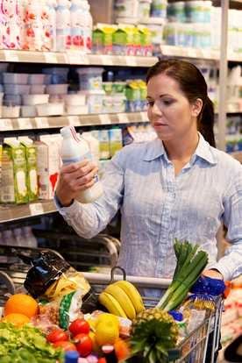
Notes:
There are dozens of bananas in the shopper's trolley.
The trolley is full of chocolates and cakes.
The shopper is dressed in black.
The shopper is checking something on the plastic bottle. -- CORRECT

Slide 12
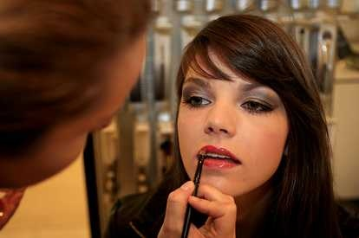
Notes:
The woman is cleaning her teeth.
The woman is applying lipstick. -- CORRECT
The woman is applying eye shadow.
The mirror is behind the woman.

Slide 13

Notes:
The woman on the right has just written something on a flip chart. -- CORRECT
The woman on the right is holding a blue felt tip pen.
The woman on the left has both hands on the laptop keyboard.
Both women are wearing yellow tops.

Slide 14
End of Photo Questions Exercise No.7
of
1 to 10

