Slide 1
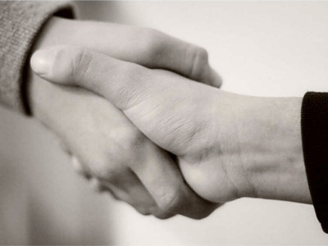
Greeting Someone

Slide 2
Useful phrases to greet some one
Hello! Hi! How are you?
Good morning! / Good Afternoon! / Good Evening!
Good / Nice to see you again.
I’m glad / I’m happy / I’m pleased to see you.
Its been ages that I haven’t see you!
Its been a while since I saw you last!
What have you been up to?
How are things?

Slide 3
Useful phrases to introduce yourself
Let me introduce myself, I am Sia Horan.
I am in charge of sales at Blue Top.

Slide 4
Introducing some one else
Can/ May I introduce a good friend of mine? This is … .
Have you met … ?
I’d like you to meet … .
I want you to meet … .

Slide 5
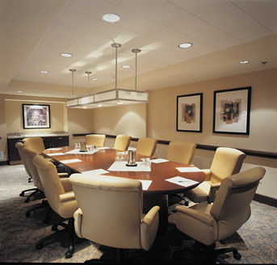
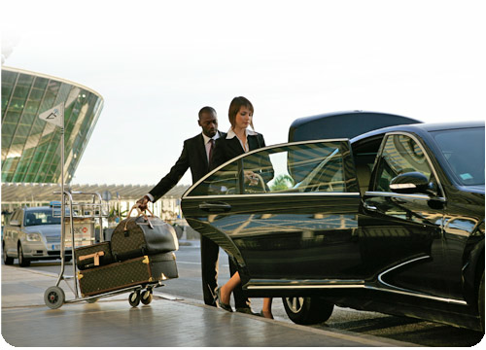
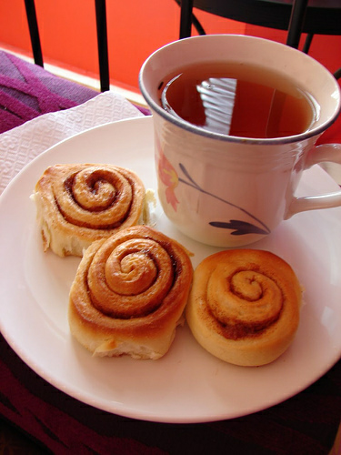
Before the meeting with the clients
Keeping the conference room ready.
Arranging transfer facilities for the client.
Arranging snacks, tea and coffee.

Slide 6
Useful phrases to welcome your guests
How do you do?
Pleased to meet you.
It’s a pleasure to meet you.
How are you? How you doing?
Very Well! Thank you.
I don’t think we have met.
Please have a seat.
Thanks for agreeing to meet me.

Slide 7
Can I offer you something to drink?
Can I take your coat?
Useful phrases to welcome your guests

Slide 8
Making contact
Excuse me, are you Mrs. … ?
Yes, that’s right.
Hello, you must be Mrs. … .
You are Mr. …, aren’t you?
Have we met?
How do you do?
I am fine and how about you?
Nice to meet you. - Nice to meet you, too.
Please, call me … . - Then you must call me … .

Slide 9
Exercise
1. What is the difference between these phrases?
a. (i) How do you do?
(ii) How are you?
b. (i) Excuse me, are you Mrs. Kramer?
(ii) Sorry, I don’t know your name.
c. (i) May I introduce myself?
(ii) Hi everybody, My name is Jim Sellers
d. (i) This is Mary.
(ii) Let me introduce you to Mary Higgins.

Slide 10
Complete the following conversations with appropriate words or phrases.
M = Martin, J = Jacqueline
M: Excuse me, ____________ Jacqueline Turner?
J: Yes, that’s ____________.
M: May I ____________ myself? I’m Martin Young. How do you do?
J: ____________, Mr. Young.
C = Chris, F = Frank
C: Hello, Chris Evans. Mind if I join you?
F: Oh, ____________ not. Frank Richards.
C: ____________ to meet you, Frank. So how are you finding the conference so far?
F: Actually, I’ve only arrived this morning.
C: All right. I …
Notes:
Excuse me, are you Jacqueline Turner?
J Yes, that’s right.
M May I introduce myself? I’m Martin Young. How do you do?
J How do you do, Mr. Young.
Hello, Chris Evans. Mind if I join you?
F Oh, of course not. Frank Richards.
C Nice/ Pleased to meet you, Frank. So how are you finding the conference so far?
F Actually, I’ve only arrived this morning.
C All right. I …

Slide 11
L = Lin, D = Dan, P = Peter
L: Dan! Good to see you again. ____________ are things?
D: Hello, Lin. Fine, thanks. Pretty busy, as always, I suppose. Can I introduce you to a colleague of_________, Peter Winston? Peter, this is Lin Farrell.
P: Nice to meet you, Ms. Farrell.
L: Nice to meet you, too. ____________, call me Lin.
P: Then you ____________ call me Peter.
Notes:
Dan! Good to see you again. How are things?
D Hello, Lin. Fine thanks. Pretty busy, as always, I suppose. Can I introduce you to a colleague of mine, Peter Winston?
Peter, this is Lin Farrell.
P Nice to meet you, Ms. Farrell.
L Nice to meet you, too. Please, call me Lin.
P Then you must call me
Home Assignment.
Give synonym: Happy
2) Give antonym: Transfer
3) Give meaning :
a) Call
b) Introduce
c) Colleague
d) Pretty
4) Make a sentence using below word:
a) Welcome
b) Guests
c) Snacks

Slide 12
Reviewed By | Reviewed On | Comments / Changes Made
Jinal | 22.09.2015 | N/A

