Slide 1


Role play --- Doctor And Patient

Slide 2
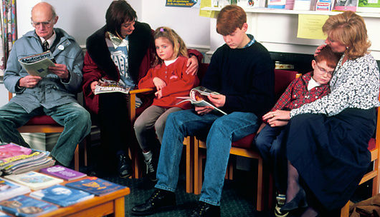
Doctor- Patient interactions
Heard at the doctor's waiting room:-
A : I Wonder when the doctor will arrive? I have a splitting headache. It's getting worse.
B : I have nausea and giddiness. Hope I don't throw up.
C : The room is getting congested.
D : And I came here for congestion in my chest because of phlegm.
E : Why hasn't the doctor come? We've been waiting for a long time.

Slide 3
F : My joints are painful. I wish I could stretch them.
G : I'm suffering from constipation. My tummy is distended and aching badly,
H : (a seventeen-year-old girl) I'm going to a birthday party day after tomorrow. I came to get rid of my pimples. When will the doctor arrive?
I : Don't lose your patience, my dear.
J : In fact, it is the doctor who is going to lose his patients, if he comes so late.

Slide 4
Vocabulary
Splitting : severe
Nausea : a vomiting sensation
Throw up : vomit
Giddiness : dizziness; a feeling of spinning around
Congested : crowded
Congestion : (here) a blockage because of infection
Phlegm : the mucous (thick liquid) produced in the nose,
lungs, etc., when one has a cold
Constipation : a condition when one has difficulty emptying the bowels
Distended : swollen and large
Pimples : small eruptions on the skin

Slide 5

Example Conversations :
Patient : Doctor, I'm not able to see clearly.
Doctor : I see.
Patient : My vision is blurred.
Doctor : I see.
Patient : When I read, the letters are hazy,
Doctor : I see.
Patient : Even when there is a bright light, it looks dim
Doctor : I see.
Patient : Sometimes, even from at a very short distance
I'm not able to see clearly what is in front of me.
Doctor : I see.
Patient : I know that you can see. But the fact is that I cannot see.
Doctor : I see. …....................

Slide 6
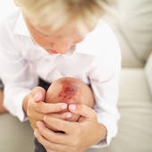
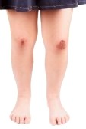
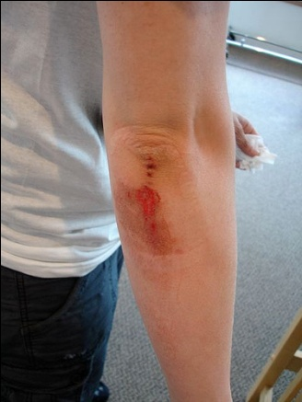
Patient : Doctor, I've hurt my toe, bruised my knee,
scraped the elbow, cut the chin,
Doctor : Wait, wait! Now, how did all this happen?
Patient : You see, I was in a hurry. I got off a moving bus,
at the signal.
Doctor : You should have been patient.
....................

Slide 7
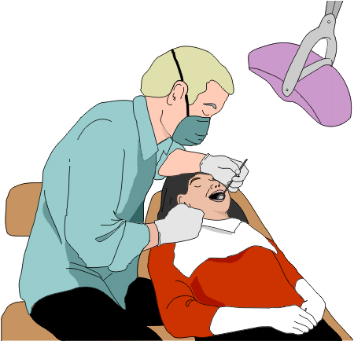
Patient : Doctor, I have a bad toothache.
Dentist : Open your mouth. Mmmm that's a cavity.
You'll need a filling. Do you eat a lot of sweets?
Patient : Yes, I do. When can I have the filling? Tomorrow?
Dentist : You can have it right now.
Patient : That's sweet of you.
....................
Vocabulary
Bruised : injured
Scraped : injured the skin by rough contact
Blurred / Hazy : unclear
Filling : material used to fill something (here) substance used to fill the holes in the teeth

Slide 8
Dr. Jones: Good morning. Come and sit down. What can I do for you?
Mr. Jack: Good morning. I don’t feel so well. I would like something to makes me better.
Dr. Jones: How do you feel?
Mr. Jack: I feel hot and tired. I don’t sleep well at night. My head aches.
Dr. Jones: When did all this start?
Mr. Jack: Three days ago. I thought I had a cold but it has got worse.
Dr. Jones: Do you have backache?
Mr. Jack: No. But my eyes are sore.
Dr. Jones: Are your eyes itchy?
Notes:
Font size changes as it is the common example of flu- changed as the conversation must look neat
Sore - painful or aching or suffering pain.
Itchy - an uncomfortable sensation or condition that causes a desire to scratch the skin.

Slide 9
Mr. Jack: Yes, they itch a lot. I also have a running nose and a cough.
Dr. Jones: Oh, dear, it sounds like the flu.
Mr. Jack: Is there anything you can give me?
Dr. Jones: No, I’m afraid not. Just drink plenty of fluids. Take aspirin when needed but not more than 8 in a day. Rest as much as you can.
Mr. Jack: I’ll do that. What can I do to sleep at night?
Dr. Jones: Take aspirin, your fever is high, so cool yourself with a lukewarm bath. If it doesn’t get any better, come back.
Mr. Jack: Thank you, doctor.

Slide 10
A conversation between a patient's attendant/relative and the doctor at the Hospital:
Arokya : Doctor, what is wrong with my mother?
Doctor : She has typhoid. I want you to monitor her temperature.
Arokya : How often should I check her temperature?
Doctor : Once every four hours.
Arokya : What diet should I give her?
Doctor : Only liquid diet.
Arokya : When should I bring her for the review?
Doctor : After three days.
....................
Vocabulary
Monitor : watch carefully for a period of time
Review : (here) check again

Slide 11
A conversation between an anxious patient and a doctor, before an operation:
Patient : Is the surgery a major one?
Doctor : Yes, it is.
Patient : How long will it take?
Doctor : 1 1/2 ? hours.
Patient : Will I be given a local or general anaesthetic ?
Doctor : General.
Patient : Will there be any after-effects?
Doctor : Except for weakness and a little nausea,
you'll be fine.
Patient : Will it be painful afterwards ?

Slide 12
Doctor : Yes. But don't worry, you' ll be given pain-killers.
Patient : What will be the cost of the surgery?
Doctor : Rs.75,000/- including post-operative care.
....................
Vocabulary
Local anaesthetic : a drug that causes loss of feeling in one part of the body
General anaesthetic : a drug that causes unconsciousness
after-effects : effects that follow the primary action of something
Post-operative : relating to the period after surgery

