Slide 1

OCCUPATIONS

Slide 2

DOCTOR

Slide 3

TEACHER

Slide 4

CHEF

Slide 5

LAWYER

Slide 6

ARCHITECT

Slide 7
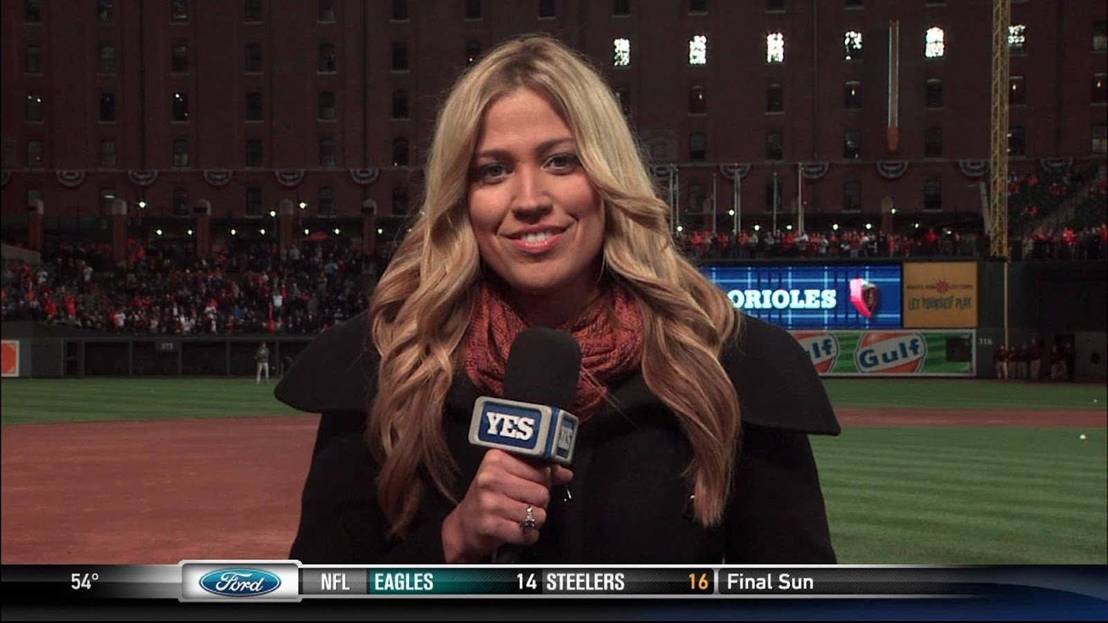
JOURNALIST

Slide 8

SOFTWARE ENGINEER

Slide 9

CIVIL ENGINEER

Slide 10

ELECTRICAL ENGINEER

Slide 11
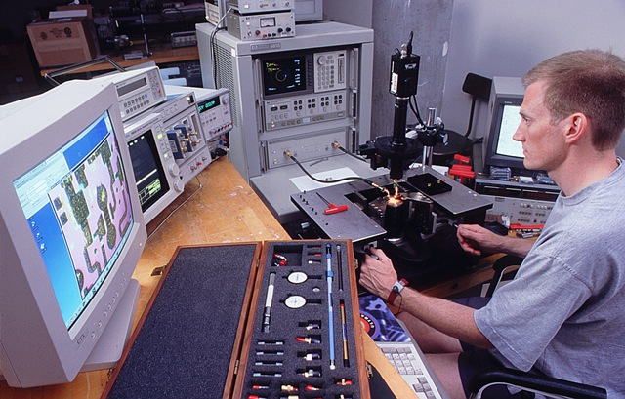
COMPUTER ENGINEER

Slide 12
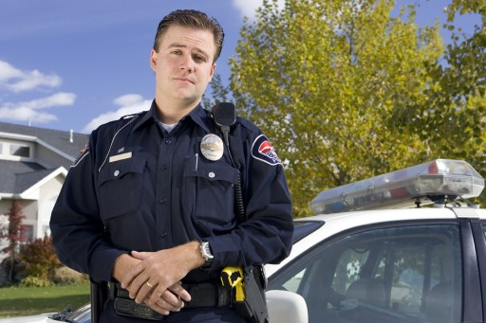
POLICEMAN

Slide 13
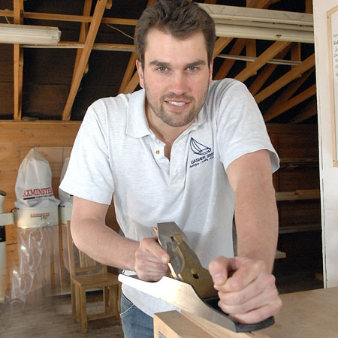
CARPENTER

Slide 14

ELECTRICIAN

Slide 15
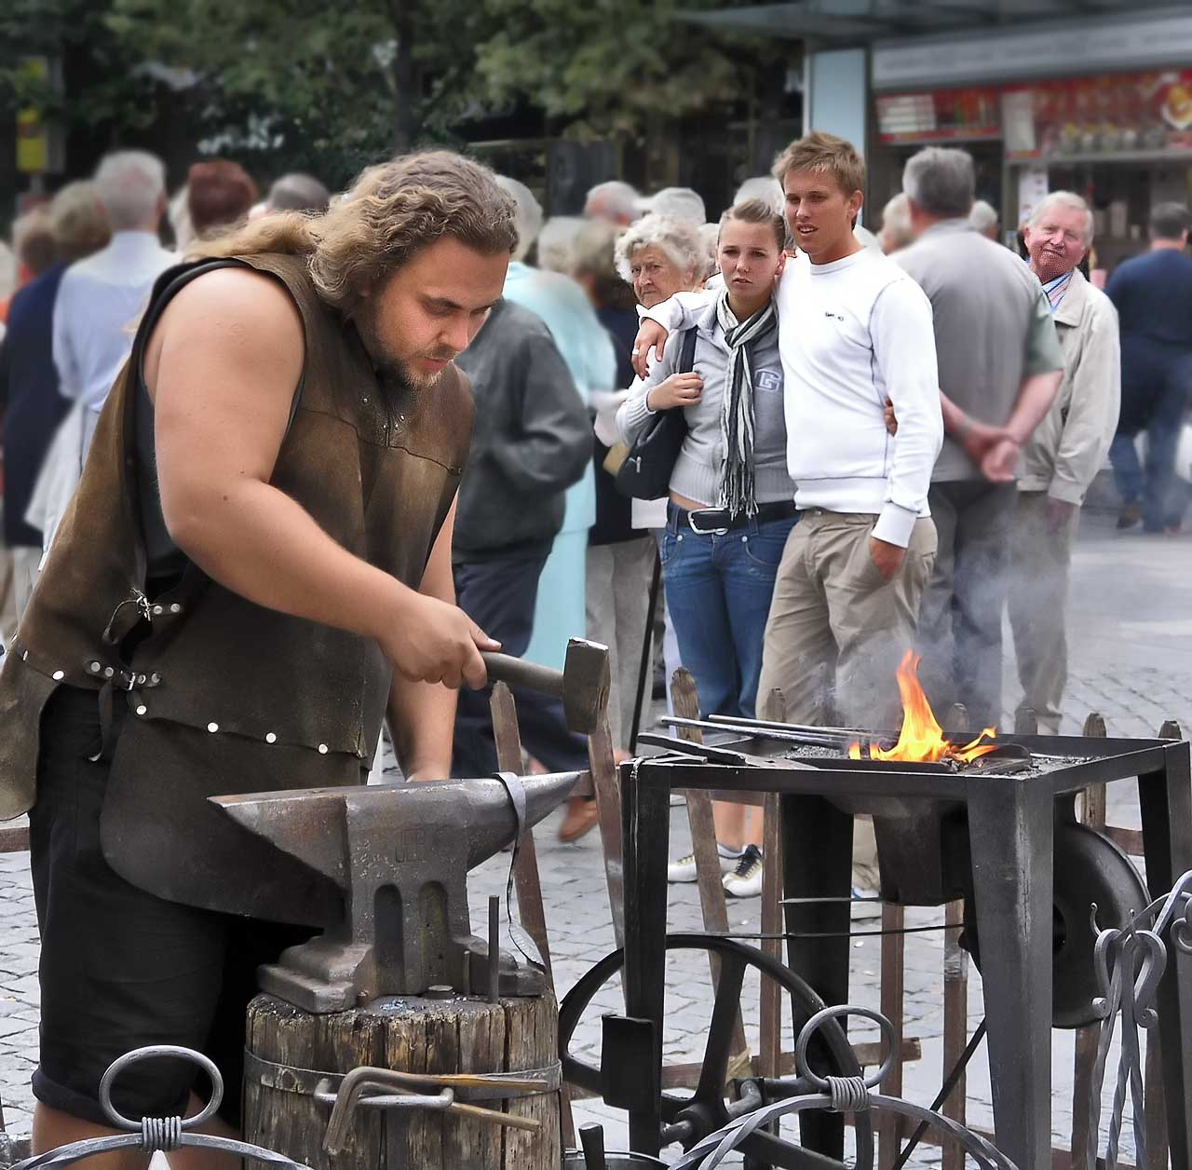
BLACKSMITH

Slide 16
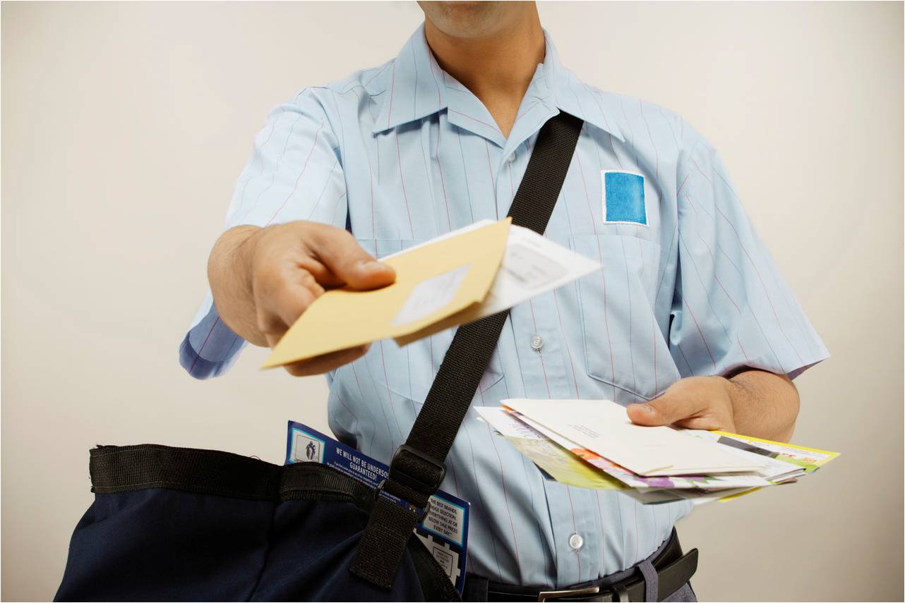
MAIL MAN

Slide 17

PLUMBER

Slide 18
Guessing game :
1) I give you medicine when you are ill. Who am I?
2) I give knowledge to you. Who am I?
3) I deliver mails to your address. Who am I?
4) I make delicacies for you. Who am I?
5) I catch robbers. Who am I?
Notes:
Doctor
Teacher
Mailman
Chef
Policeman

Slide 19

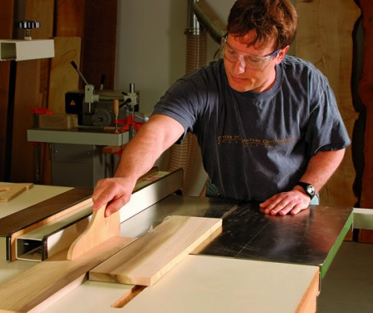


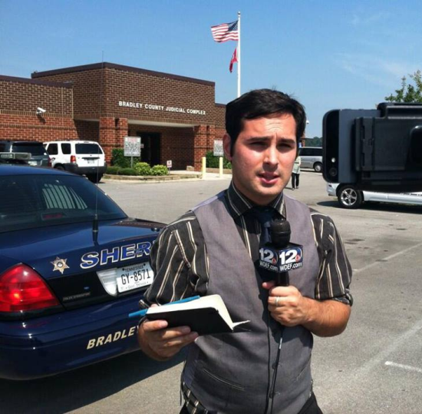
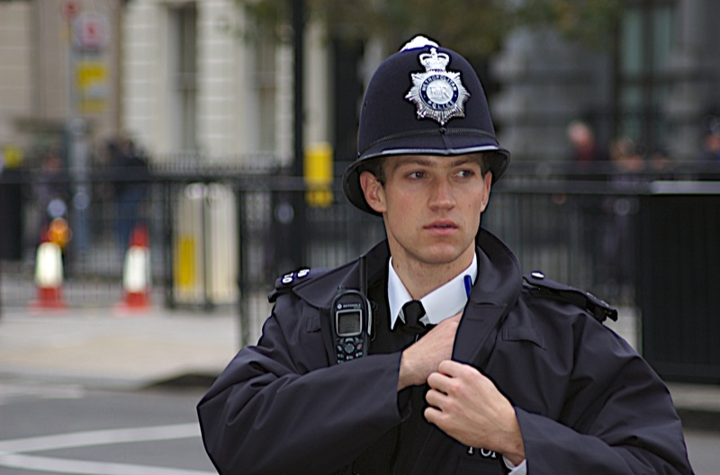
Name the pictures and write the spellings
1)
2)
3)
4)
5)
6)
Notes:
Electrician, Carpenter, Plumber, Architect, Journalist, Policeman
HOME – ASSIGNMENT
1)Give synonym : Police
2) Give antonym : Robber
3) Give meaning :
a) Plumber b) Carpenter c) Software Engineer d) Chef
4) Make a sentence using below word :
a) Lawyer b) Journalist c) Doctor

Slide 20
Reviewed By | Reviewed On | Comments / Changes Made
Anisha | 14.09.2015 | N.A.
Shilpa | 01.03.2016 | Changed the picture of Policeman & changed the exercise on slide 19 as the it was repetition of the previous exercise.

