Slide 1
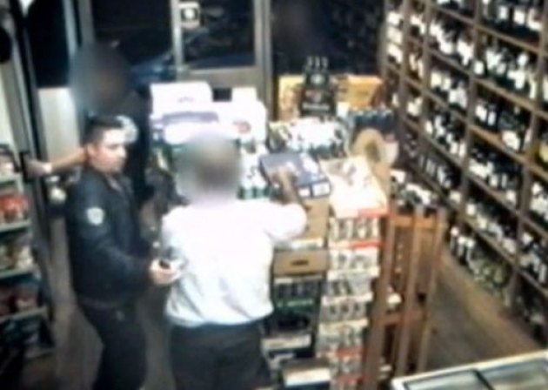
Shopkeeper 'placed in trance by hypnotist' during theft in north London
http://www.bfmtv.com/international/a-londres-un-commercant-cambriole-sous-hypnose-851348.html

Slide 2
News reading
A “hypnotist thief” apparently put the owner of an up market off-licence in a trance before rifling through his trouser pockets and stealing the day’s takings.
The raid mirrors techniques used as entertainment by street magicians and is the first time its use in crime has been captured on CCTV in the UK.
The suspect, an Eastern European man wearing a black bomber jacket, brushed past Mr Haider as he placed a bottle on a shelf, and gently tapped him on the arm.
A few seconds later, the suspect made a stabbing gesture with his right hand at eye-level which appeared to leave Mr Haider, known as Aziz, mesmerized.
He reached inside the motionless shop owner’s trouser pocket, and pulled out his wallet before briefly squeezing his shoulder.
The thief, who kept up a quietly-spoken patter throughout, then mimed the gesture of a pregnant woman’s belly as Mr Haider turned to face him.
He reached into his other pocket and pulled out the day’s takings, hundreds of pounds in a bundle of notes, before tapping him once more on the shoulder and quickly walking out.
.

Slide 3
Comprehension
1) What is this news about??
2) Which techniques is used as entertainment by street magicians ?
3) What was the Eastern European man (the suspect) wearing??
4) What did the thief mimed as Mr. Haider turned to face him?
5) Before tapping him once more on the ________ and quickly walking out.
Notes:
1)About the thief who hypnotized the shopkeeper and robbed him
2) raid mirrors techniques
3) an Eastern European man wearing a black bomber jacket,
4) he mimed the gesture of a pregnant woman’s belly as Mr Haider turned to face him.
5) shoulder

Slide 4
Vocabulary
1) Rifling
2) Stealing
3) Mesmerized
4) Squeezing
5) Mimed
Notes:
Rifling:the arrangement of spiral grooves on the inside of a rifle barrel.
2) stealing: take (another person's property) without permission or legal right and without intending to return it.
3) mesmerized : capture the complete attention of (someone); transfix.
4) Squeezing : firmly press (something soft or yielding), typically with one's fingers.
5) Mimed : use only gesture and movement to act out (a play or role).

Slide 5
Writing
1) What is your point of view about this topic?
2) Write 2 sentences on Hypnotize?
3) What measures should to be taken to stop such activities ?

Slide 6
Conversation
1) What do you think about this event?
2) How should people be aware of such robbers?
3) Do you know of any such event taking place in your area?
4) What do you think, such robbers hypnotize people for fun or to grab money?

Slide 7
