Slide 1
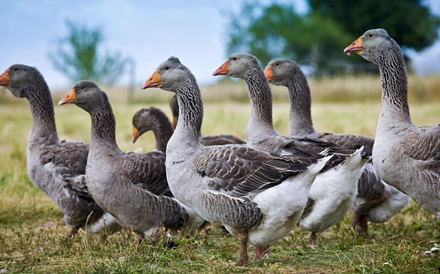
French court clears foie gras producer of cruelty
http://www.france24.com/en/20150319-french-court-clears-foie-gras-producer-cruelty/

Slide 2
A French court on Thursday cleared a foie gras producer who had been accused by animal rights activists of "cruelty" for the conditions in which it force-fed its birds.
News:Reading
The case targeted one of France's best-known producers, Ernest Soulard, a company based in the western Vendée province which supplies top restaurants, including Le Fouquet's and George V in Paris.
It was brought by animal rights group L214, which released a video in 2013 which claimed to show the conditions at farms under contract to Ernest Soulard, with ducks confined in individual cages, barely able to move.
The video prompted top chefs, including multi-Michelin-starred Joel Robuchon and Britain's Gordon Ramsay, to suspend their orders with the company.
Ernest Soulard insisted that the video was a fake, and said on Thursday that the claim had been fully vindicated by the court.

Slide 3
"It has been demonstrated that the images that caused such a stir on the Internet were falsified, so justice has been done," the director general of Ernest Soulard, Roland Tonarelli, told reporters
"We have turned the page with our clients, everyone is absolutely convinced that we are blameless."
L214 has denied manipulating the video, saying it received the images from someone with access to the force-feeding areas and "simply edited them together".
"It's a disappointing decision, but it's only one step in the long process of taking into account the suffering of animals and banning force-feeding," said the lawyer for L214, Hélène Thouy.
"One day, we will look back on the force-feeding of animals as a barbaric practice to be filed away in the museum of horrors," she added.

Slide 4
Force-feeding ducks to make foie gras – a practice known as "gavage" – has been banned in several countries but remains legal in France.
However, the European Union ruled in 2011 that birds cannot be kept in individual cages and gave farms until the end of 2015 to comply.
Tonarelli said his company sticks closely to the law: "Even if certain people do not agree with this method of production, it is still perfectly legal.
"The well-being of the animal is key to our trade, our raison d'être. An animal in good health makes a good product."

Slide 5
Comprehension
1) What does this topic describe?
2) What was the video about?
3) What was done to ducks to make foie gras?
4) A practice of force feeding ducks to make foie gras is known as __________.
Notes:
2) The video prompted top chefs, including multi-Michelin-starred Joel Robuchon and Britain's Gordon Ramsay, to suspend their orders with the company.
3)By force feeding ducks
4) gavage

Slide 6
Vocabulary
1)Confined
2) Vindicated
3) Falsified
4) Barbaric
5) Gavage
Notes:
1)Confined:(of a space) restricted in area or volume; cramped.
2) Vindicated :clear (someone) of blame or suspicion.
3) Falsified: alter (information, a document, or evidence) so as to mislead.
4) Barbaric: savagely cruel.
5) Gavage:the administration of food or drugs by force, especially to an animal, typically through a tube leading down the throat to the stomach.

Slide 7
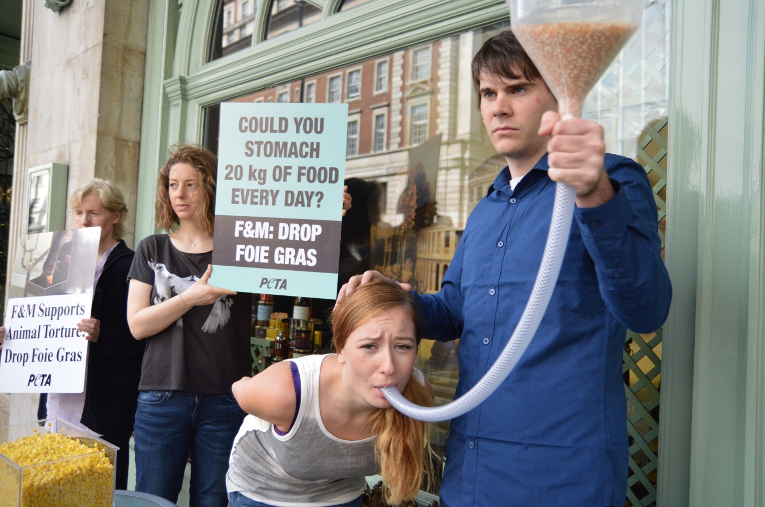
Writing
1) Write 3 lines about how you feel after knowing this?
2) What should be done to avoid this ?

Slide 8
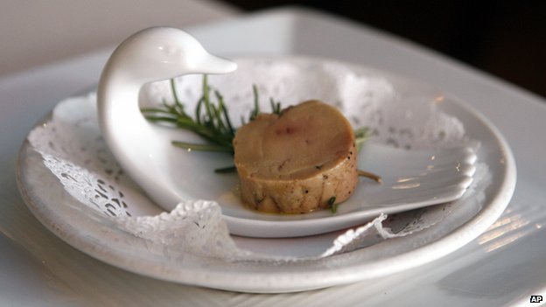
Conversation
1) How will you conclude this topic?
2) What actions should be taken in order to avoid this./
3) How often do you eat foie gras?

