Slide 1
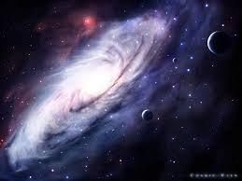
Cosmic

Slide 2
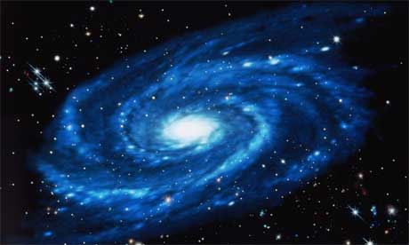
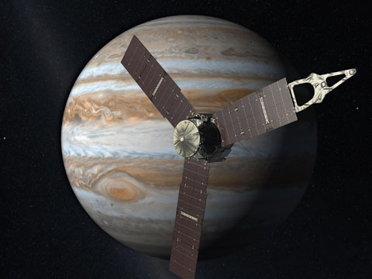
The Cosmic Vision is the paraphrasing name given to the roadmap for scientific space based missions of the European Space Agency (ESA) in the time frame between 2015 and 2025.
Experts are developing this rapidly-growing industry known as "geo-information".
We take a look at a business which analyses our world by using satellite images and
aerial shots.

Slide 3
VOCABULARY
Paraphrase | Express the meaning of (the writer or speaker or something written or spoken) using different words, esp. to achieve greater clarity.
Variability | The quality of being subject to variation.
Coronal | Relating to the crown or corona of something, in particular.
Disrupting | Drastically alter or destroy the structure of (something).
M3 | Third Medium Class Mission.
Exoplanet | A planet outside the Solar System.
Asteroid | A small rocky body orbiting the sun.
Consortia | An association, typically of business companies.
Oscillation | To swing or move to and fro, as a pendulum does.
Terrestrial | An inhabitant of the earth.
Habitable | Suitable to live in.
Constrain | Severely restrict the scope, extent, or activity of.

Slide 4
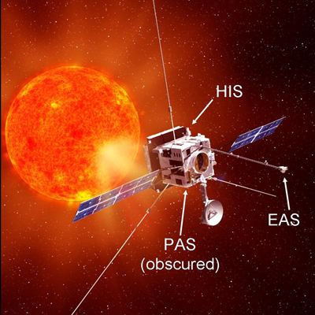
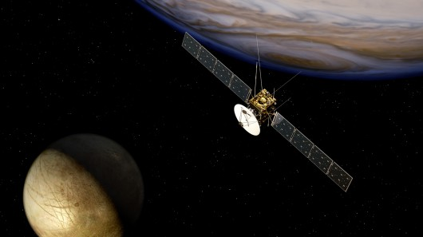
There are currently three selected missions of the programme,
Solar Orbiter, Euclid JUICE (Jupiter Icy Moon Explorer)
"Euclid will shed light on the nature of one of the most fundamental forces of the universe, while Solar Orbiter will help scientists to understand processes, such as coronal mass ejections, that affect Earth’s citizens by disrupting, for example, radio communication and power transmission,"
The instruments JUICE will be developed by scientific teams from 16 European countries, the US and Japan, through corresponding national funding.
Notes:
Solar Orbiter = The first mission, Solar Orbiter, is the most ambitious ever undertaken to study the Sun and has been scheduled for launch in 2017.
Euclid = Will provide Hubble Space Telescope-quality images across the whole sky in the search for dark matter, will launch in 2019.
JUICE, will carry a total of 11 scientific experiments to study the gas giant planet and its large ocean-bearing moons. JUICE is the first Large-class mission in ESA’s Cosmic Vision 2015–2025 programme. Planned for launch in 2022 and arrival at Jupiter in 2030, it will spend at least three years making detailed observations of the biggest planet in the Solar System and three of its largest moons, Ganymede, Callisto and Europa.
These moons are thought to harbour vast water oceans beneath their icy surfaces and JUICE will map their surfaces, sound their interiors and assess their potential for hosting life in their oceans.

Slide 5
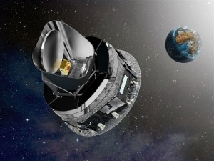
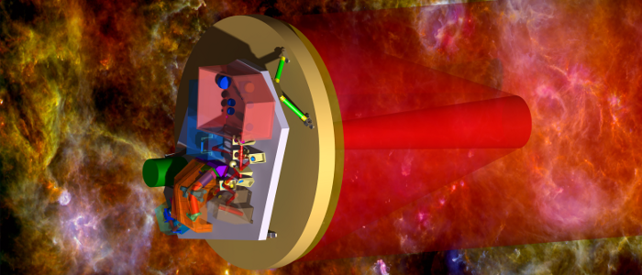
→ The Five M3 Candidate Missions are: EChO, LOFT, Marco Polo, Plato, STE-Quest
EChO (Exoplanet Characterisation Observatory), a proposed mission to study
exoplanet atmospheres.

Slide 6
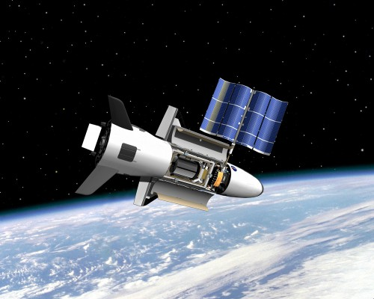
LOFT(Large Observatory For X-ray Timing), a proposed mission to study neutron stars and
black holes by detecting their very rapid X-ray variability.
It comprises of two instruments :
Large Area Detector (LAD), a 10 m² collimated X-ray detector
Wide Field Monitor (WFM), a coded-mask wide field X-ray monitor

Slide 7
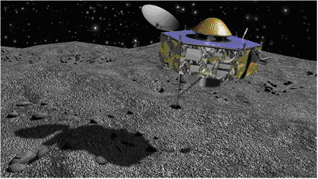
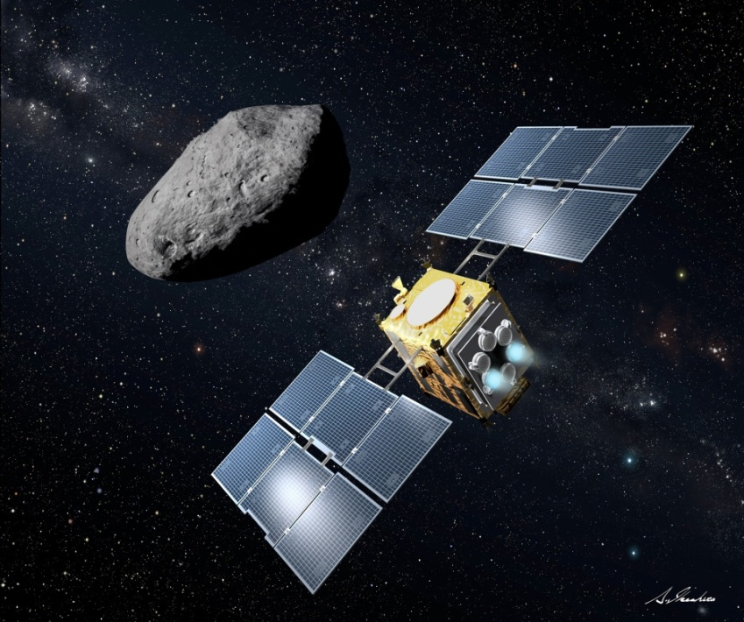
Marco Polo-R a proposed mission to return a sample from a near Earth asteroid (NEA).
It was proposed as a collaboration with the Japan Aerospace Exploration Agency (JAXA) and was named after one of the first western people to build good relations between Europe and Asia.
Marco Polo was subject to assessment studies by ESA and by three independent industrial consortia (Astrium (UK), OHB (Germany) and Thales (Italy)). Marco Polo was not selected to continue to the next phase.

Slide 8
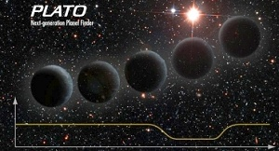
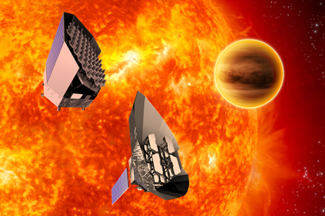
Plato, (PLAnetary Transits and Oscillations of stars) is a proposed mission to search for new exoplanets and measure stellar oscillations
The scientific goals of PLATO 2.0 are:
- reveal the interior of planets and stars
- detect planets over the whole sky, including terrestrial planets in
the habitable zone
- constrain planet formation and evolution
- provide accurate ages of planetary systems
- provide targets for atmosphere spectroscopy

Slide 9
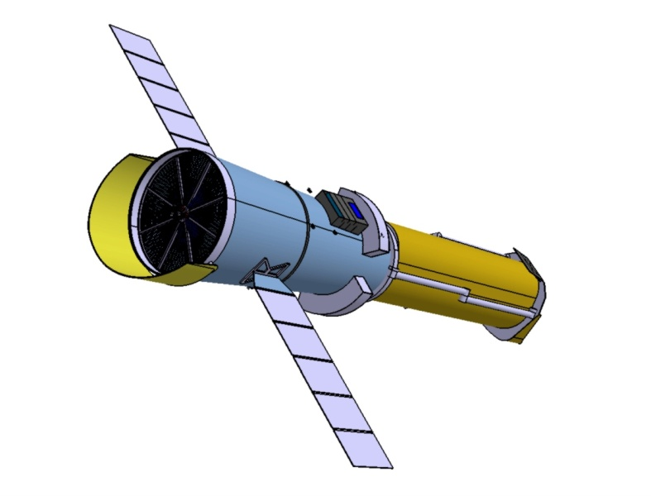
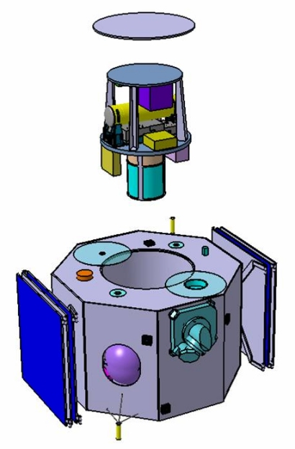
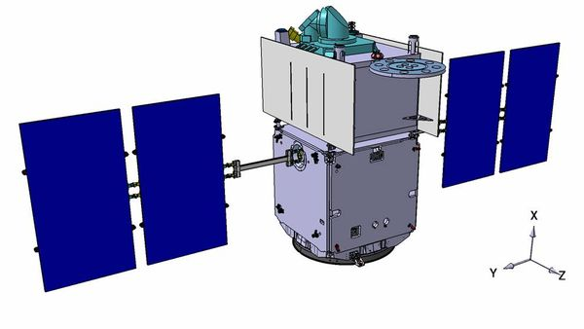
STE-QUEST(Space-Time Explorer and Quantum Equivalence Principle Space Test), a proposed mission devoted to precise measurements of general relativity effects.
It is a proposed satellite mission to test the Einstein Equivalence Principle to high precision and search for new fundamental constituents and interactions in the Universe.
It will contain an atom clock and an atom interferometer. It was selected for an initial assessment phase as one of the five candidates of the European Space Agency’s Cosmic Vision program.

Slide 10
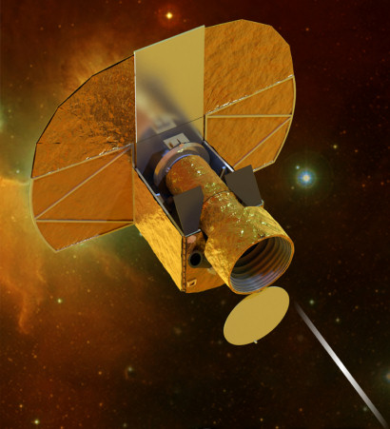
CHEOPS, a mission to search for exoplanets by photometry launch planned for 2017.
CHEOPS - CHaracterizing ExOPlanet Satellite - is the first mission dedicated to searching for exoplanetary transits by performing ultrahigh precision photometry on bright stars already known to host planets.
The main science objective of the CHEOPS mission will be to study the structure of exoplanets, with sizes typically ranging between one and six Earth radii, orbiting bright stars.

Slide 11
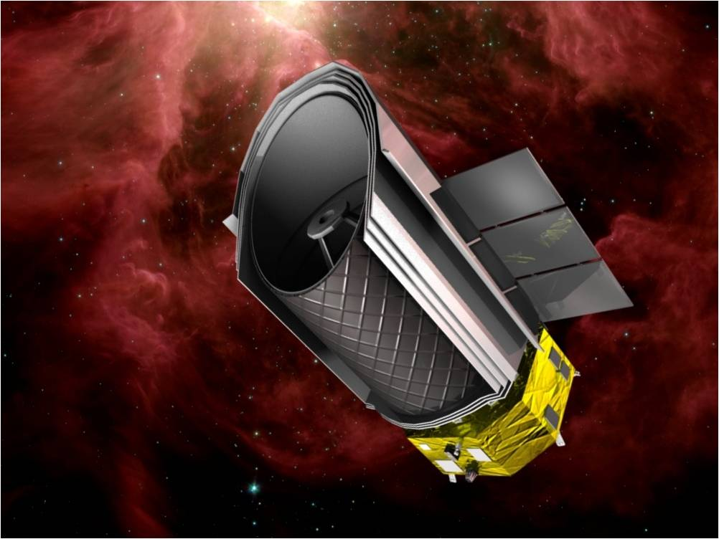
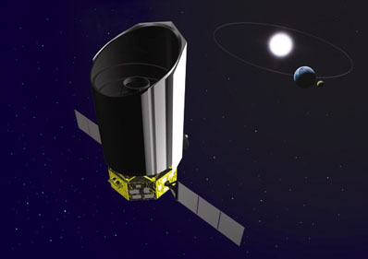
The Space Infrared Telescope for Cosmology and Astronomy (SPICA), is a Japanese-led next generation infrared astronomy mission aimed at revealing the origins of planets and galaxies.
Spica, a proposed contribution to a Japanese JAXA mission Within the framework of its future science missions program Cosmic Vision 2015 - 2025 this mission is considered at the European Space Agency, ESA, as a mission of opportunity.
.

Slide 12
General knowledge
1) What are comets often called?
a) Dirty snowballs
b) Filthy dirt balls
c) Silly streakers
2) What is the nucleus of a comet primarily made of?
a) Rock
b) Hopes and dreams
c) Ice and dust
3) True or False: Chinese astronomers kept records of comet sightings for centuries. They even tracked Halley's Comet as far back as 240 BC.
a) True
b) False
Notes:
Dirty snow balls
2) Ice and dust
3) True
Exercise:
1) Give synonym: Cosmic
2) Give antonym: Expert
3) Give meanings of the following-
Accurate
Formation
Precision
Initial
4) Make a sentence with the words given below-
Disrupting
Oscillation
Terrestrial

Slide 13
Reviewed By | Reviewed On | Comments / Changes Made
Ruchika | 11/09/2015 | ok

